Slide 1
The Fundamental Group
Sam Kitchin

Slide 2
Definitions
A path is a continuous function over the interval [0,1] in a space X
A loop is a path that starts and ends at the same point, x₀, called the base point of the loop

Slide 3
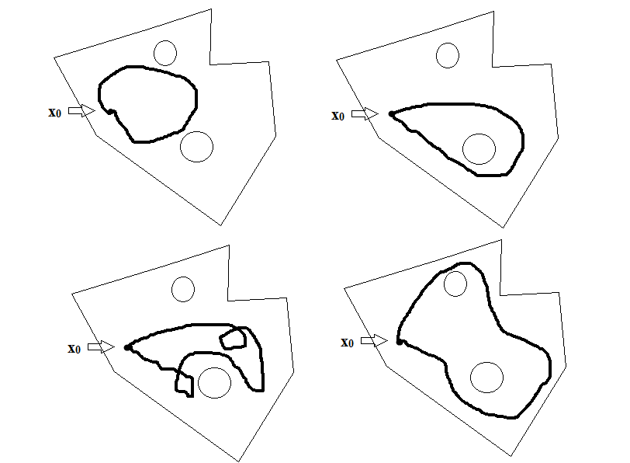
Examples of Loops

Slide 4
Homotopy
A homotopy from two loops α & β with the same base point is a continuous function, H, such that H_{t} has the same base point as α & β, and H₀ = α & H₁ = β
If a homotopy exists between two loops, the loops are homotopic
Given a loop α, the set of all loops homotopic to α is the homotopy class of α and is denoted <α>

Slide 5
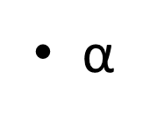
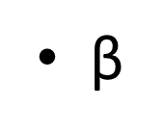
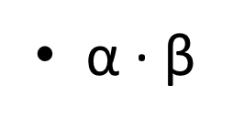
Concatenation
For two loops α & β with the same base point: α ∙ β is the concatenation of α & β.

Slide 6
Product of Homotopy Classes
Again let α & β be two loops in a space X with a common base point
<α><β> = <α ∙ β>
Well defined operation
Claim that the set of homotopy classes under this product operation forms a group

Slide 7
What is a Group?
A group, G, is a set of elements with the following properties:
G is closed under the group operation
G is associative - i.e. (a∙b)∙c = a∙(b∙c)
G contains an identity element
Every element has a unique inverse

Slide 8
Quick Example
The set {0,1,2,3} is a group under addition modulo 4
Closed under addition
Addition is associative
0 is the identity
Every element has a unique inverse
0⁻¹ = 0 , 1⁻¹ = 3 , 2⁻¹ = 2 , 3⁻¹ = 1

Slide 9
So is the Product of Homotopy classes on a Space a Group?
Closed under operation
Associative
(<α><β>)<γ> = <α>(<β><γ>)
Identity Element
The constant path
Inverses
Reverse a loop

Slide 10
The Fundamental Group
Let X be a topological space, and let x₀ be a base point on X.
Then the Fundamental Group of X is the set of homotopy classes of loops with base point x₀ under the product of homotopy classes.
π₁(X, x₀ )

Slide 11
Homomorphism & Isomorphism
A homomorphism, h, is a map from a group G to a group H such that for any two elements
a, b ϵ G:
h(a ∙ b) = h(a) ∙ h(b)
If h is also a bijection then it is called an isomorphism
Theorem: For a path connected space, the fundamental group does not depend on the choice of base point.

Slide 12
Theorems from Messer & Straffin
Suppose f : X → Y is a continuous function and x₀ is designated as the base point in X. Then f induces a homomorphism
f* : π₁(X , x₀) → π₁(Y , f(x₀))
defined by
f* (<α>) = (f ◦ α) for all <α> ϵ π₁(X , x₀)

Slide 13
Theorems from Messer & Straffin
Suppose X, Y, & Z are topological spaces. Let x₀ be designated as the base point for X
The identity function id_{x} : X → X induces the identity homomorphism id_{π1(X , x0)} : π₁(X , x₀) → π₁(X , x₀)
If f : X → Y and g : Y → Z are continuous functions, then (f◦g)* = f*◦g*

Slide 14
Theorem – The fundamental group of a space X is a topological invariant

Slide 15
The Sphere
What is the fundamental group of the sphere?
A space where all loops are homotopic to the constant path is called simply connected

Slide 16
The Circle
Let α be a loop on the unit circle S¹.
Let $\overline{\text{α}}$ be a continuous function from [0,1] to ℝ that measures the net angle α makes around the circle.
Note: Because α is a loop, it starts and ends at the same point on the circle. Thus the number of rotations α makes around the circle will be an integer.

