Slide 1
Exploring the Fourth Dimension
Maggie Bernard
May 8, 2012

Slide 2
History
Georg Friedrich Bernhard Riemann – introduction of the fourth dimension in geometry
Möbius - turn a three-dimensional object into its mirror image by an appropriate rotation through four-dimensional space
W.I Stringham – six regular polytopes
Hermann Minkowski – space/time continuum

Slide 3
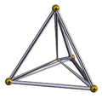
Definition of Polytope
“A finite region of n-dimensional space enclosed by a finite number of hyperplanes”
A body formed by multiple cells, or three-dimensional elements
A 4-polytope is often called a polychronon
5-cell
Notes:
Here talk about going from vertices, to edge, to faces, to cells… this will come up later in discussion of Euler characteristic

Slide 4
Hypersphere
Sphere lying in R4
The set of points (x1, x2, x3, x4) such that x12 + x22 + x32 + x42 = R2, where R is the radius of the hypersphere
Cross sections are spheres
Dimensional analysis: circle, sphere, hypersphere
Gluing together 3-balls
Glue together along boundary, which is a 2-sphere. We are not gluing together the interior.

Slide 5
Hypersphere: Stereographic Projection
Hypersphere maps to R3
Send the South Pole to the origin of R3
Points send us further and further from origin
The North Pole is sent to infinity

Slide 6
Visualization
Vectors:
The four standard basic vectors that can be used to reach any point in R4 are as follows:
1
0
0
0
0
1
0
0
0
0
1
0
0
0
0
1

Slide 7
Visualization
2. Adding time the three-dimensional universe
Example 1: Building a sphere using 2-D circles and time
Example 2: Building a hypersphere using 3-D spheres and time
Notes:
Think of building shapes over time, kinda like a slide show

Slide 8
Dimensional Analysis
Shadows: A four dimensional body casts a three dimensional shadow
Bounding curves: A four dimensional body is body by three dimensional surfaces

Slide 9
Euler Characteristic
Can also use dimensional analysis to determine the Euler characteristic equation for four dimensional bodies:
A two dimensional object has a Euler characteristic of V-E=0
A three dimensional surface has a X=V-E+F=2
A four dimensional body has a X=V-E+F-C=0, where c = number of cells

Slide 10
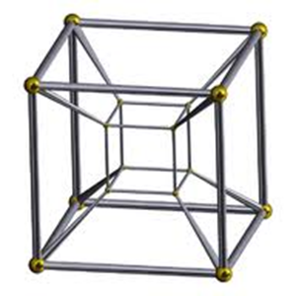
Example 1: Tesseract
Vertices: 16
Edges: 32
Faces: 24
Cells: 8
X=V-F+F-C
=16-32+24-8=0

Slide 11
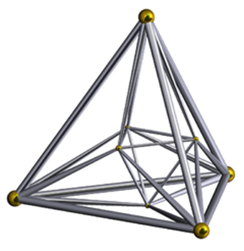
Example 2: 16-cell
Vertices: 8
Edges: 24
Faces: 32
Cells: 16
X=V-F+F-C
=8-24+32-16=0

Slide 12
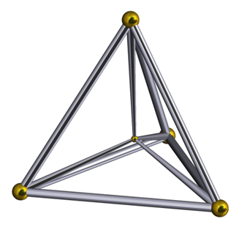
Example 3: 5-cell
Vertices:
Edges:
Faces:
Cells:
X=V-F+F-C

