Slide 1
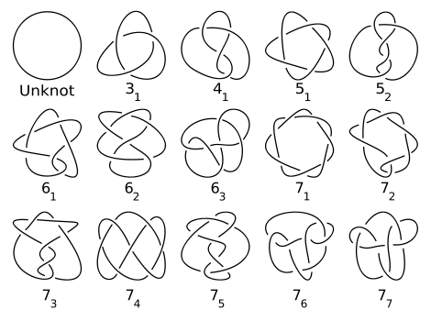
What do these knots have in common?
Hint: Numbers can be categorized as this, also

Slide 2
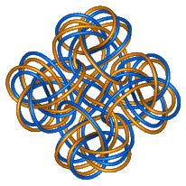
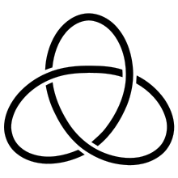
Factorization of Knots and the Uniqueness of this Process
By Lindsay Fox

Slide 3
Comparison to Factorization of Integers
Fundamental Theorem of Arithmetic
States that every positive integer greater than 1 is either prime or composite
Additionally, there is only one way to write the number, meaning that the factorization is unique (up to order)
300 = 2²· 3· 5²
Therefore, 300 is a composite number

Slide 4
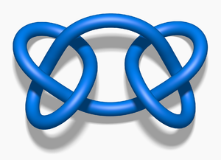
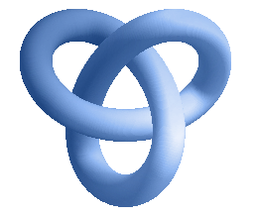
Schubert & Factoring Knots
1949, Schubert proves that decomposition of knots is unique up to order.
Prime Knot:
Cannot be decomposed further
It’s factors are itself and the unknot
Composite Knot
Can be decomposed into nontrivial knots, and this factorization is unique
Trivial Knot
The unknot is the trivial knot.
Not prime; not composite

Slide 5
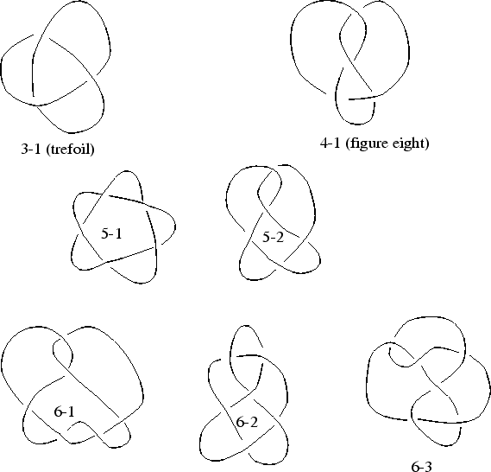
Examples of Prime Knots
Euclid proved that there are an infinite number of prime numbers
Likewise, there are an infinite number of prime knots.
Here are a few

Slide 6
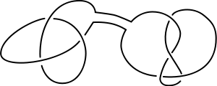
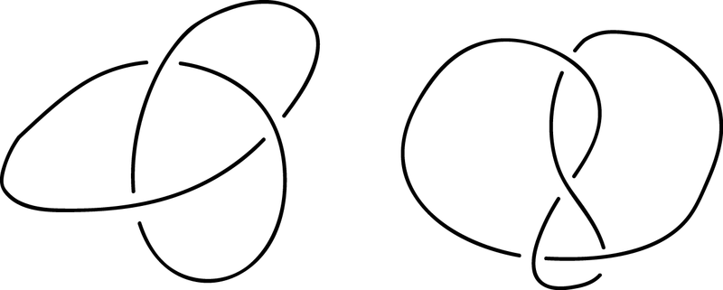
How to factor knots?
Factoring is the opposite of a connect sum
Dissecting sphere system
This incorporates a sphere, S, which intersects the knot, K, at precisely 2 points transversely
S divides K into two components, one ball on the interior of the sphere, one on the exterior

Slide 7
Dissecting Sphere System
Picture taken from Sullivan’s “Knot Factoring”
Intersection of S and K must be transverse
S → 2S balls that are 3-D balls (one on interior; one on exterior of S)
Each dss generates S+1 prime factors
If S>1, more than one ball will determine the same factor

Slide 8
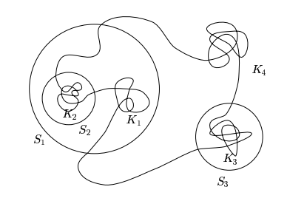
Dissecting Sphere System cont…
Picture taken from Sullivan’s “Knot Factoring”
Each S determines a factor for its region, int(s_{i})
Region inside of sphere, but outside of other spheres
Ex: S₂

Slide 9
Uniqueness of Factorization
Uniqueness: One way to factor knots (disregarding order)
We can relate this to the proof of uniqueness for integers (below looks like Euclid’s Theorem):
K is a prime knot, then K|L+M implies that K|L or that K|M

Slide 10
Uniqueness of Factorization
K can be decomposed in different ways, let’s say by getting the two sequences of factors:
K₁, K₂….K_{m} and K₁’,K₂’…K’_{n}.
If we number the two sequences in the same way, then as they go on, m=n, and so
K₁ ≈ K₁’, K₂ ≈ K₂’…K_{m}≈K_{m}’

Slide 11
Switching Move
Idea: Remove a sphere and draw another sphere that is disjoint from the other spheres
Result: This “switching” of spheres will still result in the same factorization, and thus factorization is unique
Things to think about:
Two knots cannot be encompassed in a larger sphere S, if there is no smaller sphere inside of S that separates the two knots
Lemma: Suppose S₂ is the sphere to be deleted; S’₂ is the sphere to be added
Once S’₂ is drawn, if S₂ was the outermost sphere within S’₂, then if S’₂ and S determine the same knot, then S’₂ ~ S

Slide 12
Implications of Schubert’s Discovery
Knot theorists can study the primes that compose more complex knots, which simplifies the process drastically
Invariants of primes v. invariants of large knots
Can tell what primes make up more complex knots
Just as Fundamental Theorem of Arithmetic was fundamental for number theory, so too is Schubert’s discovery of unique factorization of knots fundamental for knot theory

Slide 13
Sources
http://www.math.unl.edu/~mbrittenham2/ldt/celt7db.gif(second slide)
http://upload.wikimedia.org/wikipedia/commons/thumb/0/04/TrefoilKnot_01.svg/220px-TrefoilKnot_01.svg.png (2)
http://en.wikipedia.org/wiki/Prime_knot (first slide)
http://red-juridica.com/Web/socios.htm (trefoil)
http://upload.wikimedia.org/wikipedia/commons/thumb/6/6a/Blue_Square_Knot.png/300px-Blue_Square_Knot.png (composite)
http://upload.wikimedia.org/wikipedia/commons/thumb/3/37/Blue_Unknot.png/150px-Blue_Unknot.png
http://en.wikipedia.org/wiki/File:Sum_of_knots.png

