Slide 1
Knot Symmetry
By:Elliot Mee

Slide 2
What is a knot?
A knot in mathematics is a closed non-self-intersecting curve in three dimensions
Examples of knots:
Circle (unknot)
Trefoil

Slide 3
What is symmetry?
Imprecise sense of harmonious or aesthetically pleasing proportionality and balance
Precise and well-defined concept of balance or "patterned self-similarity" that can be demonstrated or proved according to the rules of a formal system

Slide 4
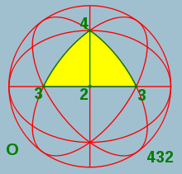
Types of Symmetry
Reversability
Periodicity
Amphichirality
Strong (+ or -)
Normal (+ or -)

Slide 5
How to detect symmetry
Looking at a knot
Rotating a knot 180 degrees
Changing crossings
Changing orientation

Slide 6
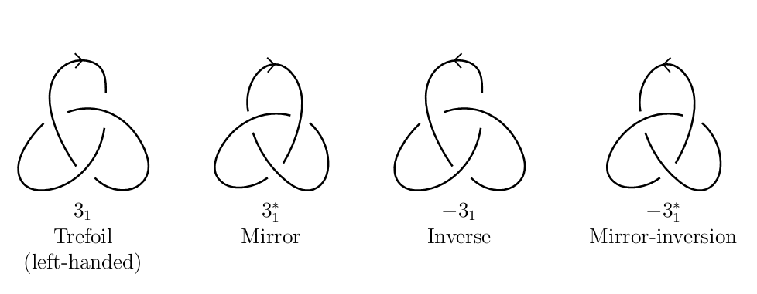

Slide 7
Reversability
An oriented knot K is called reversible if K is oriented equivalent to K^{r}.
Reverses orientation
Crossings remain the same
-K

Slide 8
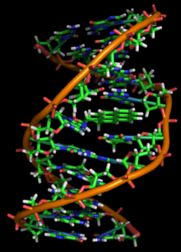
Modern Example
DNA
RNA

Slide 9
Positive Amphichirality
Called positive amphichiral if it is oriented equivalent to K^m
Change all crossings
Keep orientation
K*

Slide 10
Positive Amphicirality
Strong or normal
Strong only when symmetry is hidden within the knot
Normal in all other cases

Slide 11
Negative Amphichirality
Called negative amphichiral if it is oriented equivalent to K^(rm)
Change all crossings
Change orientation
-K*

Slide 12
Negative Amphichirality
Strong or normal
Strong only when symmetry is hidden within the knot
Normal in all other cases

Slide 13
Symmetries of connected sums
When finding symmetry of connected sums, use strong amphichirality
For positive, T(K)=K^m
For negative, T(K)=K^rm

Slide 14
Periodic Symmetry
For any integer q≥2, let R_{q} denote the linear transformation of R3 consisting of a rotation about the z-axis of 360/q
Knots K and Rq differ by a rotation of 360/q

Slide 15
Murasugi
Professor at University of Toronto
Testing a knot for possible periods
Based on Alexander polynomial
Murasugi Conditions

Slide 16
Murasugi Conditions
The Alexander polynomial of J, A_{j}(t), divides the Alex. Poly. of K
Ak(t)=±t^i(Aj(t))^q(1+t+t^2+…+t^(lambda-1)^(q-1)(mod p)

Slide 17
Questions? Confused? Me too….

