Slide 1
PHY 712 Electrodynamics
12-12:50 AM MWF Olin 103
Plan for Lecture 9:
Continue reading Chapter 4
Dipolar fields and dielectrics
Electric field due to a dipole
Electric polarization P
Electric displacement D and dielectric functions

Slide 2
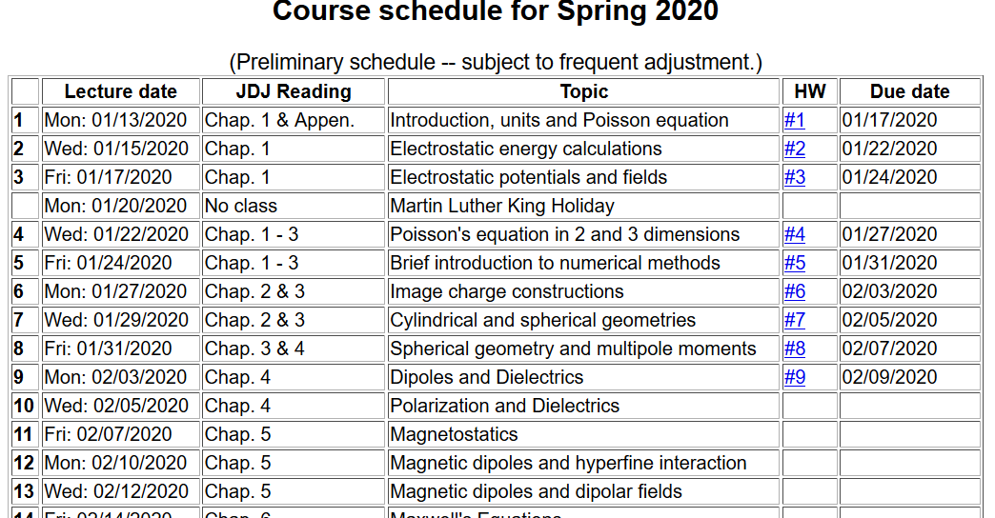

Slide 3
Review: General results for a multipole analysis of the electrostatic potential due to an isolated charge distribution:
q_{lm}

Slide 4
Notion of multipole moment:

Slide 5
General form of electrostatic potential in terms of multipole moments:

Slide 6
Focus on dipolar contributions:

Slide 7
“Justification” of surprizing δ-function term in dipole electric field -- Assuming dipole is located at r=0, we need to need to evaluate the electrostatic field near r=0:

Slide 8
Some details:

Slide 9
More details

Slide 10
More details continued --

Slide 11
In summary --

Slide 12
Summary of key argument:
z
r₂
r₁
y
x

Slide 13
Coarse grain representation of macroscopic distribution of dipoles:

Slide 14
Coarse grain representation of macroscopic distribution of dipoles -- continued:

Slide 15
Coarse grain representation of macroscopic distribution of dipoles -- continued:

Slide 16
Coarse grain representation of macroscopic distribution of dipoles -- continued:
Boundary value problems in dielectric materials

Slide 17
Boundary value problems in the presence of dielectrics – example:
ε₁
ε₂
E₁
E₂
D₁
D₂
For isotropic dielectrics:

Slide 18
Boundary value problems in the presence of dielectrics – example:
E₀
a
E
θ
z
ε
ε₀

Slide 19
Boundary value problems in the presence of dielectrics – example -- continued:

Slide 20
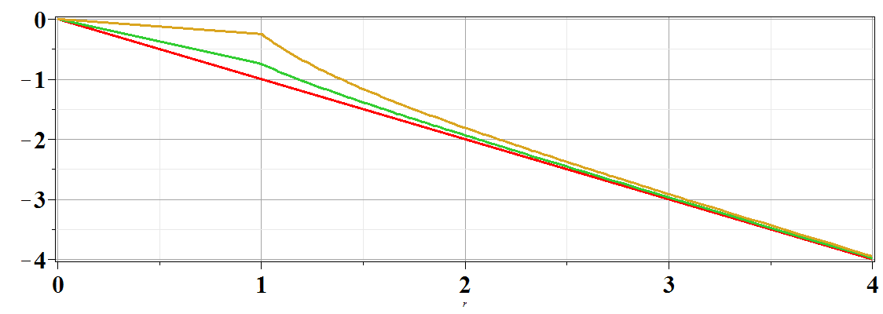
Boundary value problems in the presence of dielectrics – example -- continued:
Φ(r,θ=0)
ε/ε₀=
10
2
1
r/a

