Slide 1
PHY 712 Electrodynamics
12-12:50 AM MWF via video link:
https://wakeforest-university.zoom.us/my/natalie.holzwarth
Plan for Lecture 34:
    Special Topics in Electrodynamics:
    Some optical properties of materials
Notes:
In this lecture we will examine some optical properties of crystalline materials.

Slide 2
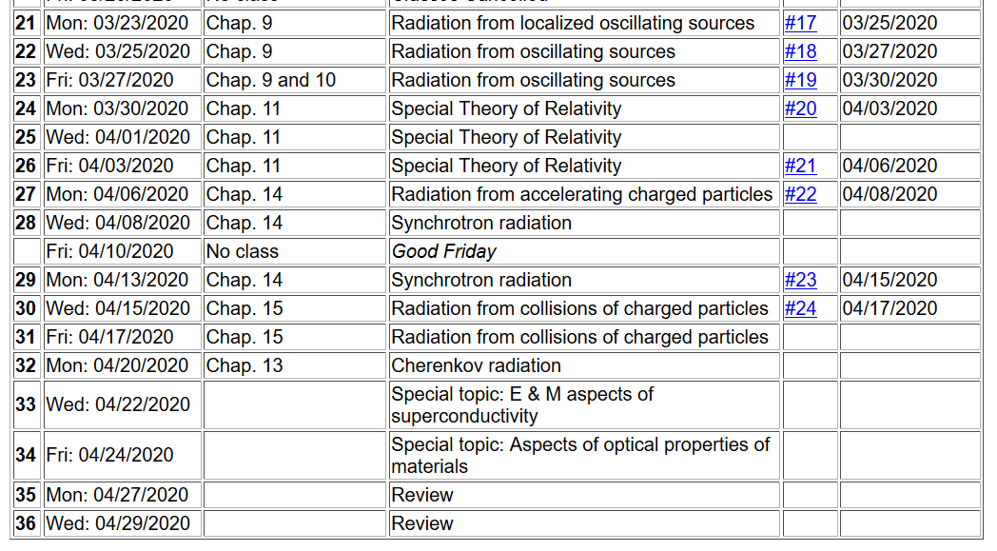
Notes:
Reminder about the schedule. Please send me topics for the review next week.

Slide 3
Aspects of optical properties of solids
Quantum effects cause discrete energy levels for electrons; EM radiation can couple the ground state of a material to its excited states
In solid materials with ~10²³ atoms, discrete states become bands of states
  Metals
  Insulators
Anisotropic effects
Note: We can analyze effectively single particle systems with high accuracy. Analysis of several/many particle systems can be accomplished with a series of approximations. We will also use a linear combination of atomic orbital approach to get the qualitative picture.
Notes:
Outline.

Slide 4
Electronic structure of an atom
For simplicity we will first consider a single electron system; a H-like ion with atomic charge Ze and one electron of charge –e:
According to Quantum Mechanics:
E₁₀₀=-13. 60569253 Z² eV
a₀ = 0. 52917721092 Å
Notes:
Starting with the ground state of an hydrogen-like atom.

Slide 5
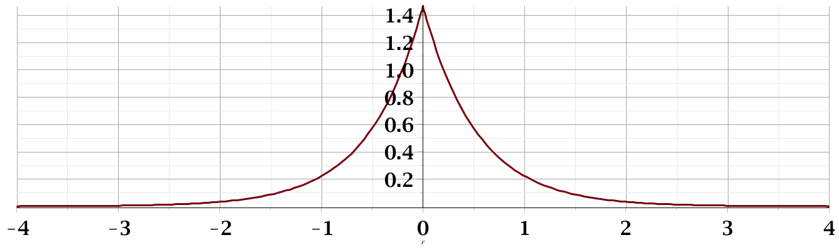
Probability amplitude for electron in the ground state:
Notes:
Ground state wavefunction.

Slide 6
Now consider one electron in the presence of two H-like ions:
Electronic structure of H-like molecular ion
(within Born-Oppenheimer approximation)
-e
r_{B}
r_{A}
R_{AB}
Z_{A}e
Z_{B}e
Notes:
Now consider what happens when you have two atoms. Find the approximate ground state using a linear combination of atomic orbitals.

Slide 7
Electronic structure of H-like molecular ion – continued
Ref. Pauling and Wilson, Introduction to Quantum Mechanics (1935) (now published by Dover)
Notes:
Finding two solutions for the linear coefficients corresponding to two approximate states.

Slide 8
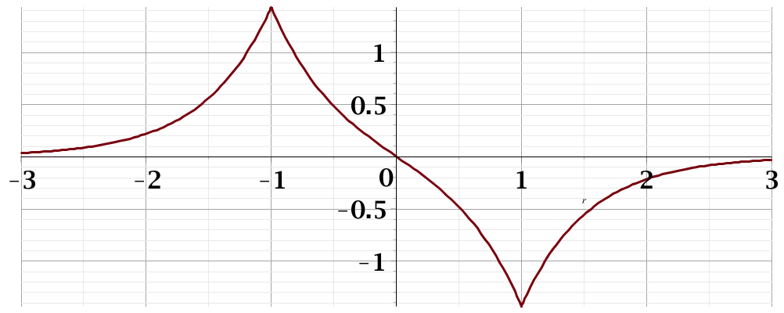
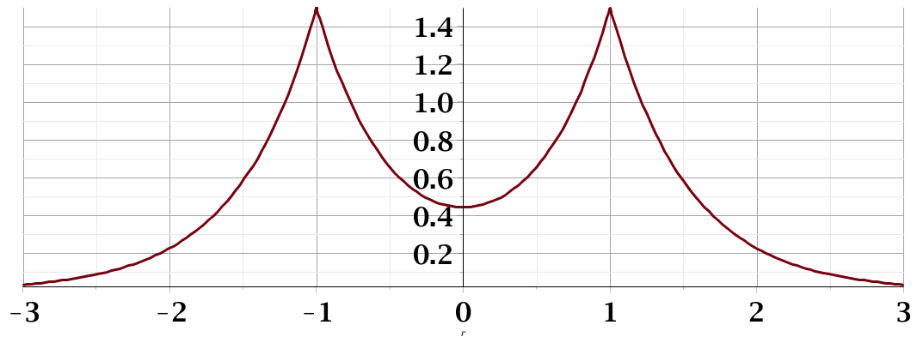
Electronic structure of H-like molecular ion – continued
E₋
Ψ₋
H_{AA}
H_{BB}
E₊
Ψ₊
Notes:
Energy levels and their corresponding eigenstates. Note that there are many more states for this system than these.

Slide 9
Formation of “energy bands” with a large number of atoms --
Extension of approximate “linear combination of atomic orbital” idea to larger systems
N=2
N=3
N=4
4β
…………….
Notes:
Now imagine extending this type of analysis to a chain of N atoms. There are more and more states asymptotically leading to a continuum. In this way, we can understand why the states of solid materials correspond to continua of states.

Slide 10
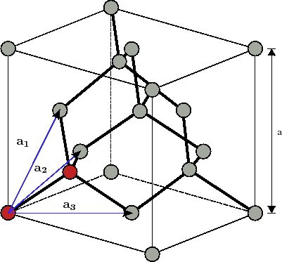
In practice, the “energy band” structure of materials is affected by competing effects of structure and composition
Example: Diamond lattice (2 C atoms per primitive unit cell)
Notes:
Consider first an ideal crystal of carbon in the diamond structure. There are two atoms per primitive unit cell and ? atoms in the cubic cell.

Slide 11
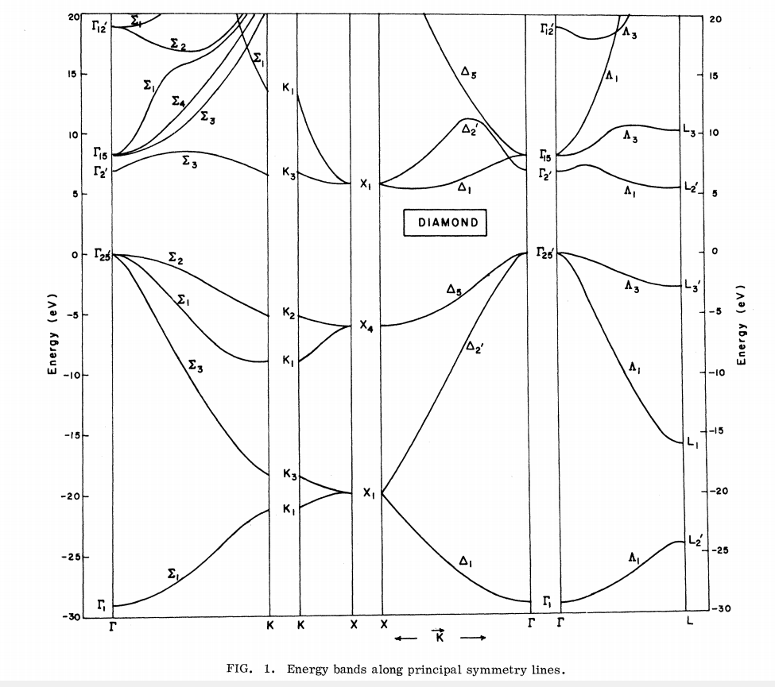
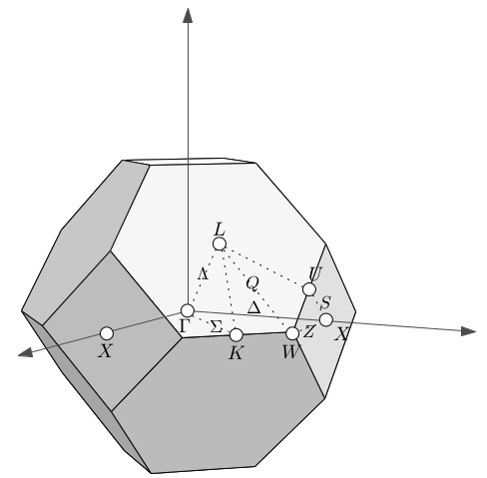
Ref. PRB 2, 2054 (1970)
E_{n}(k)
Note: Valence bands must accommodate 8 valence electrons from two C 1s²2s²2p² atoms per unit cell
Notes:
This is a plot of the band structure of diamond. The valence band spans ~ 30 eV. The conduction band is separated from the occupied states by ~5.1 eV.

Slide 12
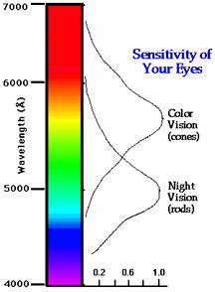
Visible light for humans
2 eV
3 eV
Notes:
Before asking what you might see when viewing a diamond crystal, here is reminder about the visible light and its energy equivalent.

Slide 13
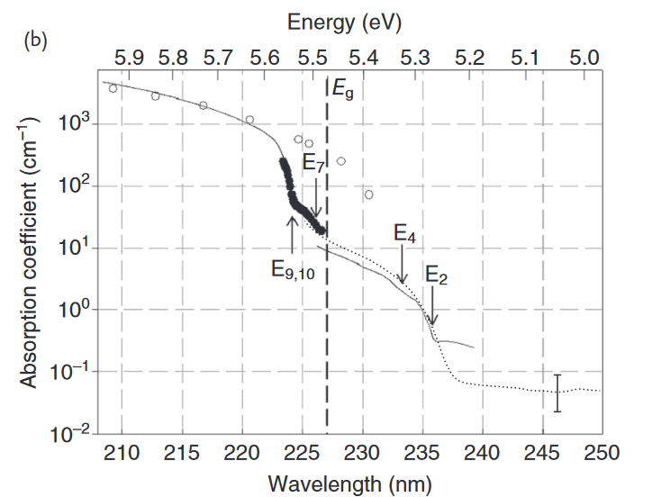
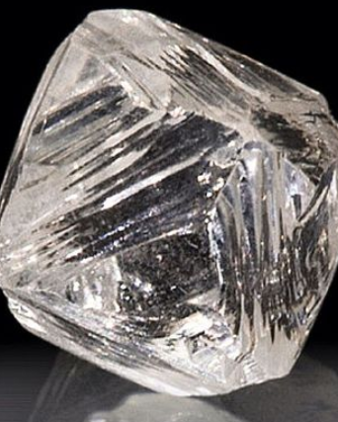
Absorption spectrum of diamond
Notes:
Here is an absorption spectrum for diamond. The image on the right is that of a natural diamond crystal.

Slide 14
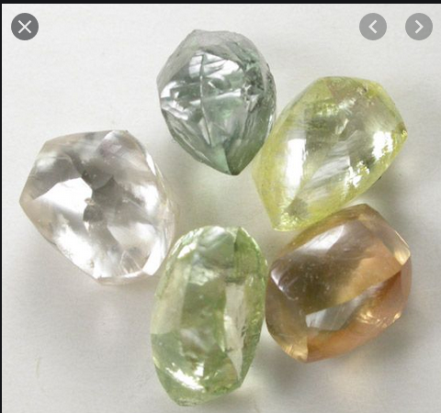
Images of natural diamonds
How is it possible for these diamonds to have absorption in the visible spectrum?
Notes:
Here is an image of diamond crystal that are not completely transparent. How can this happen?

Slide 15
E_{n}(k)
Possible impurity states in band gap
Notes:
From the viewpoint of the band structure, it is not possible to absorb sub band gap light. Impurity states do not fit into the band picture since they are not part of the periodic structure.

Slide 16
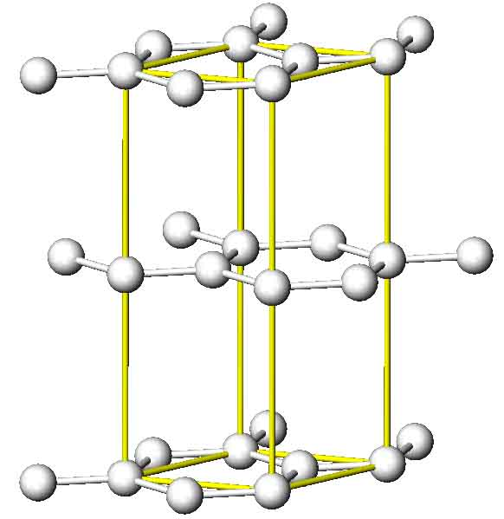
Another example --
Example: Graphite (4 C atoms per unit cell)
Notes:
Now consider another form of carbon in the graphite structure.

Slide 17
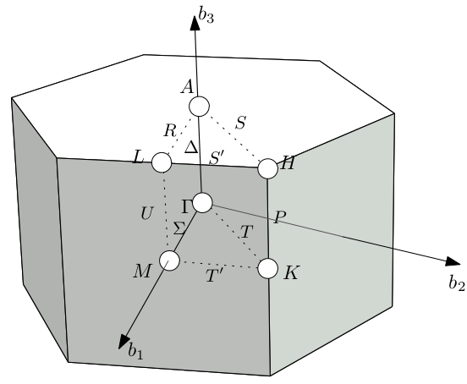
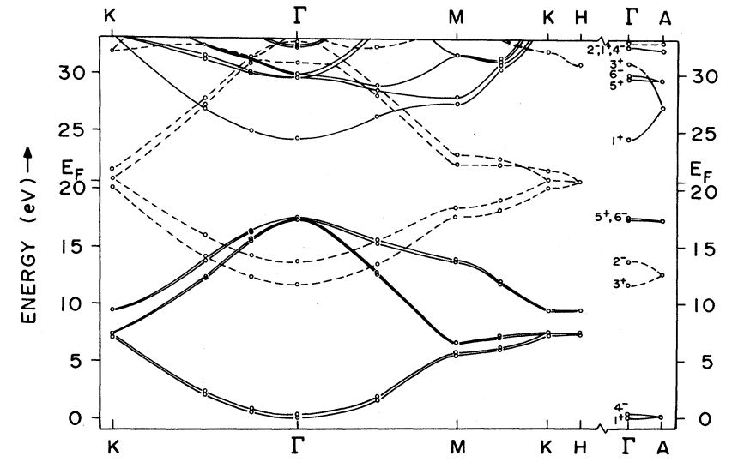
Note: Valence bands must accommodate 16 valence electrons from four C 1s²2s²2p² atoms per unit cell
Ref. PRB 26, 5382 (1982)
Band diagram for graphite
Notes:
This is a band diagram of the electronic states of graphite. What do you think that graphite would look like?

Slide 18
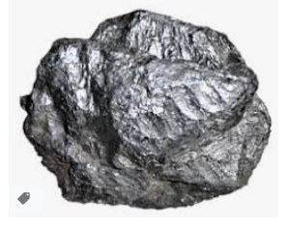
Image of natural graphite (semi metal)
Notes:
This looks similar to the sample in my office. Graphite is called a semi metal.

Slide 19
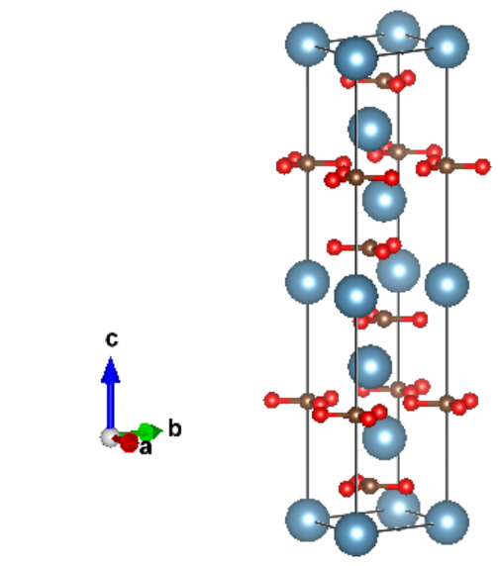
Another example --
Example: Calcite CaCO₃
Notes:
Now consider another example of a transparent but anisotropic material, calcite.

Slide 20
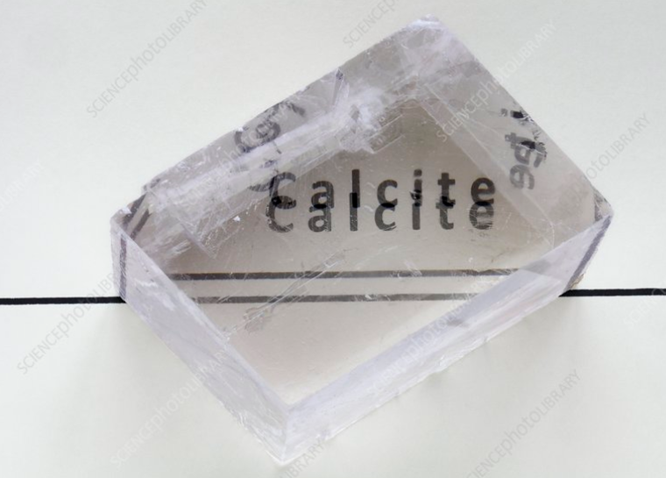
Notes:
Image of a calcite crystal

Slide 21

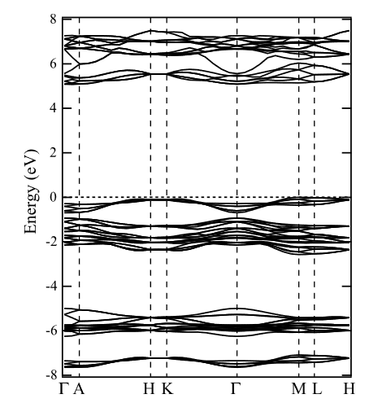
Notes:
Band structure of calcite

Slide 22
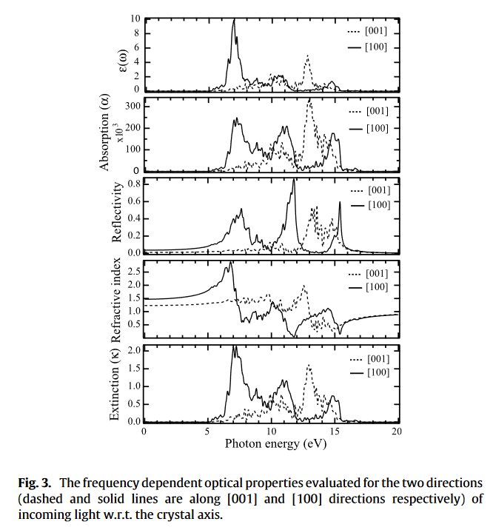
CaCO₃
Calculated optical properties
2 eV
n_{o}=1.7
n_{e}=1.5
3 eV
Notes:
Calculated optical properties.

Slide 23
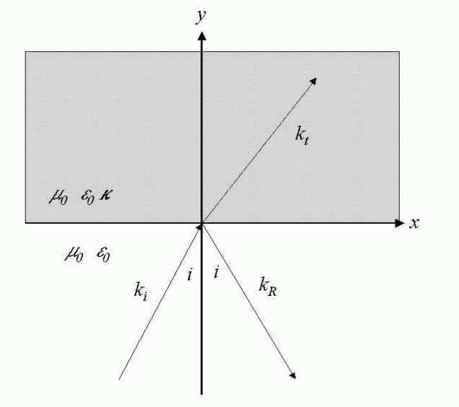
Reflectance and transmittance in an anisotropic crystal --
Notes:
Analysis of the reflectivity and transmittance of a birefringent crystal. This was covered briefly when we discussed the isotropic case in Chapter 7.

Slide 24
Consider the problem of determining the reflectance from an anisotropic medium with isotropic permeability μ₀ and anisotropic permittivity ε₀ κ where:
By assumption, the wave vector in the medium is
confined to the x-y plane and will be denoted by
The electric field inside the medium is given by:

Slide 25
Inside the anisotropic medium, Maxwell’s equations are:
After some algebra, the equation for E is:
From E, H can be determined from

Slide 26
The fields for the incident and reflected waves are the same as for the isotropic case.
Note that, consistent with Snell’s law:
Continuity conditions at the y=0 plane must be applied for the following fields:
There will be two different solutions, depending of the polarization of the incident field.

Slide 27
Solution for s-polarization

Slide 28
Some details for s-polarization

Slide 29
Notes:
Here we identify the s polarization with the “ordinary” wave.

Slide 30
Solution for p-polarization

Slide 31
Some details for p-polarization
Conventionally this is called the extraordinary wave since it does not necessarily satisfy Snell’s law.
Notes:
Here we identify the “extraordinary” wave with p polarization.

