Slide 1
PHY 712 Electrodynamics
12-12:50 AM MWF via video link:
https://wakeforest-university.zoom.us/my/natalie.holzwarth
Plan for Lecture 30:
Finish reading Chap. 14 and start Chap. 15 –
Radiation from scattering charged particles
Thompson and Compton scattering
Radiation from particle collisions
Notes:
In this lecture we will discuss radiation due to collions.

Slide 2
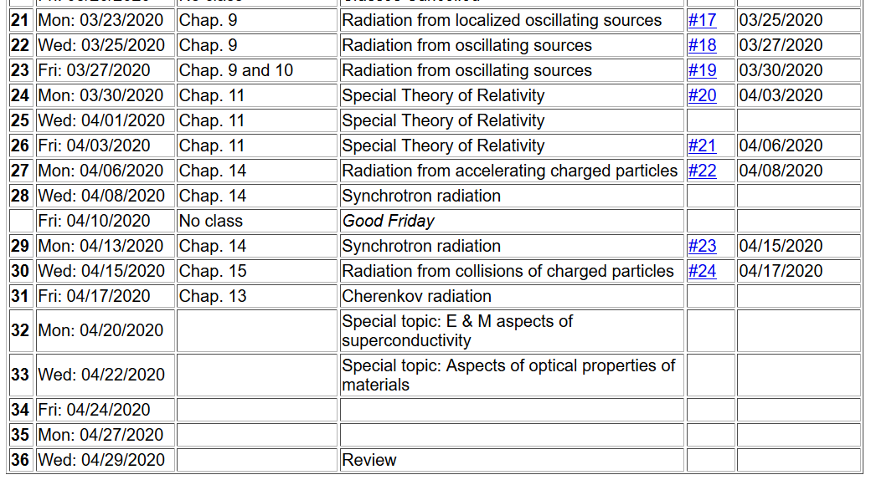
Notes:
Last homework set for the semester.

Slide 3
Thompson scattering --
Some details of scattering of electromagnetic waves incident on a particle of charge q and mass m_{q}
r
k₀
θ
ε₂
ε₀
φ
ε₁
Notes:
Consider the effects of a charged particle encountering an electromagnetic wave.

Slide 4
Thompson scattering – non relativistic approximation
Notes:
The power generated in the far field approximated by the non-relativistic limit, is given here. Now we consider that the particle acceleration is due to the oscillating electric field. The power of the radiation of the particle is then given here.

Slide 5
Thompson scattering – non relativistic approximation -- continued
z
r
k₀
θ
ε₂
y
ε₀
φ
x
ε₁
Notes:
By evaluating the radiation geometry, we can determine the power distribution.

Slide 6
Thompson scattering – non relativistic approximation -- continued
z
r
k₀
θ
ε₂
y
ε₀
φ
x
ε₁
Notes:
The radiated field is polarized perpendicularly to the propagation direction so that the power depends on the dot product of radiation polarization and the incident polarization.

Slide 7
Thompson scattering – non relativistic approximation -- continued
z
r
k₀
θ
ε₂
y
ε₀
φ
x
ε₁
Notes:
Evaluating the dot products for this geometry.

Slide 8
Thompson scattering – non relativistic approximation -- continued
Scattered light may be polarized parallel to incident field or polarized with an angle θ so that the time and polarization averaged cross section is given by:
This formula is appropriate in the X-ray scattering of electrons or soft γ-ray scattering of protons
Notes:
Summary of results in the non-relativistic limit.

Slide 9
Thompson scattering – relativistic and quantum modifications
p_{q}
incident photon
α
p
θ
p’
scattered
photon
04/08/2013
9
Notes:
When the photon energy is comparable to the rest mass energy of the charged particle, we have to consider momentum and energy conservation. This was ferst analyzed by Compton. Your homework asks you to examine the Compton scattering relationships.

Slide 10
Thompson scattering – relativistic and quantum modifications
p_{q}
incident photon
α
p
θ
p’
scattered
photon
Notes:
The effects of the Compton scattering change the cross section.

Slide 11
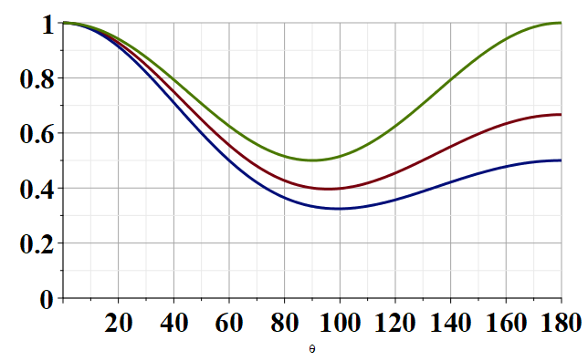
Modified Thompson scattering cross section
θ
Notes:
Plot of the changes to the Thompson cross section due to the Compton effect.

Slide 12
Radiation produced by collisions of charged particles
Generation of X-rays in a Coolidge tube
https://www.orau.org/ptp/collection/xraytubescoolidge/coolidgeinformation.htm
Notes:
Next time we will consider more generally the properties of radiation produced by charged particle collisions.

Slide 13
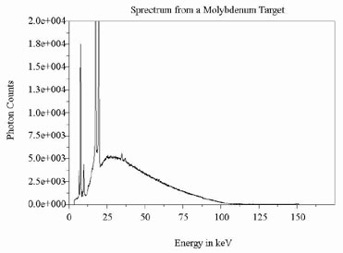
http://www.ndt-ed.org/EducationResources/CommunityCollege/Radiography/Physics/xrays.htm
Quantum effects – due to the release of core electrons
Notes:
Example of x-ray spectrum .

