Slide 1
PHY 712 Electrodynamics
12-12:50 AM MWF via video link:
https://wakeforest-university.zoom.us/my/natalie.holzwarth
Plan for Lecture 29:
Finish reading Chap. 14 –
Radiation from charged particles
Review of synchrotron radiation
Free electron laser
Notes:
In this lecture, we will summarize what we learned about synchrotron radiation and also discuss some other radiation results

Slide 2
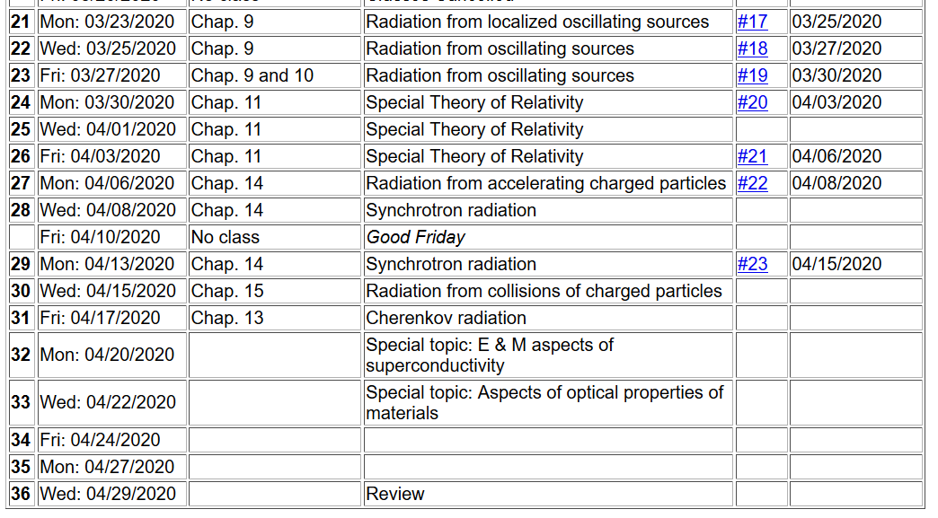
Notes:
One hopefully simple homework for this lecture.

Slide 3
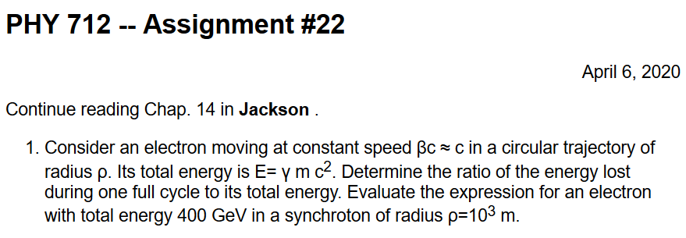
Comment on HW 22
What is β? What is γ? What is mc²?
Notes:
Some hints about “back of the envelope” calculation methods.

Slide 4
Advice about remaining topics to cover
Cherenkov radiation
Radiation from collisions of charged particles
Electrodynamics of superconductivity
Optical properties of materials
Notes:
Please vote on these or suggest other topics that you prefer to cover, time permitting.

Slide 5
Spectral composition of electromagnetic radiation -- continued
Notes:
Review of key points.

Slide 6
z
r
.
θ
β
y
β
Top view:
x
ρ
y
x
Notes:
Geometry of particle moving in a circular path.

Slide 7
z
r
.
θ
β
y
β
x
Notes:
Note that there are two perpendicular polarizations conveniently defined as shown.

Slide 8
z
r
.
θ
β
y
β
x
Notes:
The analytic expressions for the radiation amplitudes for the two polarizations are given here.

Slide 9
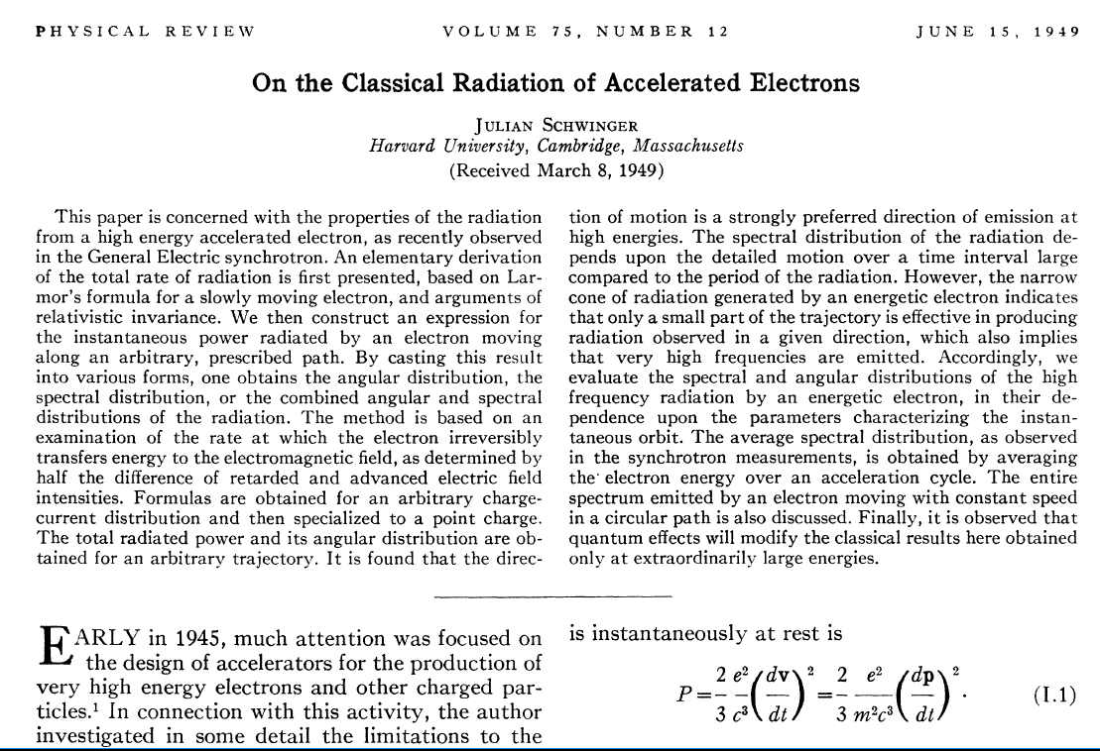
Notes:
These results were obtained by Julian Schwinger in 1949.

Slide 10
Evaluation of integrals representing distant charged particles moving in a circular trajectory such that the spectrum represents a superposition of light generated over many complete circles. In this case, there is an interference effect which results in the spectrum consisting
of discrete multiples of v/ρ.
Notes:
Schwinger directly evaluated the amplitude equations using some cleaver identities.

Slide 11
Useful identity involving Bessel functions
Notes:
Some of the identities repeated from last time.

Slide 12
Astronomical synchrotron radiation -- continued:
Notes:
More details.

Slide 13
Astronomical synchrotron radiation -- continued:
In both of the expressions, the sum over m includes both negative and positive values. However, only the positive values of ω and therefore positive values of m are of interest. Using the identity: the
result becomes:
These results were derived by Julian Schwinger (Phys. Rev. 75, 1912-1925 (1949)). The discrete case is similar to the result quoted in Problem 14.15 in Jackson's text.
Notes:
Comment on the relevance of the results.

Slide 14
Notes:
At the other extreme, for man made synchrotrons, the intensity pattern is concentrated tangentially to electron path as represented by the Bessel functions of the third kind. It is convenient to define the critical frequency omega_{c}.

Slide 15
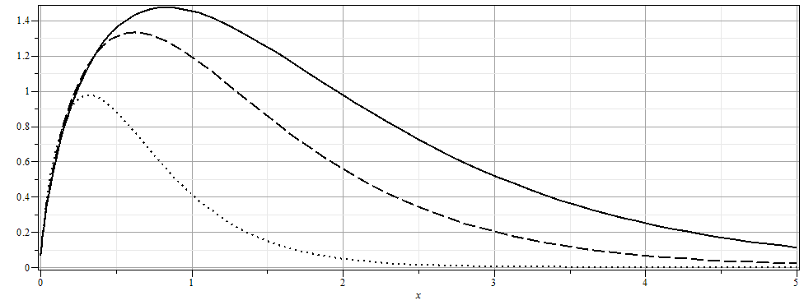
Notes:
In this case the spectral frequency is scaled by the critical frequency omega_{c}.

Slide 16
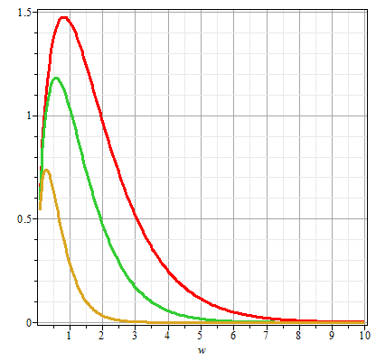
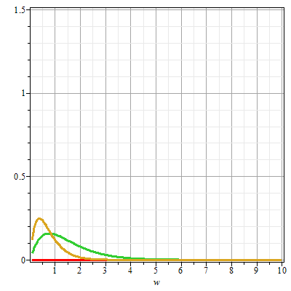
Plots of the intensity function for synchrotron radiation
γθ=0
γθ=0.5
γθ=1
γθ=1
γθ=0.5
ω/ω_{c}
ω/ω_{c}
Notes:
The intensity is highly peaked at angle 0 and is much more intense for the “parallel” polarization.

Slide 17
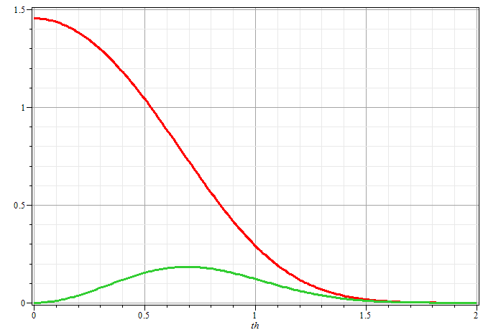
Plots of the intensity function for synchrotron radiation
ω/ω_{c}=1
γθ
Notes:
Plots of the intensity at the critical frequency as a function of angle

Slide 18
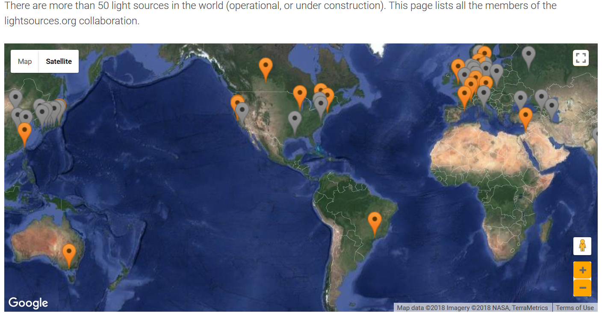
Synchrotron facilities worldwide
https://lightsources.org/
Notes:
If you are interested in man made light sources, this website, collects information from many installations throughout the world.

Slide 19
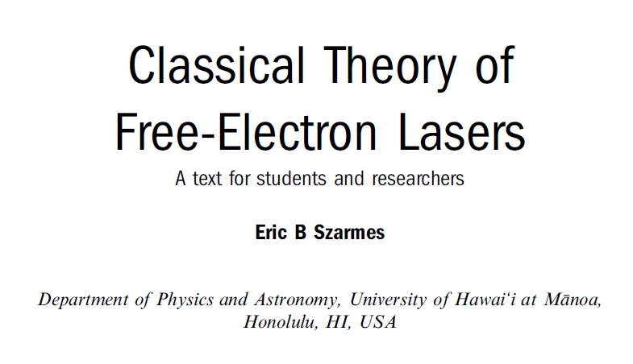
Free electron laser:
https://iopscience.iop.org/book/978-1-6270-5573-4
Notes:
Another technology that generates intense light, is the so-called Free Electron Laser. This reference is a good source for some of the design features and background physics.

Slide 20
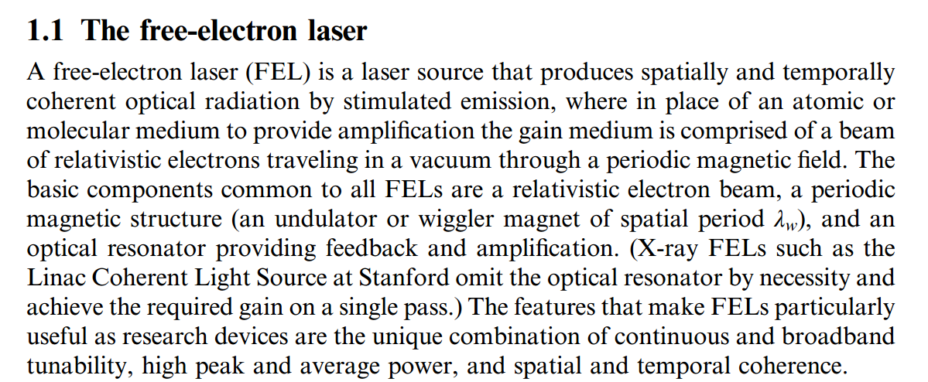
Notes:
The design features include accelerating charges, but also use wave guides.

Slide 21
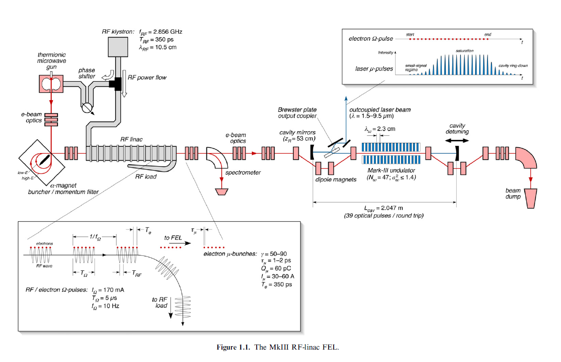
Notes:
Diagram from the text.

Slide 22
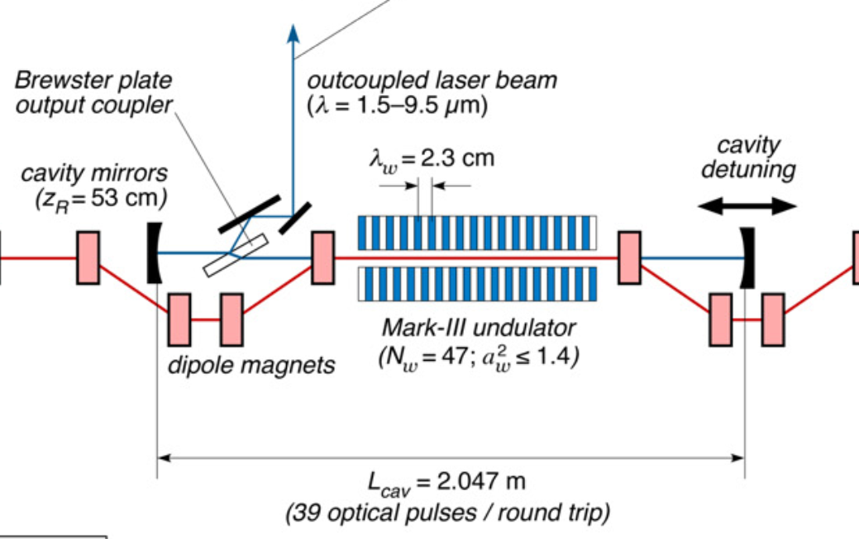
Notes:
Portion of the device where the light forms a standing wave between two mirrors and the electron is manipulated with periodic magnetics.

Slide 23
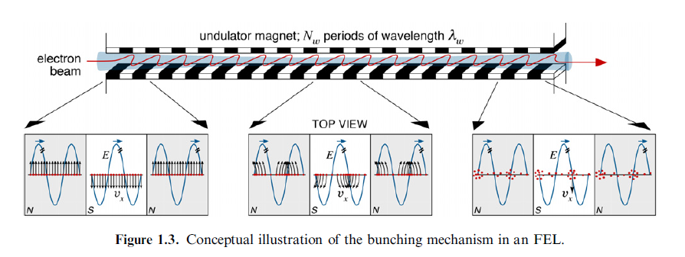
Electron emission in periodic magnet
Notes:
Lots of physical processes are engineered into this device.

Slide 24
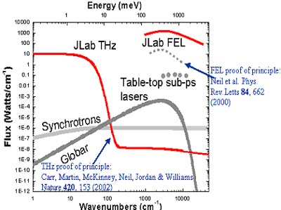
Spectral output for FEL at Jefferson Lab (in Virginia)
Notes:
Data from Free Electron Laser facility in Virginia showing the range of intensities of various light sources

Slide 25
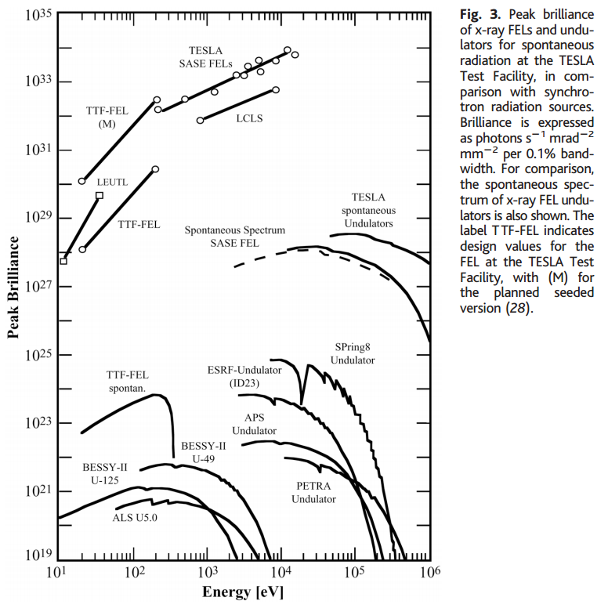
Notes:
Data from a review article on Free Electron Lasers

Slide 26
Back to fundamental processes – Thompson and Compton scattering
Some details of scattering of electromagnetic waves incident on a particle of charge q and mass m_{q}
r
k₀
θ
ε₂
ε₀
φ
ε₁
Notes:
For next time.

