Slide 1
PHY 712 Electrodynamics
12-12:50 AM MWF via video link:
https://wakeforest-university.zoom.us/my/natalie.holzwarth
Plan for Lecture 28:
Continue reading Chap. 14 – Synchrotron radiation
Radiation from electron synchrotron devices
Radiation from astronomical objects in circular orbits
Notes:
In this lecture, we will examine in detail, the angular and spectral properties of synchrotron radiation which is presented in Chapter 14 of Jackson.

Slide 2
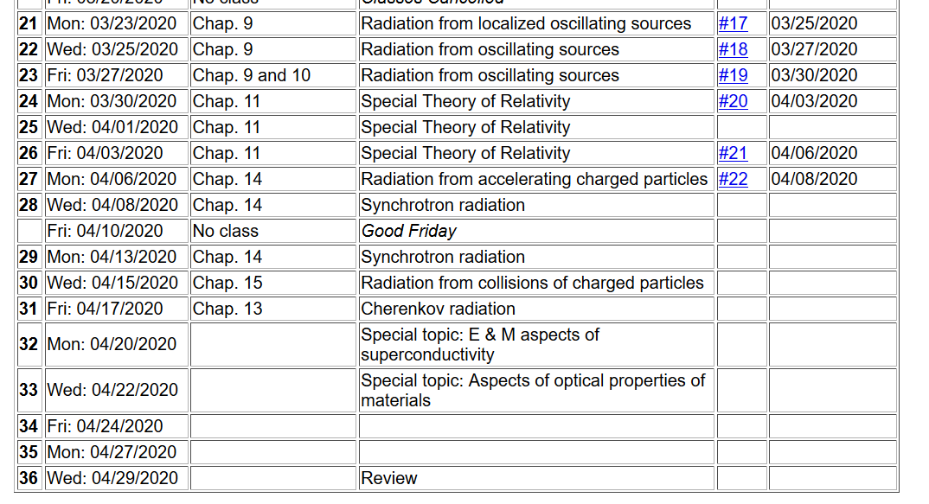
Outstanding homework and project topics due Mon. 4/13/2020.
Notes:
Please note due date.

Slide 3
Radiation from charged particle in circular path
z
r
.
Power distribution for circular acceleration
θ
β
y
β
x
Notes:
A convenient geometry to discuss synchrotron radiation of charged particle moving in the x-y plane.

Slide 4
Spectral composition of electromagnetic radiation
Starting with the power distribution from a charged particle:
Notes:
Equations for analyzing spectral decomposition of radiation.

Slide 5
Spectral composition of electromagnetic radiation -- continued
Notes:
Review of Parceval’s theorem and derivation of the spectral expression expressions that we will use.

Slide 6
Spectral composition of electromagnetic radiation -- continued
Notes:
Basic equations that need to be evaluated for each given particle trajectory.

Slide 7
Spectral composition of electromagnetic radiation -- continued
Notes:
Further evaluations.

Slide 8
Spectral composition of electromagnetic radiation -- continued
Notes:
Up to now, the equations have been exact. Now we consider some reasonable approximations that are appropriate for measuring the spectrum far from the source.

Slide 9
Spectral composition of electromagnetic radiation -- continued
Notes:
Some details of the approximate equations.

Slide 10
Spectral composition of electromagnetic radiation -- continued
Notes:
From the tope identity, the intensity expression can be further simplified.

Slide 11
Spectral composition of electromagnetic radiation -- continued
Notes:
Summary of equations that need to be avaluated.

Slide 12
Synchrotron radiation light source installations
Synchrotron at Brookhaven National Lab, NY
E_{c}= 3 GeV X-ray radiation
https://www.bnl.gov/ps/
Notes:
Before we start to evaluate the expressions, we will first consider some the large synchrotron radiation installations currently available today. (Actually some of these facilities have shutdown due to the pandemic unless they are being used for studying certain viruses. This is an arial photo of the facility on Long Island, NY.

Slide 13
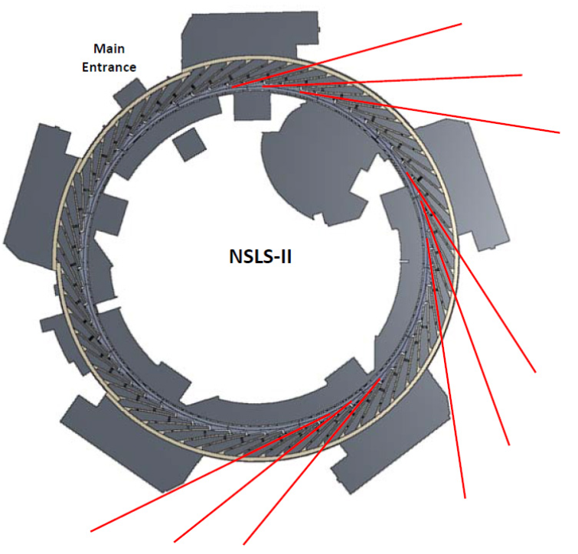
Spectrometer and sample
Notes:
Diagram showing the positioning of the experimental ports in red where the radiation from the circulating electrons is used.

Slide 14
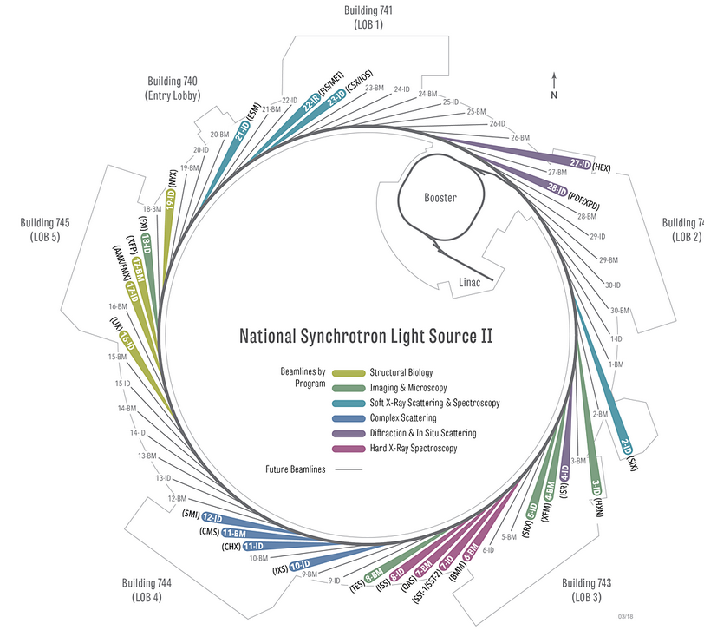
Overview of developed beamlines.
Notes:
More detail with indications of particular experiments.

Slide 15
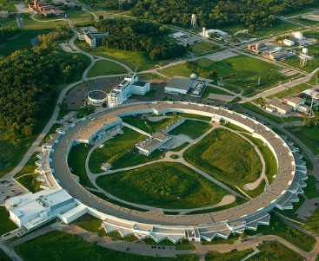
Advanced photon source, Argonne National Laboratory
https://www.aps.anl.gov/
Notes:
Arial photo of the facility of Argonne National Laboratory

Slide 16
z
r
.
θ
β
y
β
Top view:
x
ρ
y
x
Notes:
Setup of the coordinate system to analyze the particle trajectory. Here rho denotes the circular radius and v denotes the particle speed (assumed to be constant).

Slide 17
z
r
.
θ
β
y
β
x
Notes:
For this analysis we will assume that the radiation is detected in the x-z plane. The angle theta is defined with respect to the x axis. Two polarization vectors denoted with epsilonparallel and epsilonperpendicular (both perpendicular to r) are defined.

Slide 18
z
r
.
θ
β
y
β
x
Notes:
Here the two amplitudes C for parallel and perpendicular polarizations are defined in terms of the trajectory parameters.

Slide 19
Notes:
Following Jackson’s derivations, we arrive at the expression given on the slide that is equivalent to Jackson’s Eq. 14.79. The two terms represent the two different polarization contributions. Both terms are expressed in terms of Bessel function of the third kind of order 1/3 or 2/3.

Slide 20
Some details:
Modified Bessel functions
Exponential factor
Notes:
Here are some of the details. It is assumed that the integrands are dominated by contributions for tr near 0, theta near 0 and speeds v close to the speed of light.

Slide 21
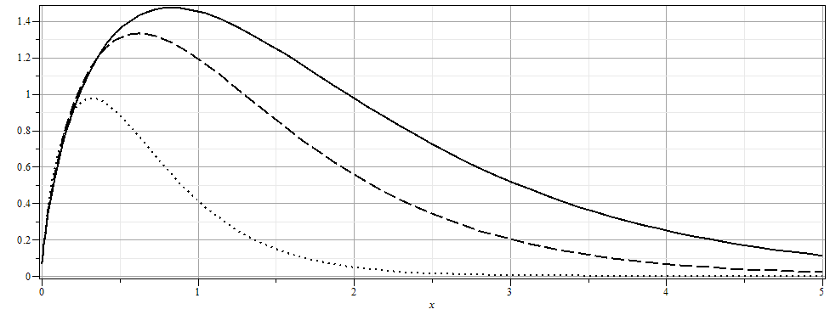
Notes:
From the expression, we can plot the intensity as a function of the scaled frequency scaled by the critical frequency defined on the previous slide for various angles theta.

Slide 22
More details
Notes:
More plots. The fact that the frequency scales with the critical frequency means that by designing facilities with different radii and gamma factors, the spectral range can be controlled.

Slide 23
The above analysis applies to a class of man-made facilities dedicated to producing intense radiation in the continuous spectrum. For more specific information on man-made synchrotron sources, the following web page is useful: http://www.als.lbl.gov/als/synchrotron_sources.html.

Slide 24
The second example of synchrotron radiation comes from a distant charged particle moving in a circular trajectory such that the spectrum represents a superposition of light generated over many complete circles. In this case, there is an interference effect which results in the spectrum consisting
of discrete multiples of v/ρ. For this case we need to reconsider the analysis. There is a very convenient Bessel function identity of the form:
Notes:
Now consider another geometry for synchrotron radiation from charge particles in outer space moving in circular orbits due to magnetic fields for example. The equations are still true. We can analyze those equations using the given identity involving a series of Bessel functions.

Slide 25
Astronomical synchrotron radiation -- continued:
Notes:
Some details are listed here.

Slide 26
Astronomical synchrotron radiation -- continued:
In both of the expressions, the sum over m includes both negative and positive values. However, only the positive values of ω and therefore positive values of m are of interest. Using the identity: the
result becomes:
These results were derived by Julian Schwinger (Phys. Rev. 75, 1912-1925 (1949)). The discrete case is similar to the result quoted in Problem 14.15 in Jackson's text.

Slide 27
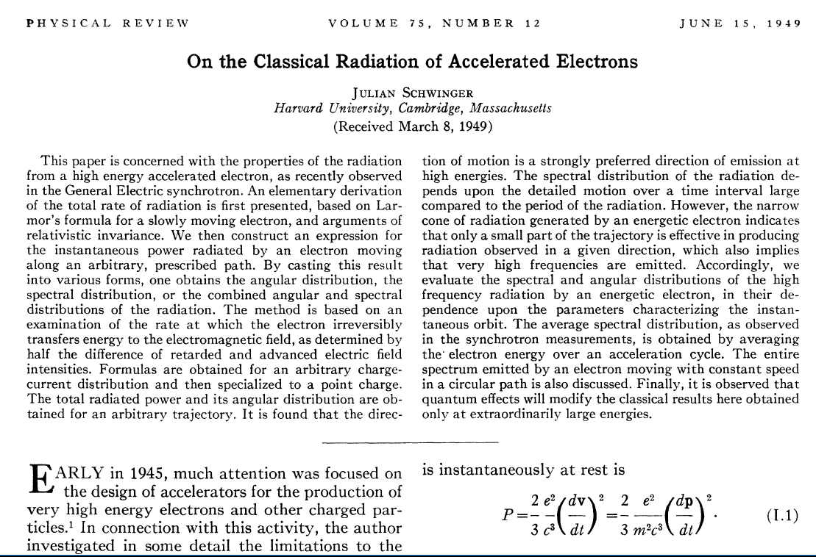
Notes:
This famous paper by Julian Schwinger discusses some of the details presented on these slides.

