Slide 1
PHY 712 Electrodynamics
12-12:50 AM MWF via video link:
https://wakeforest-university.zoom.us/my/natalie.holzwarth
Plan for Lecture 26:
Finish Chap. 11 and begin Chap. 14
Electromagnetic field transformations & corresponding analysis of Liénard-Wiechert potentials for constant velocity sources
Radiation by moving charged particles
Notes:
In this lecture we will continue to discuss the electromagnetic fields produced by a moving charged particle using the Lienard-Wiechert potentials. First we need to make sure that we obtain consistent results with Lecture 25. Then we will start to discuss the results from more general trajectories.

Slide 2
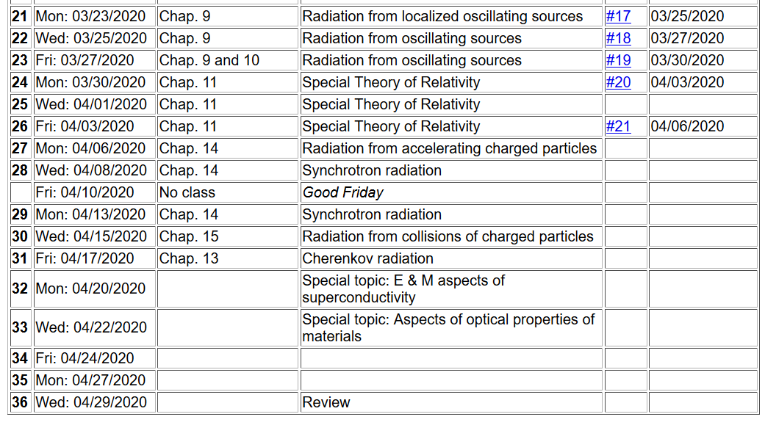
Notes:
The homework from today’s lecture involves deriving some of the details of today’s lecture.

Slide 3
Inverse transformation of field strength tensor
Notes:
Review of the Lorentz transformation for the field strength tensor --

Slide 4
Example:
y
y’
v
b
q
x
x’
z
z’
Notes:
This is the example that we have been studying from Lecture 25.

Slide 5
Example:
y
y’
v
b
q
x
x’
z
z’
Notes:
Using the fields from the moving frame, we can write the expressions for the fields in the stationary frame.

Slide 6
Example:
y
y’
v
b
q
x
x’
z
z’
Expression in terms of consistent coordinates
Notes:
Here the fields measured in the stationary frame are expressed in terms of the time t measured in the stationary frame.

Slide 7
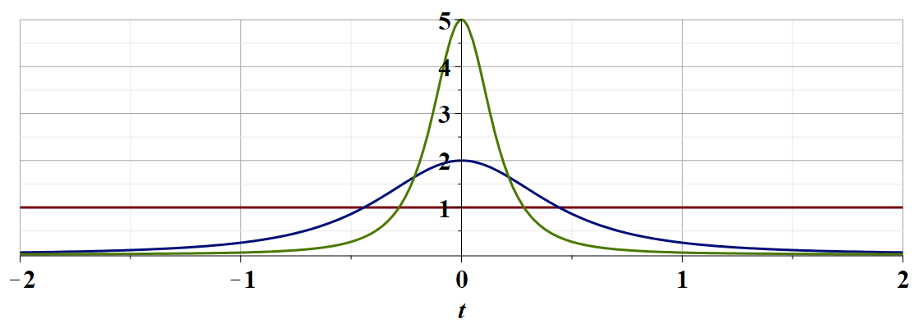
γ_{v}=5
γ_{v}=2
γ_{v}=1
c
Notes:
This is a plot shown in Lecture 25 of E_{y} as a function of time.

Slide 8
Examination of this system from the viewpoint of the
the Liénard-Wiechert potentials –(Gaussian units)
Notes:
Now we consider how we may arrive at the same result without changing reference frames by analyzing the EM fields produced by a moving charge using the Lienard-Wiechert analysis.

Slide 9
Radiation from a moving charged particle
z
r-R_{q}(t)
q
r
R_{q}(t)
y
x
Notes:
Here we consider a charged particle (charge q) moving along the red trajectory. The vector r indicates the point at which we will evaluate the fields. The retarded time t_{r} is defined here.

Slide 10
Examination of this system from the viewpoint of the
the Liènard-Wiechert potentials –(Gaussian units)
Notes:
In our case, the trajectory of the moving particle is described as constant velocity along the x-axis while the fields are measured at the fixed point b along the y axis.

Slide 11
Some details
Notes:
For your homework for this lecture, you are asked to review the evaluations here.

Slide 12
Some details continued:
Notes:
When the dust clears, we do verify the E and B fields obtained using the Lorentz transformation.

Slide 13
Radiation from a moving charged particle
z
r-R_{q}(t)
q
r
R_{q}(t)
y
x
Notes:
With this success, we are motivated to apply this approach to more general particle trajectories.

Slide 14
Liénard-Wiechert fields (cgs Gaussian units):
Notes:
Here we review the equations from the Lienard-Wiechert analysis. We particularly notice that for the fields very far from the particle positions, the dominant terms are those which involve the acceleration of the particle.

Slide 15
Electric field far from source:
Notes:
These acceleration terms are given here. These are the terms that we will focus on. Here we define a unit vector Rhat. Jackson calls this vector n. In principle, this unit vector varies in time, but at large enough distances from the source, it is an approximately constant unit vector.

Slide 16
Poynting vector:
Notes:
In addition to calculating the fields themselves, we will be interested in calculating the Poynting vector due to the fields in the radiation zone.

Slide 17
Power radiated
Notes:
After some algebra, we arrive at the expression for the power radiated per unit solid angle. We will examine this result more in detail next time, but for now, we will consider the result in the non-relativistic limit when beta is nearly 0.

Slide 18
Radiation from a moving charged particle
z
.
v
r-R_{q}(t_{r})=R
q
Θ
r
R_{q}(t)
y
x
Notes:
This slide attempts to show the geometry of the trajectory and fields.

Slide 19
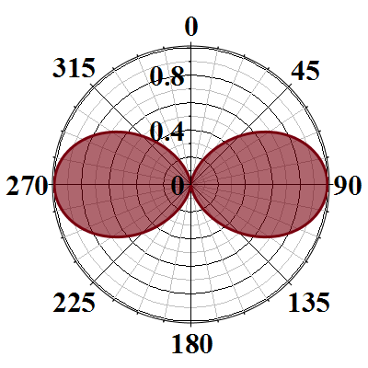
Radiation power in non-relativistic case -- continued
Blue arrow indicates the particle acceleration direction
Notes:
Here we illustrate the non-relativistic power distribution, showing that the radiation intensity is concentrated in the directions perpendicular to the particle acceleration. Next time we will see how relativistic effects change this radiation pattern.

