Slide 1
PHY 712 Electrodynamics
12-12:50 AM Olin 103
Plan for Lecture 19:
Chap. 8 in Jackson – Wave Guides
TEM, TE, and TM modes
Justification for boundary conditions; behavior of waves near conducting surfaces

Slide 2
Colloquium discussion: “How Can the Physics Colloquium Experience be Improved?”
George P. Williams, Jr. Lecture Hall, (Olin 101) Wednesday, February 26, 2020 at 3:00 PM
There will be a reception in the Olin Lounge at approximately 3:30 or 4 PM following the discussion. All interested persons are cordially invited to attend.
ABSTRACT Over the years, the WFU Physics Colloquium series has hosted a variety of physicists, scientists and mathematicians in related fields to provide a window to new ideas. In principle, this opportunity for exposure to new ideas is an essential part of our education. In practice, there may be ways to improve the colloquium. Professor N. A. W. Holzwarth will lead a discussion among all students registered for PHY 301/601 and other interested participants on how we might optimize the colloquium experience.

Slide 3
Next week --
Colloquium: “Changes in Blood Clot Structure and Mechanics in Cardiovascular and Thromboembolic Diseases”
Dr. Stephen Baker, Teacher Scholar Postdoctoral Fellow WFU Physics George P. Williams, Jr. Lecture Hall, (Olin 101) Wednesday, March 4, 2020 at 3:00 PM
There will be a reception in the Olin Lounge at approximately 4 PM following the colloquium. All interested persons are cordially invited to attend.
ABSTRACT Studies in recent years have shown blood clot structure and mechanical properties to be a novel risk factor for cardiovascular diseases, the leading cause of morbidity and mortality worldwide. As a result, we need to better understand how the structural and mechanical properties of blood clots from patients with cardiovascular disease are different from those of healthy individuals. To study these properties, we need to determine how they change at different length scales. On the nano- and microscale, an atomic force microscope is an extremely versatile piece of equipment that can be used for nanometer to micrometer scale imaging, normal force unfolding of single molecules, or even novel lateral force techniques.

Slide 4
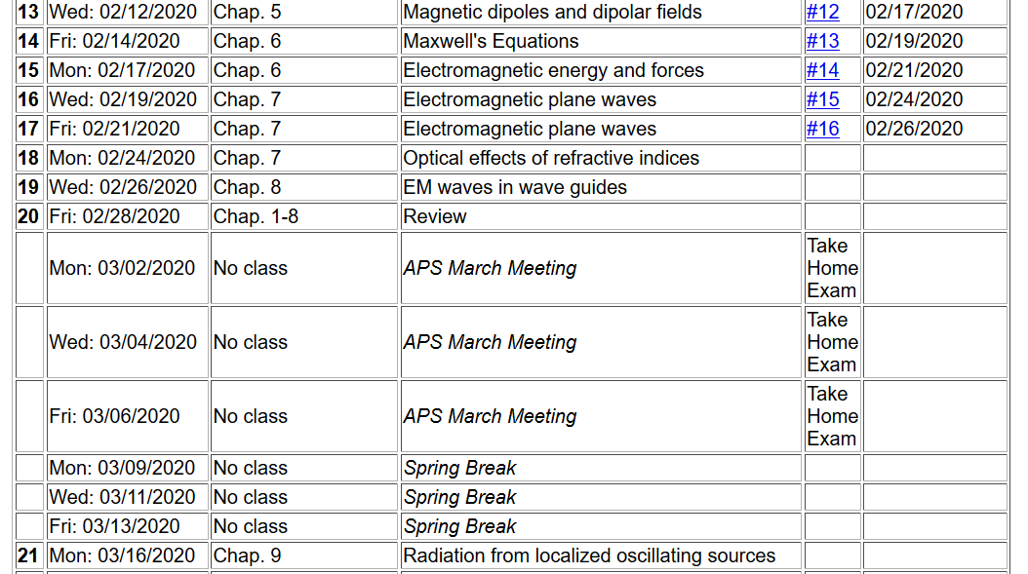

Slide 5
Maxwell’s equations

Slide 6
Analysis of Maxwell’s equations without sources -- continued:

Slide 7
Analysis of Maxwell’s equations without sources -- continued:
Both E and B fields are solutions to a wave equation:

Slide 8
Analysis of Maxwell’s equations without sources -- continued:
Note: ε, μ, n, k can all be complex; for the moment we will assume that they are all real (no dissipation).
For real
ε, μ, n, k

Slide 9
Analysis of Maxwell’s equations without sources -- continued:
E₀
B₀
k

Slide 10
Transverse electric and magnetic waves (TEM)
TEM modes describe electromagnetic waves in lossless media and vacuum
E₀
B₀
For real
ε, μ, n, k
k

Slide 11
Effects of complex dielectric; fields near the surface on an ideal conductor

Slide 12
Some details:

Slide 13
Fields near the surface on an ideal conductor -- continued

Slide 14
Some representative values of skin depth
Ref: Lorrain² and Corson
 | σ (10⁷ S/m) | μ/μ₀ | δ (0.001m) at 60 Hz | δ (0.001m) at 1 MHz
Al | 3.54 | 1 | 10.9 | 84.6
Cu | 5.80 | 1 | 8.5 | 66.1
Fe | 1.00 | 100 | 1.0 | 10.0
Mumetal | 0.16 | 2000 | 0.4 | 3.0
Zn | 1.86 | 1 | 15.1 | 117

Slide 15
Relative energies associated with field

Slide 16
Fields near the surface on an ideal conductor -- continued
r||
0
z

Slide 17
Fields near the surface on an ideal conductor -- continued
r||
0
z

Slide 18
Boundary values for ideal conductor
At the boundary of an ideal conductor, the E and H fields decay in the direction normal to the interface.
H₀

Slide 19
Wave guides – dielectric media with one or more metal boundary
H₀
Waveguide terminology
TEM: transverse electric and magnetic (both E and H fields are perpendicular to wave propagation direction)
TM: transverse magnetic (H field is perpendicular to wave propagation direction)
TE: transverse electric (E field is perpendicular to wave propagation direction)

Slide 20
Analysis of rectangular waveguide
Boundary conditions at surface of waveguide:
E_{tangential}=0, B_{normal}=0
y
x
z
Cross section view
b
a

Slide 21
Analysis of rectangular waveguide
y
x
z

Slide 22
Solution of Maxwell’s equations within the pipe:

Slide 23
Maxwell’s equations within the pipe in terms of all 6 components:

Slide 24
TE modes for rectangular wave guide continued:

Slide 25
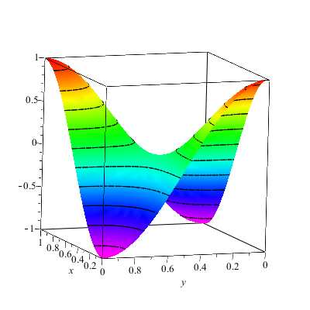
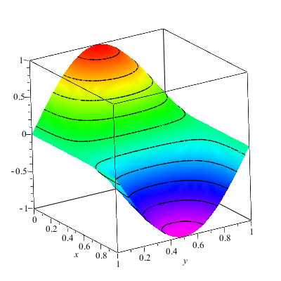
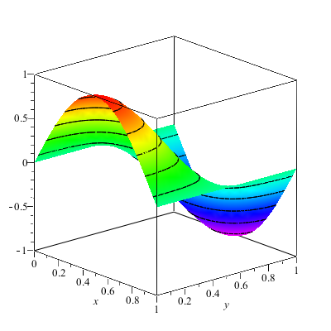
Solution for m=n=1

Slide 26
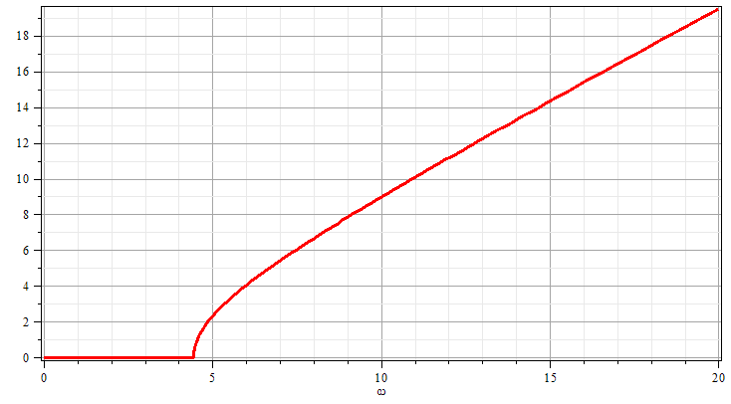
Solution for m=n=1
k
ω

Slide 27
Resonant cavity
y
x
z
27

Slide 28
Resonant cavity
y
x
z

Slide 29
Wave guides – dielectric media with one or more metal boundary
Coaxial cable
TEM modes
Simple optical pipe
TE or TM modes
k
k
E
H
Waveguide terminology
TEM: transverse electric and magnetic (both E and H fields are perpendicular to wave propagation direction)
TM: transverse magnetic (H field is perpendicular to wave propagation direction)
TE: transverse electric (E field is perpendicular to wave propagation direction)

Slide 30
Wave guides
Top view:
z
μ ε
Inside medium, μ ε assumed to be real
a
b
Coaxial cable
TEM modes
(following problem 8.2 in Jackson’s text)

Slide 31
Electromagnetic waves in a coaxial cable -- continued
Top view:
μ ε
ρ
a
φ
b

Slide 32
Electromagnetic waves in a coaxial cable -- continued
Top view:
μ ε
ρ
a
φ
b

