Slide 1
PHY 712 Electrodynamics
9-9:50 AM MWF Olin 105
Plan for Lecture 29:
Finish reading Chap. 14 –
Radiation from charged particles
Review of synchrotron radiation
Free electron laser
Thompson and Compton scattering

Slide 2
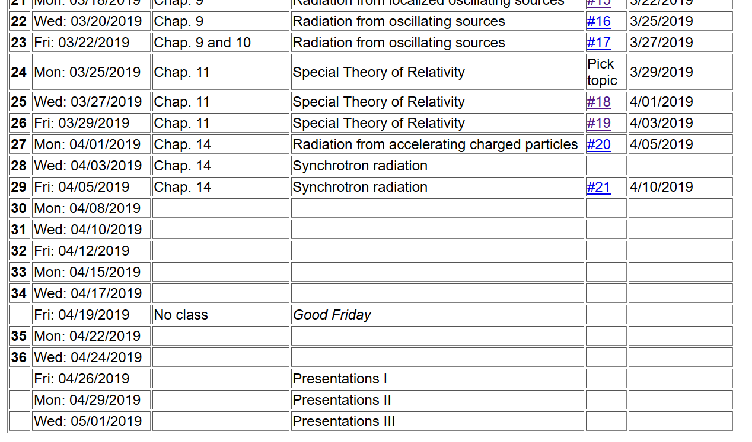

Slide 4
Advice about remaining topics to cover
Cherenkov radiation
Electrodynamics of superconductivity
Radiation from collisions of charged particles
Optical properties of materials

Slide 5
Spectral composition of electromagnetic radiation -- continued

Slide 6
z
r
.
θ
β
y
β
Top view:
x
ρ
y
x

Slide 7
z
r
.
θ
β
y
β
x

Slide 8
z
r
.
θ
β
y
β
x

Slide 9
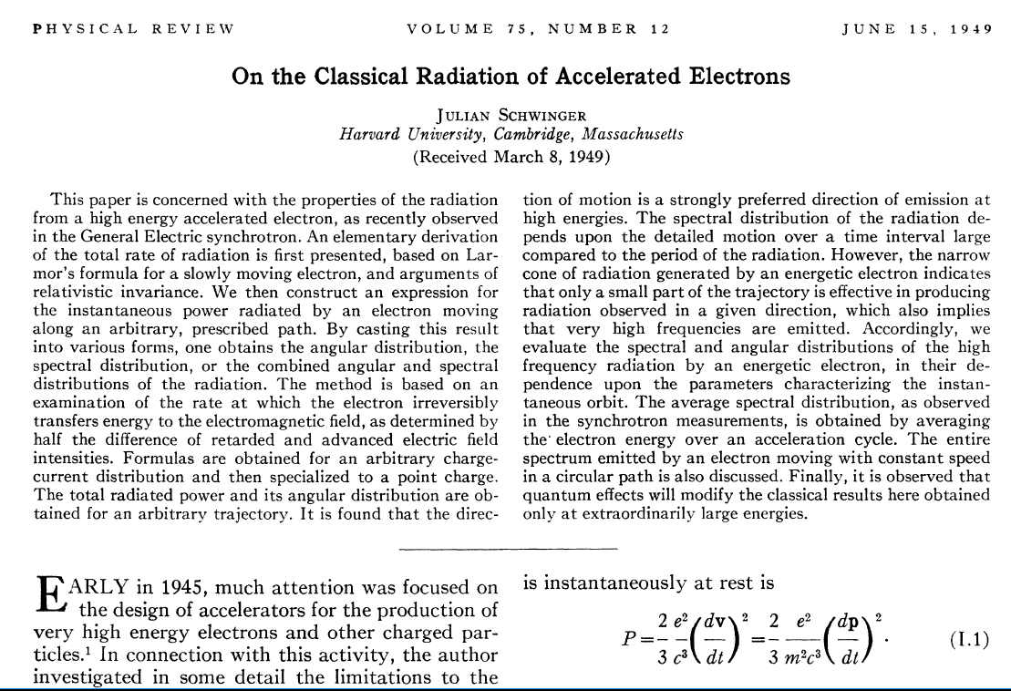

Slide 10
Evaluation of integrals representing distant charged particles moving in a circular trajectory such that the spectrum represents a superposition of light generated over many complete circles. In this case, there is an interference effect which results in the spectrum consisting
of discrete multiples of v/ρ.

Slide 11
Useful identity involving Bessel functions

Slide 12
Astronomical synchrotron radiation -- continued:

Slide 13
Astronomical synchrotron radiation -- continued:
In both of the expressions, the sum over m includes both negative and positive values. However, only the positive values of ω and therefore positive values of m are of interest. Using the identity: the
result becomes:
These results were derived by Julian Schwinger (Phys. Rev. 75, 1912-1925 (1949)). The discrete case is similar to the result quoted in Problem 14.15 in Jackson's text.

Slide 15
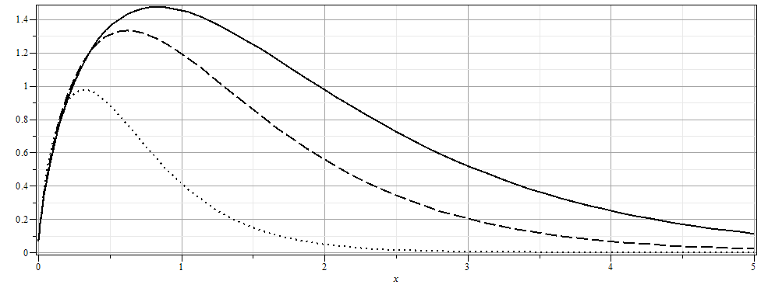

Slide 16
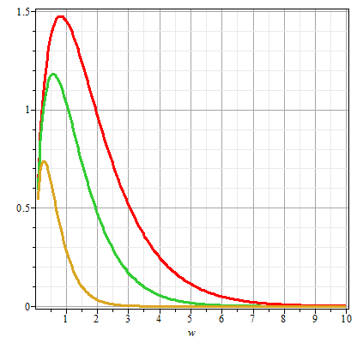
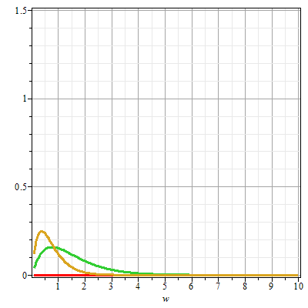
Plots of the intensity function for synchrotron radiation
γθ=0
γθ=0.5
γθ=1
γθ=1
γθ=0.5
ω/ω_{c}
ω/ω_{c}

Slide 17
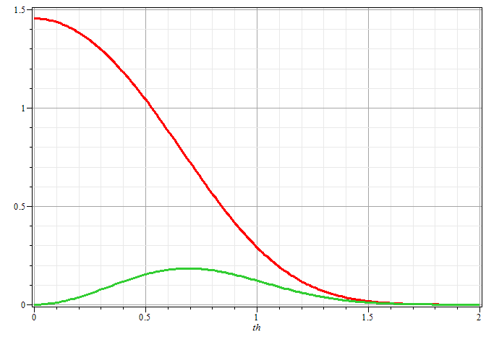
Plots of the intensity function for synchrotron radiation
ω/ω_{c}=1
γθ

Slide 18
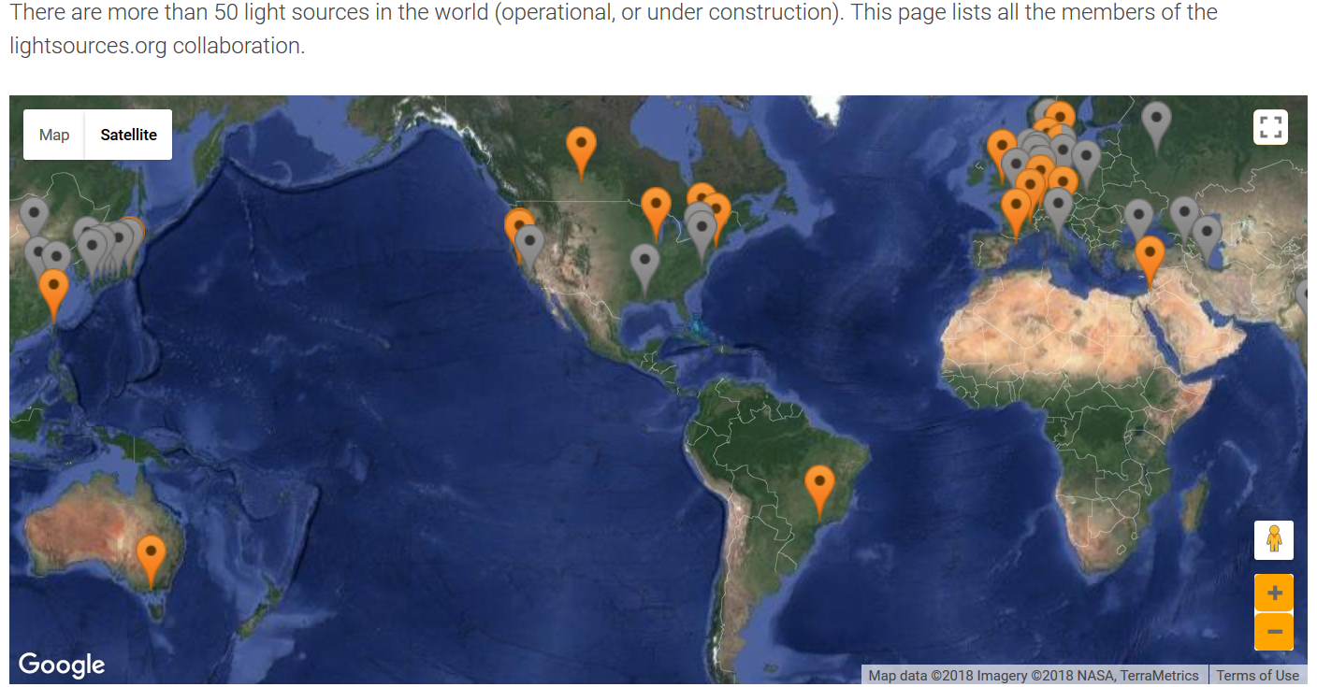
Synchrotron facilities worldwide
https://lightsources.org/

Slide 19
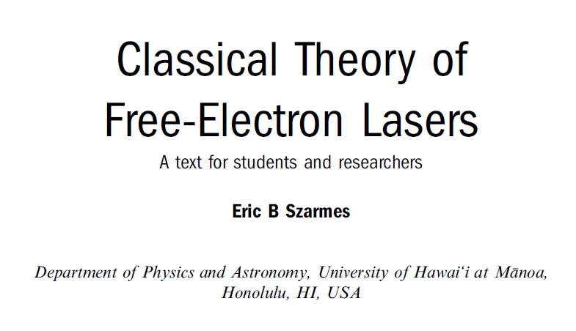
Free electron laser
Reference:

Slide 20
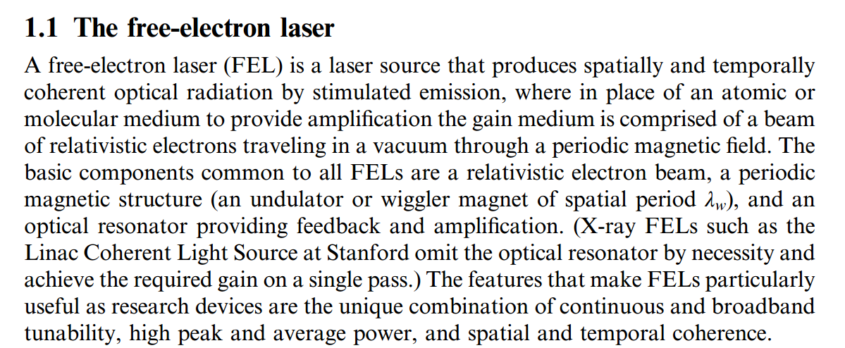

Slide 21
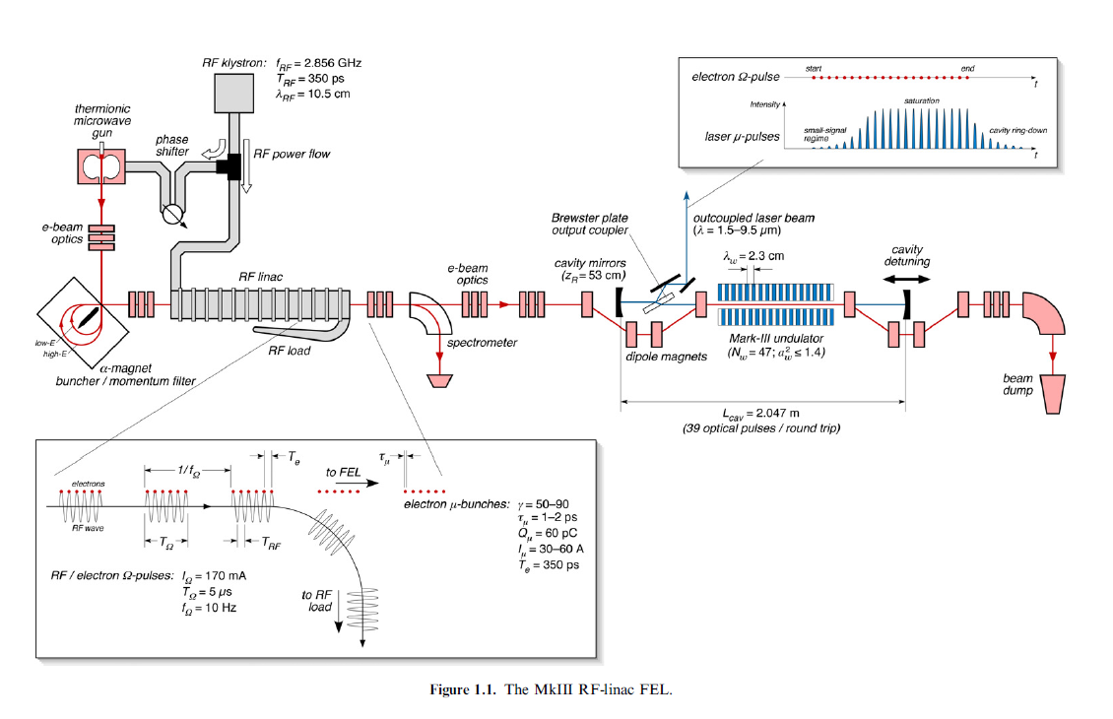

Slide 22
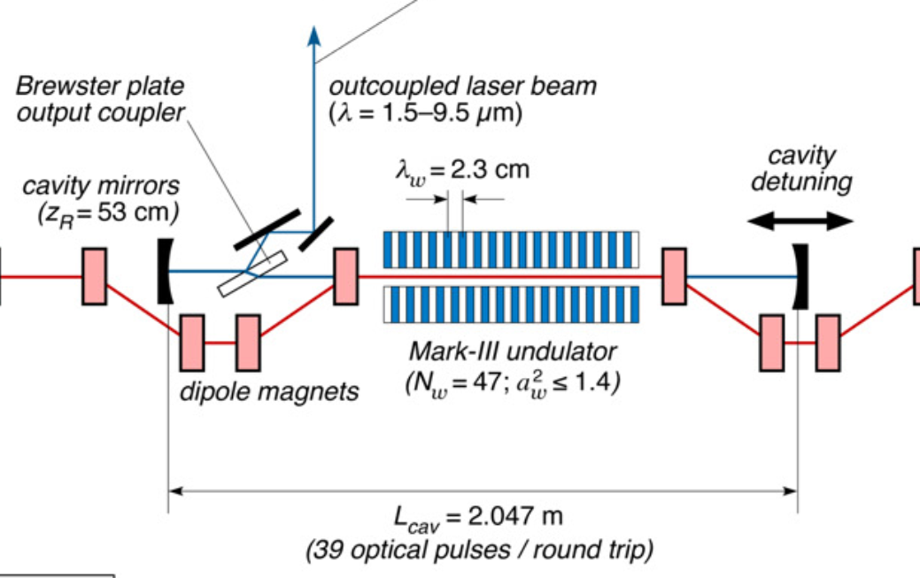

Slide 23
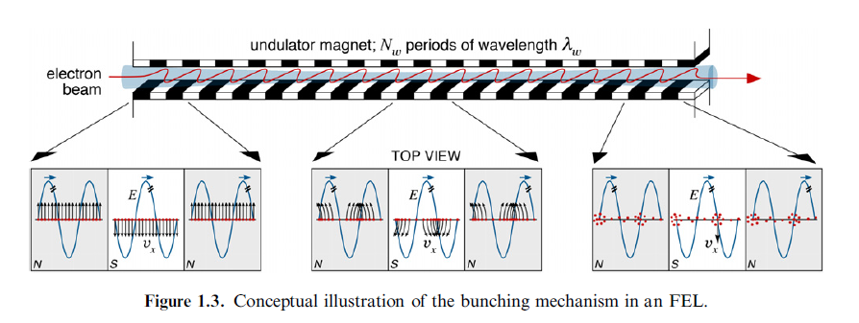
Electron emission in periodic magnet

Slide 24
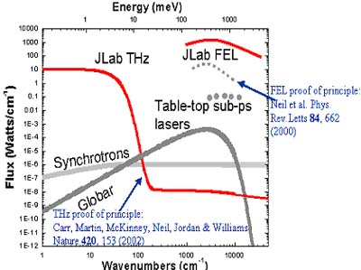
Spectral output for FEL at Jefferson Lab (in Virginia)

Slide 25
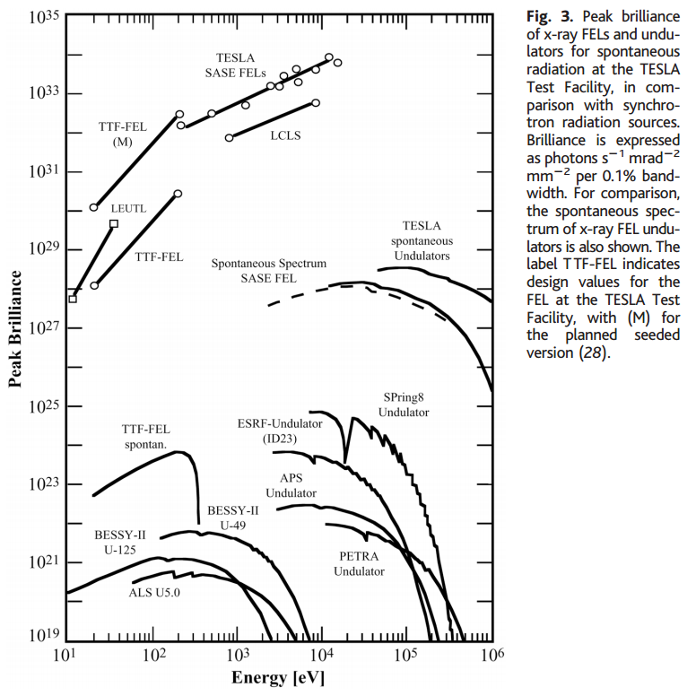

Slide 26
Some details of scattering of electromagnetic waves incident on a particle of charge q and mass m_{q}
r
k₀
θ
ε₂
ε₀
φ
ε₁

Slide 27
Thompson scattering – non relativistic approximation

Slide 28
Thompson scattering – non relativistic approximation -- continued
r
k₀
θ
ε₂
ε₀
φ
ε₁

Slide 29
Thompson scattering – non relativistic approximation -- continued
Scattered light may be polarized parallel to incident field or polarized with an angle θ so that the time and polarization averaged cross section is given by:
This formula is appropriate in the X-ray scattering of electrons or soft γ-ray scattering of protons

Slide 30
Thompson scattering – relativistic and quantum modifications
p_{q}
incident photon
α
p
θ
p’
scattered
photon
04/08/2013
30

Slide 31
Thompson scattering – relativistic and quantum modifications
p_{q}
incident photon
α
p
θ
p’
scattered
photon

