Slide 1
PHY 712 Electrodynamics
9-9:50 AM Olin 105
Plan for Lecture 19:
Complete reading of Chapter 7
Comments on reflectivity of plane waves
Summary of complex response functions for electromagnetic fields

Slide 2
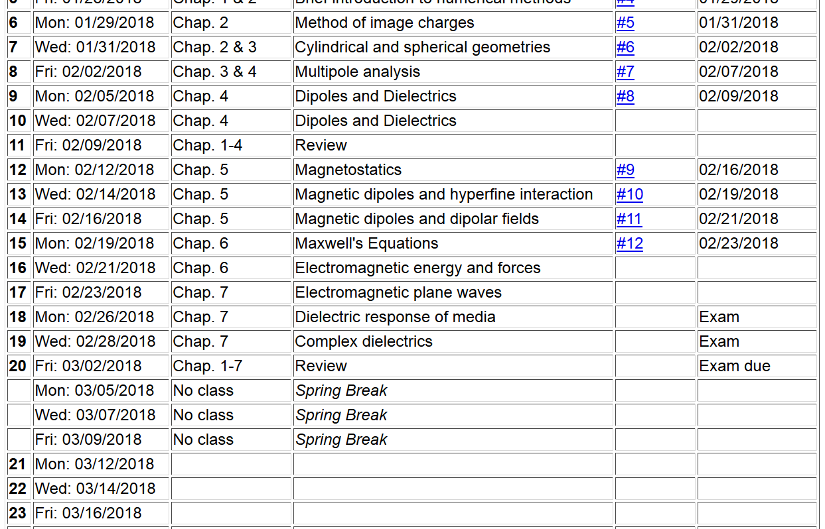

Slide 3
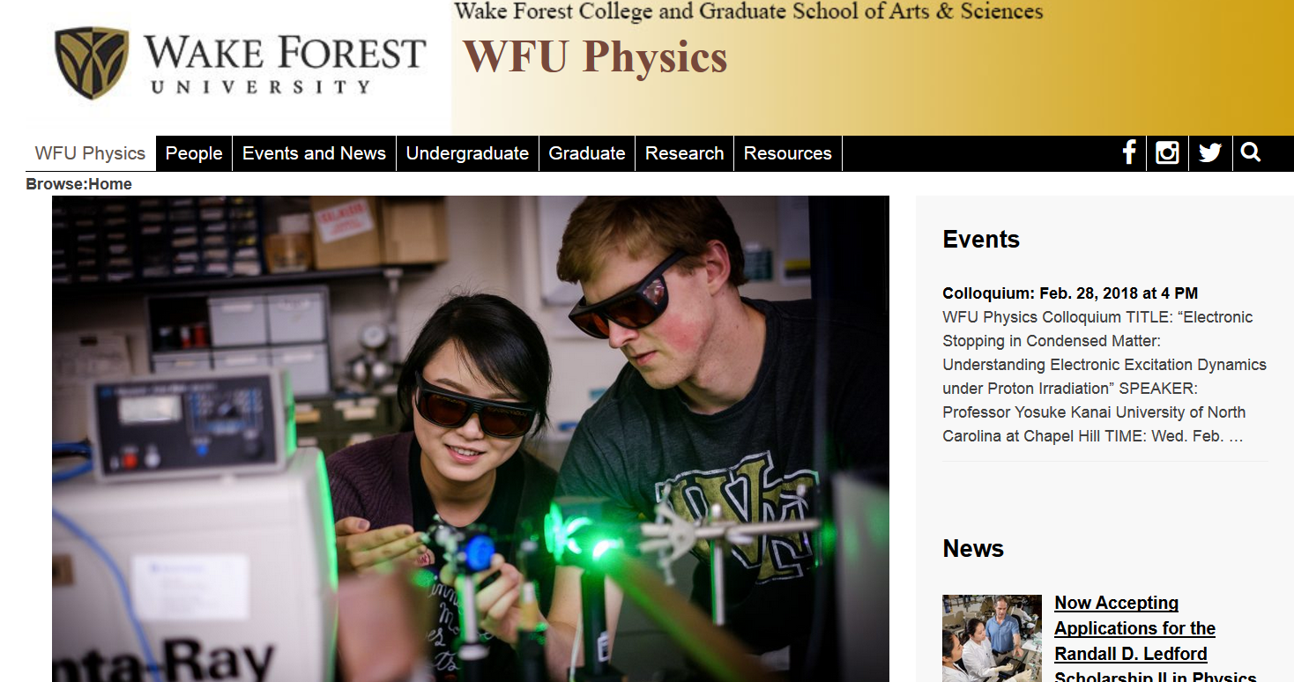

Slide 4
Some comments on the Fresnel Equations
Different behaviors of s and p polarization
Brewster’s angle
Total internal reflection

Slide 5
Review: Electromagnetic plane waves in isotropic medium with real permeability and permittivity: μ ε.

Slide 6
Review:
Reflection and refraction between two isotropic media
μ’ ε’
θ
k’
μ ε
k_{i}
k_{R}
i
R

Slide 7
Reflection and refraction of plane electromagnetic waves at a plane interface between dielectrics (assumed to be lossless)
μ’ ε’
k’
θ
μ ε
k_{R}
k_{i}
i
R

Slide 8
For s-polarization (E in plane of incidence)
For p-polarization (E perpendicular to plane of incidence)

Slide 9
Reflectance for s-polarization
Reflectance for p-polarization

Slide 10
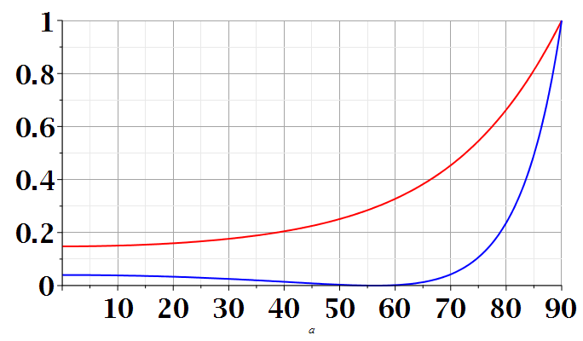
s-polarization
p-polarization
i
i

Slide 11
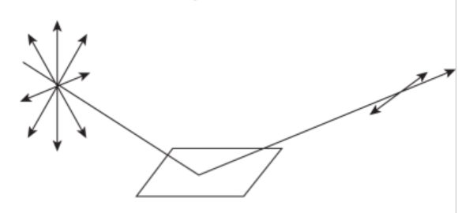
n=1
surface normal
k_{i}
k_{R}
i
n’>1
Polarization due to reflection from a refracting surface

Slide 12
Reflection and refraction between two isotropic media -- continued
μ’ ε’
θ
k’
μ ε
k_{i}
k_{R}
i
R
Total internal reflection:

Slide 13
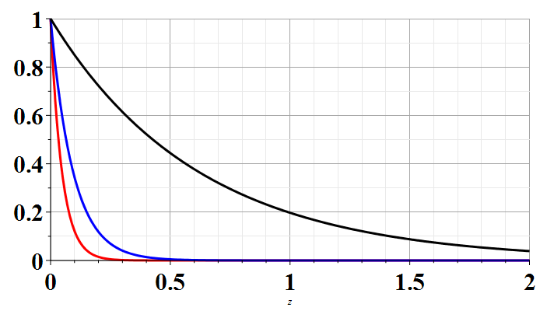
Example of total internal reflection
n’=1 and n=1.5 ➔ i₀ = sin⁻¹(1/1.5)=41.81º
Relative transmitted intensity
i=42º
i=50º
i=90º
z/λ
Transmitted illumination confined within a few wavelengths of the surface.

Slide 14
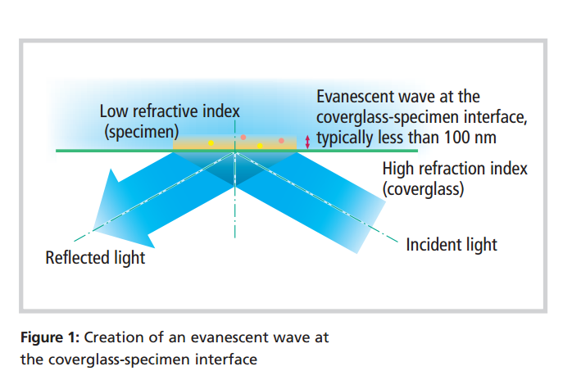
TIRF (total internal reflection fluorescence)
www.nikon.com/products/microscope-solutions/bioscience.../nikon_note_10_lr.pdf

Slide 15
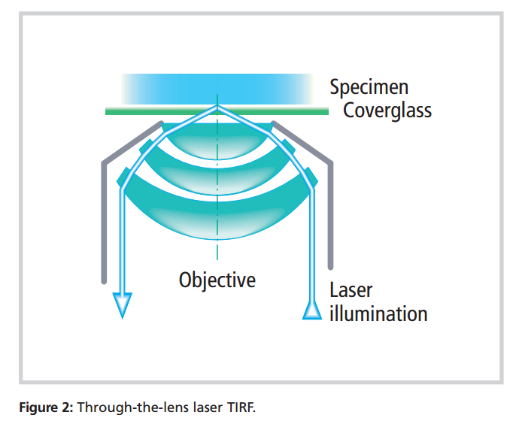
Design of TIRF device using laser and high power lens

Slide 16
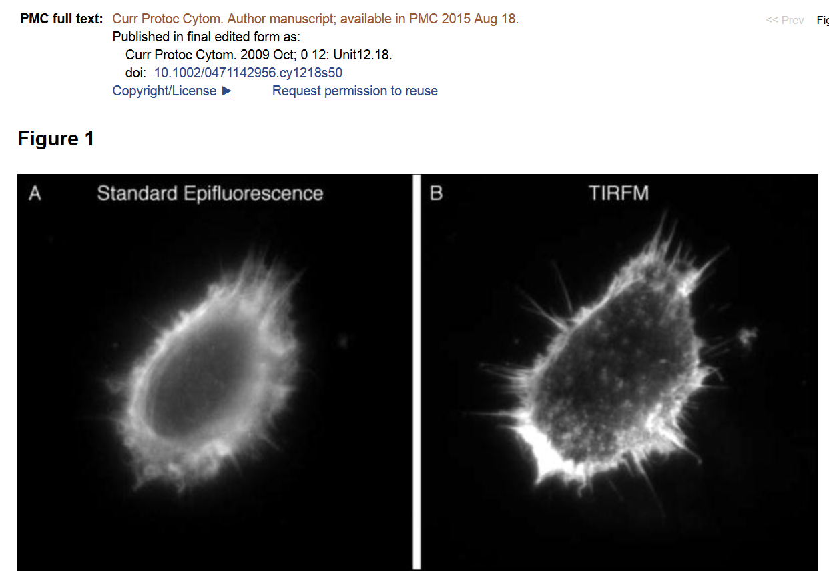

Slide 17
Special case: normal incidence (i=0, θ=0)
PHY 712 Spring 2013 -- Lecture 19
17

Slide 18
Extension to complex refractive index n= n_{R} + i n_{I}

Slide 19
Origin of imaginary contributions to permittivity --
Review: Drude model dielectric function:

Slide 20
Drude model dielectric function:

Slide 21
Drude model dielectric function – some analytic properties:

Slide 22
Analysis for Drude model dielectric function – continued --
Analytic properties:

Slide 23
Because of these analytic properties, Cauchy’s integral theorem results in:
Kramers-Kronig transform – for dielectric function:

Slide 24
Further comments on analytic behavior of dielectric function

Slide 25
Further comments on analytic behavior of dielectric function

