Slide 1
PHY 712 Electrodynamics
9-9:50 AM MWF Olin 105
Plan for Lecture 16:
Finish reading Chapter 6
Some details of Liénard-Wiechert results
Energy density and flux associated with electromagnetic fields
Time harmonic fields

Slide 2
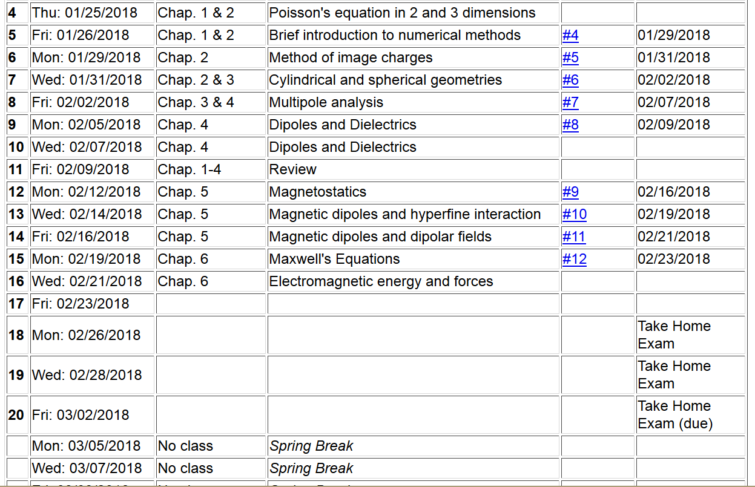

Slide 3
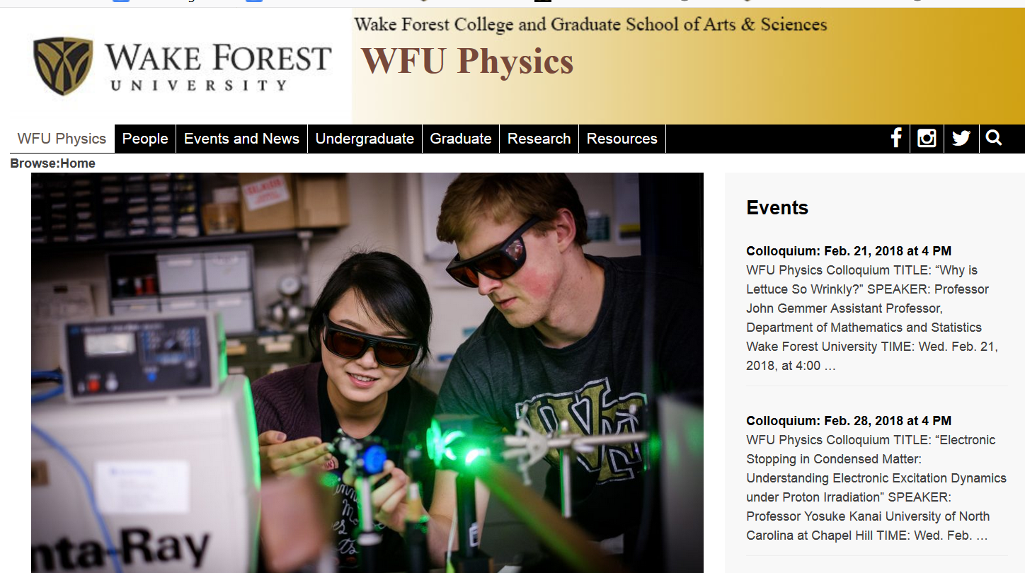

Slide 4
Solution of Maxwell’s equations in the Lorentz gauge -- continued
Liénard-Wiechert potentials and fields --
Determination of the scalar and vector potentials for a moving point particle (also see Landau and Lifshitz The Classical Theory of Fields, Chapter 8.)
Consider the fields produced by the following source: a point charge q moving on a trajectory R_{q}(t).
R_{q}(t)
q

Slide 5
Solution of Maxwell’s equations in the Lorentz gauge -- continued
We performing the integrations over first d³r’ and then dt’
making use of the fact that for any function of t’,
where the ``retarded time'' is defined to be

Slide 6
Solution of Maxwell’s equations in the Lorentz gauge -- continued
Resulting scalar and vector potentials:
Notation:

Slide 7
Solution of Maxwell’s equations in the Lorentz gauge -- continued
In order to find the electric and magnetic fields, we need to evaluate
The trick of evaluating these derivatives is that the retarded time t_{r} depends on position r and on itself. We can show the following results using the shorthand notation:
and

Slide 8
Solution of Maxwell’s equations in the Lorentz gauge -- continued

Slide 9
Maxwell’s equations
Energy analysis of electromagnetic fields and sources

Slide 10
Energy analysis of electromagnetic fields and sources -- continued

Slide 11
Energy analysis of electromagnetic fields and sources -- continued

Slide 12
Momentum analysis of electromagnetic fields and sources

Slide 13
Comment on treatment of time-harmonic fields

Slide 14
Comment on treatment of time-harmonic fields -- continued
Equations in time domain in frequency domain
Note -- in all of these, the real part is taken at the end of the calculation.

Slide 15
Comment on treatment of time-harmonic fields -- continued

Slide 16
Summary and review
Maxwell’s equations

Slide 17
Maxwell’s equations

Slide 18
Analysis of Maxwell’s equations without sources -- continued:

Slide 19
Analysis of Maxwell’s equations without sources -- continued:
Both E and B fields are solutions to a wave equation:

Slide 20
Analysis of Maxwell’s equations without sources -- continued:
Note: ε, μ, n, k can all be complex; for the moment we will assume that they are all real (no dissipation).

Slide 21
Analysis of Maxwell’s equations without sources -- continued:

Slide 22
Analysis of Maxwell’s equations without sources -- continued:
Transverse Electric and Magnetic (TEM) waves

Slide 23
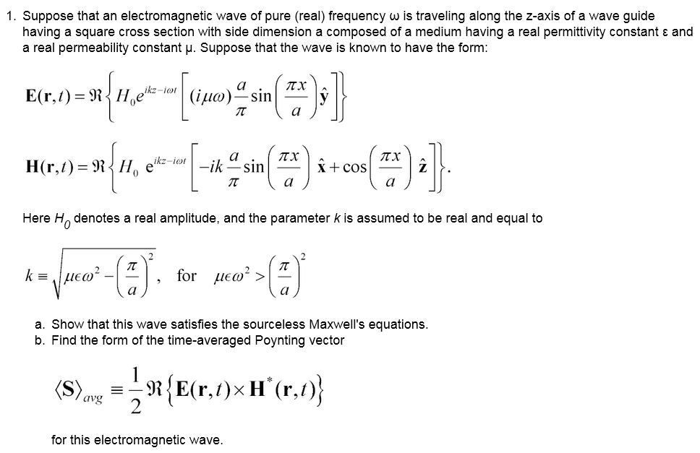
More general result (example found in waveguides)

