Slide 1
PHY 712 Electrodynamics
9-9:50 AM MWF Olin 105
Plan for Lecture 7:
Start reading Chapter 3
Solution of Poisson/Laplace equation for special geometries –
Cylindrical
Spherical

Slide 2
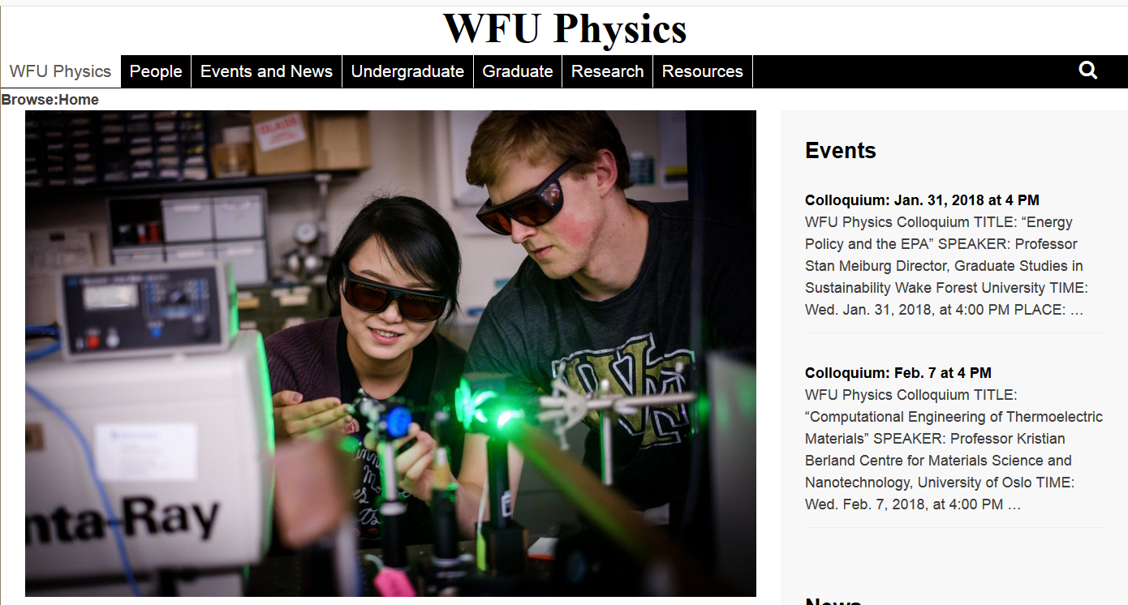

Slide 3
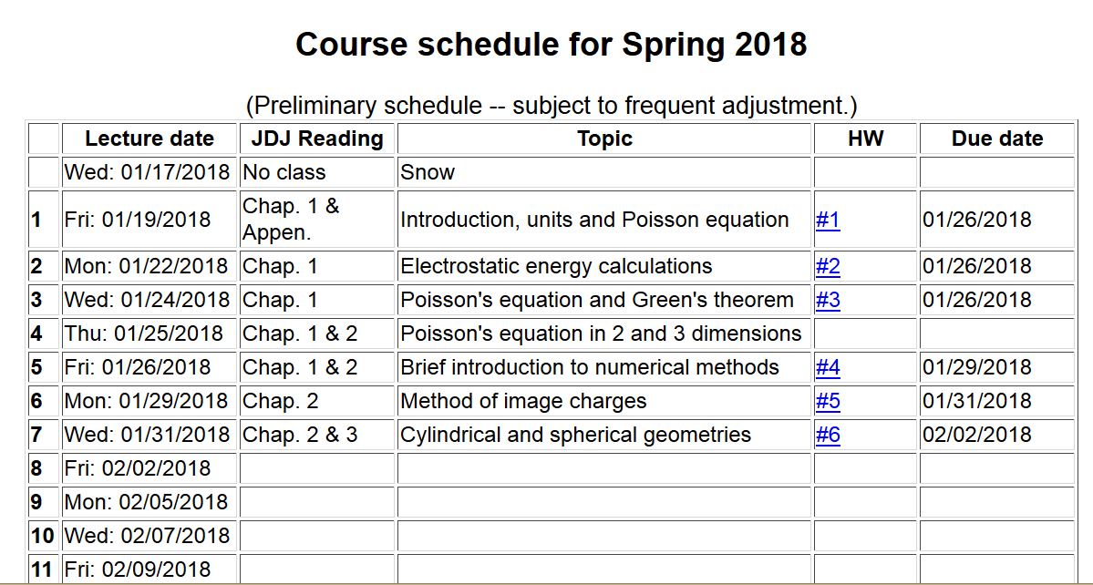

Slide 4
Solution of the Poisson/Laplace equation in various geometries -- cylindrical geometry with no z-dependence (infinitely long wire, for example):
φ
ρ

Slide 5
Cylindrical coordinates with trivial z-dependence –
some details:
φ
ρ

Slide 6
Solution of the Poisson/Laplace equation in various geometries -- cylindrical geometry with no z-dependence (infinitely long wire, for example):
φ
ρ

Slide 7
Solution of the Poisson/Laplace equation in various geometries -- cylindrical geometry with z-dependence
φ
ρ
z

Slide 8
Cylindrical geometry continued:
φ
ρ
z

Slide 9
Cylindrical geometry continued:
φ
ρ
z

Slide 10
Solutions of Laplace equation inside cylindrical shape
Example with non-trivial boundary value at z=L
m=0
m=1
m=2
kρ

Slide 11
Solutions of Laplace equation inside cylindrical shape
Example with non-trivial boundary value at z=L

Slide 12
Solutions of Laplace equation inside cylindrical shape
Example with non-trivial boundary value at ρ=a
m=0
m=1
m=2
kρ

Slide 13
Solutions of Laplace equation inside cylindrical shape
Example with non-trivial boundary value at ρ=a

Slide 14
Green’s function for Dirchelet boundary value inside cylindar:

Slide 15
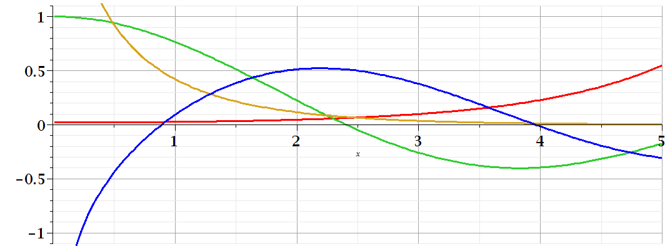
Comments on cylindrical Bessel functions
m=0
K₀
I₀/50
J₀
N₀

Slide 16
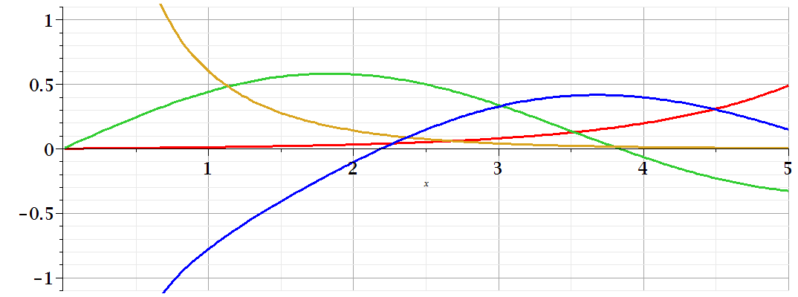
Comments on cylindrical Bessel functions
K₁
m=1
I₁/50
J₁
N₁

Slide 17
Some useful identities involving cylindrical Bessel functions

Slide 18
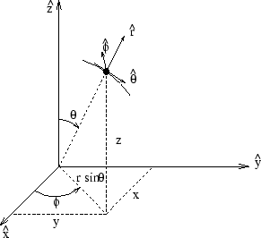
Poisson and Laplace equation in spherical polar coordinates
http://www.uic.edu/classes/eecs/eecs520/textbook/node32.html

Slide 19
Poisson and Laplace equation in spherical polar coordinates -- continued

Slide 20
Properties of spherical harmonic functions

Slide 21
Useful identity:

Slide 22
Example -- continued

Slide 23
Useful identity:

Slide 24
Useful identity:

Slide 25
Some spherical harmonic functions:

