Slide 1
PHY 712 Electrodynamics
9-9:50 AM MWF Olin 105
Plan for Lecture 36:
Special Topics in Electrodynamics:
Electromagnetic aspects of superconductivity
London equations
Brief mention of quantum mechanism
Tunneling between two superconductors

Slide 2
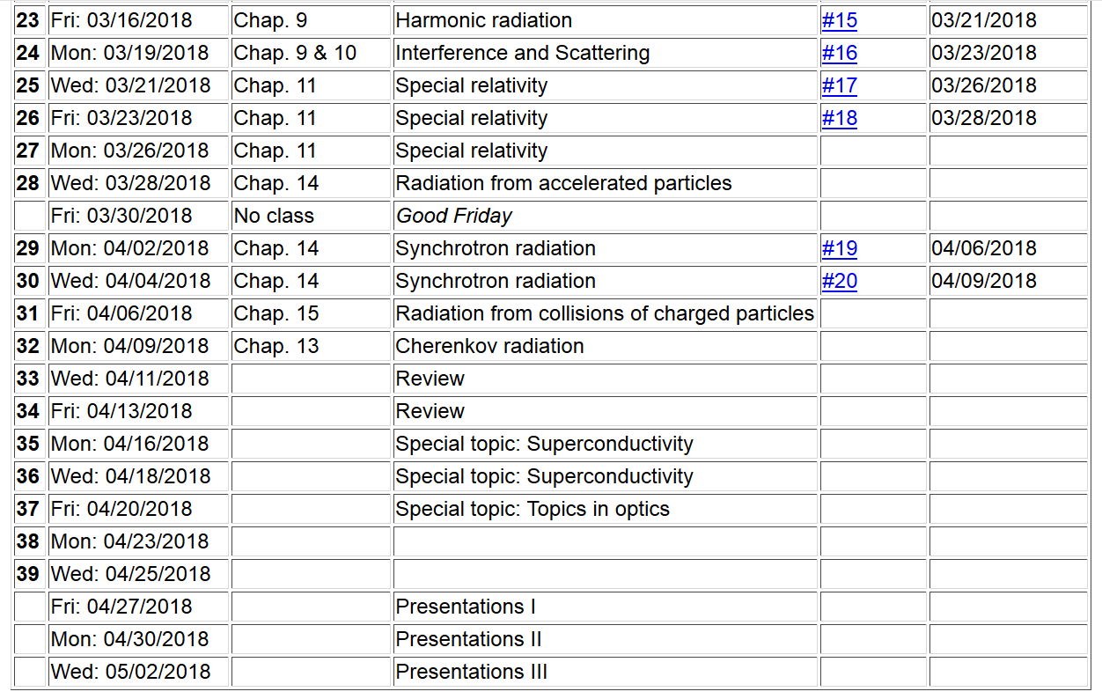

Slide 3
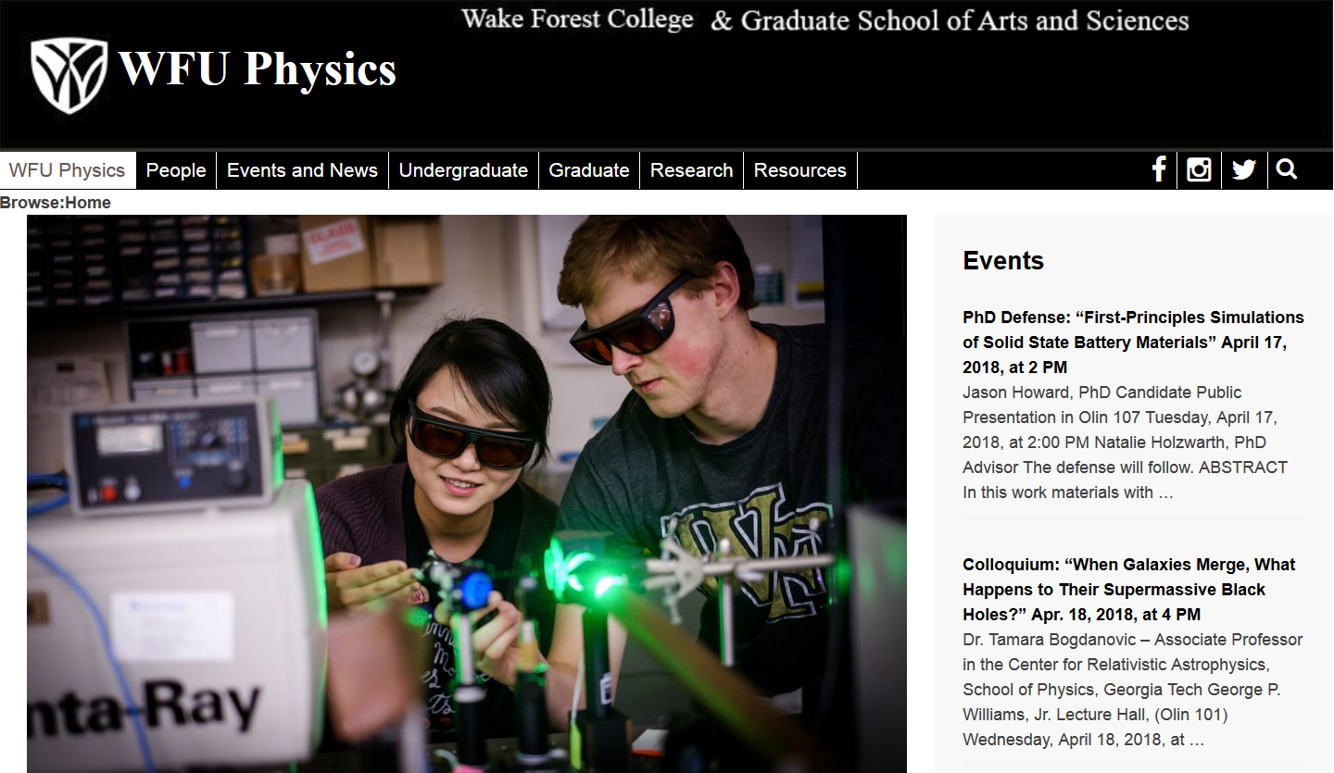

Slide 4
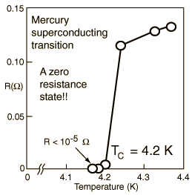
Special topic: Electromagnetic properties of superconductors
Ref:D. Teplitz, editor, Electromagnetism – paths to research,
Plenum Press (1982); Chapter 1 written by Brian Schwartz and Sonia Frota-Pessoa
History:
1908 H. Kamerlingh Onnes successfully liquified He
1911 H. Kamerlingh Onnes discovered that Hg at 4.2 K has vanishing resistance
1957 Theory of superconductivity by Bardeen, Cooper, and Schrieffer

Slide 5
Behavior of superconducting material – exclusion of magnetic field according to the London model
λ_{L}
x

Slide 6
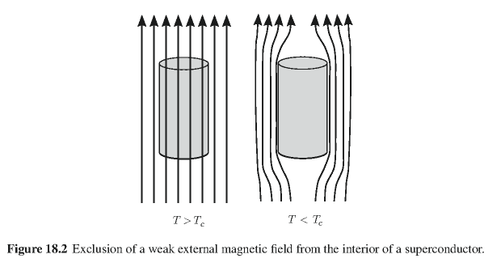
Behavior of magnetic field lines near superconductor
normal
state:
superconducting state:

Slide 7
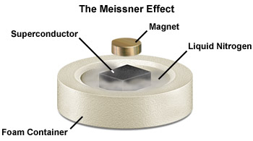

Slide 8
characteristic phonon energy
density of electron states at E_{F}
attraction potential between electron pairs

Slide 9
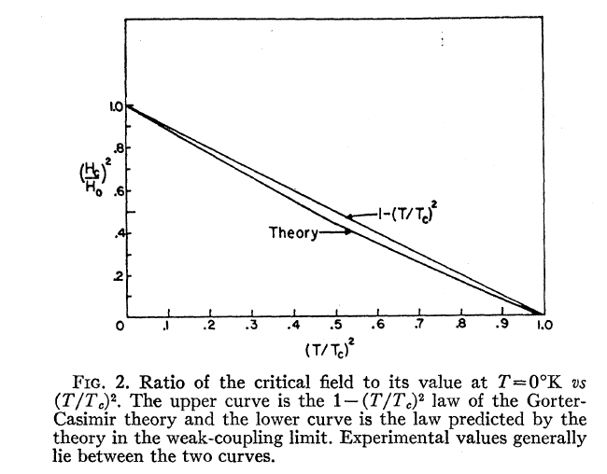
Temperature dependence of critical field
From PR 108, 1175 (1957)
Bardeen, Cooper, and Schrieffer, “Theory of Superconductivity”
characteristic phonon energy
density of electron states at E_{F}
attraction potential between electron pairs

Slide 10
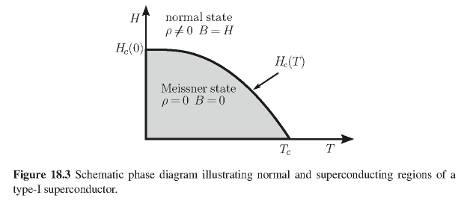
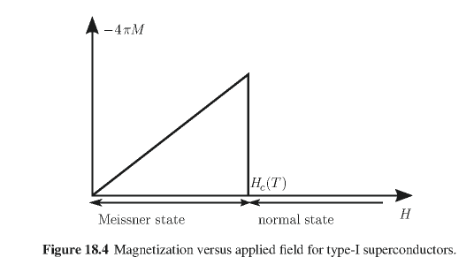
Type I superconductors:

Slide 11
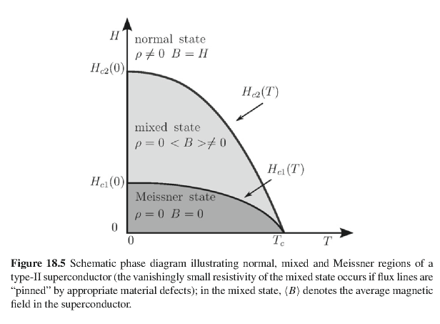
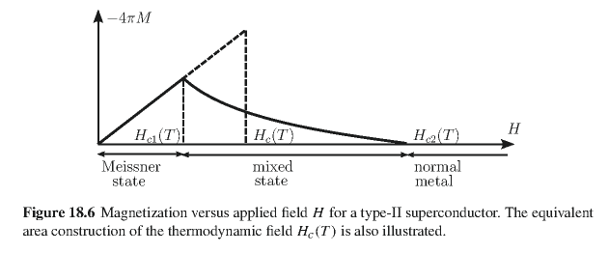
Type II superconductors

Slide 12
Quantization of current flux associated with the superconducting state (Ref: Ashcroft and Mermin, Solid State Physics)

Slide 13
Quantization of current flux associated with the superconducting state -- continued
Suppose a superconducting material has a cylindrical void. Evaluate the integral of the current in a closed path within the superconductor containing the void.
dl
Such “vortex” fields can exist within type II superconductors.

Slide 14
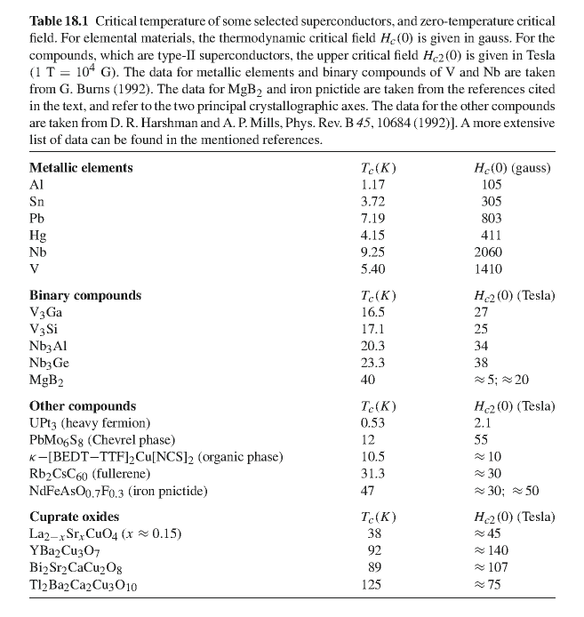

Slide 15
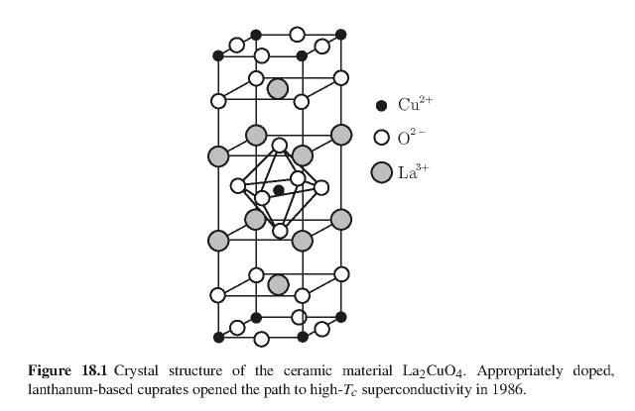
Crystal structure of one of the high temperature superconductors

Slide 16
Some details of single vortex in type II superconductor

Slide 17
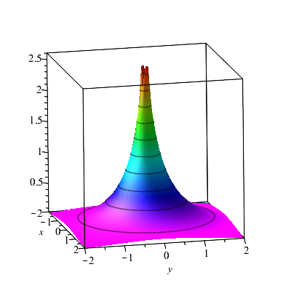
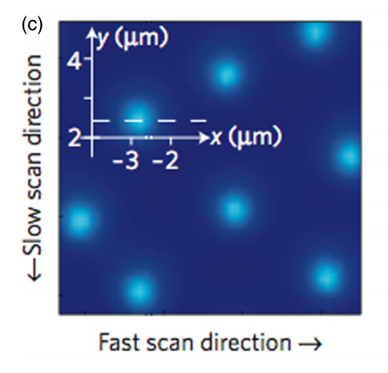
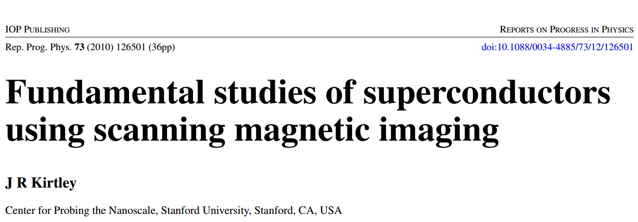
Scanning probe images of vortices in YBCO at 22 K

Slide 18
Mechanism for vortex detection --
Josephson junction -- tunneling current between two superconductors (Ref. Teplitz, Electromagnetism (1982))
d
x
B_{z}

Slide 19
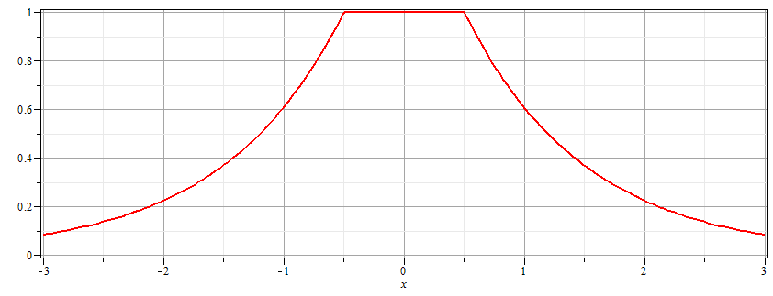
Josephson junction -- continued
Supercon left
Junction
Supercon right
B_{z}
d

Slide 20
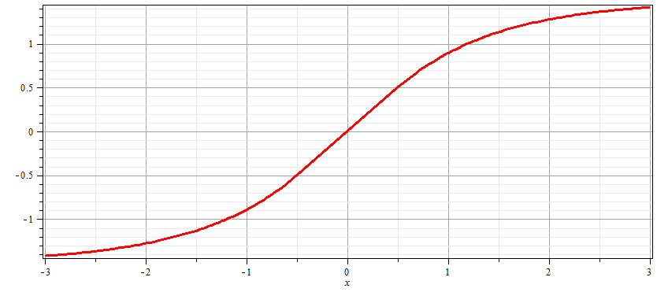
Josephson junction -- continued
Supercon left
Junction
Supercon right
A_{y}
d

Slide 21
Josephson junction -- continued
d
L
R
x
Coupling parameter

Slide 22
Josephson junction -- continued

Slide 23
Josephson junction -- continued
J_{L}
J_{R}
J_{T}
L
R
x

Slide 24
Josephson junction -- continued
J_{L}
J_{R}
J_{T}
L
R
x

Slide 25
Josephson junction -- continued
J_{L}
J_{R}
J_{T}
L
R
x

Slide 26
Josephson junction -- continued
Supercon left
Junction
Supercon right
A_{y}
d

Slide 27
Josephson junction -- continued
J_{L}
J_{R}
J_{T}
L
R
x
B_{z}

Slide 28
Josephson junction -- continued
J_{L}
J_{R}
J_{T}
L
R
w
w
x

Slide 29
Josephson junction -- continued
J_{L}
J_{R}
J_{T}
L
R
w
w
x

Slide 30
Josephson junction -- continued
d
J_{L}
J_{R}
J_{T}
L
R
w
w
x
B_{z}

Slide 31
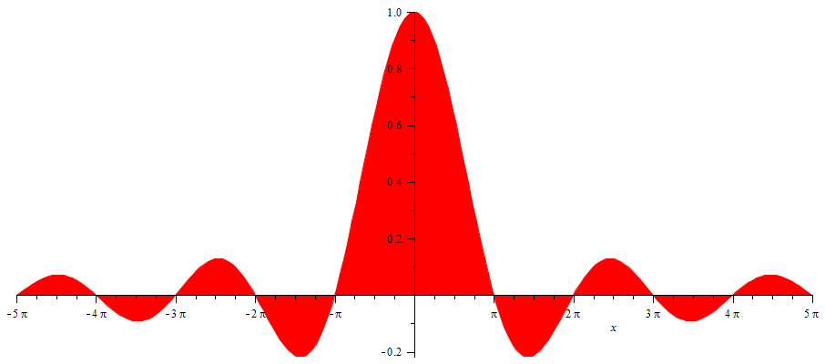
Josephson junction -- continued
SQUID =superconducting quantum interference device
I_{T}
Φ/Φ₀
Note: This very sensitive “SQUID” technology has been used in scanning probe techniques. See for example, J. R. Kirtley, Rep. Prog. Physics 73, 126501 (2010).

Slide 32
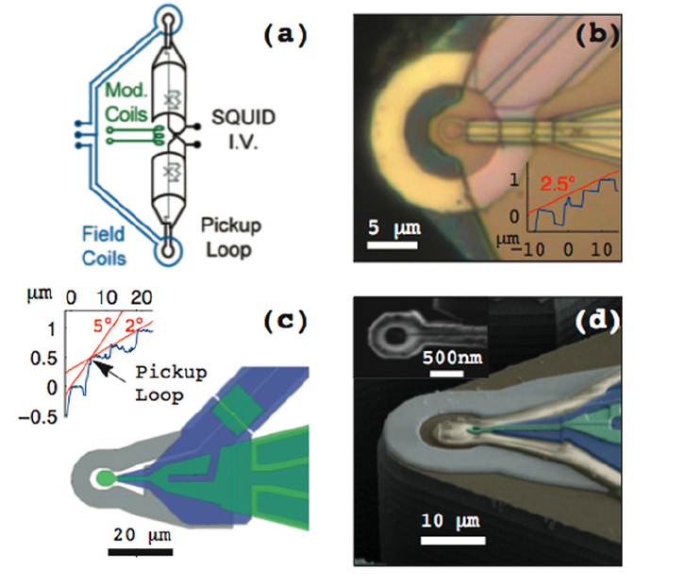
Scanning SQIUD microscopy
Ref. J. R. Kirtley, Rep. Prog. Phys. 73 126501 (2010)

Slide 33
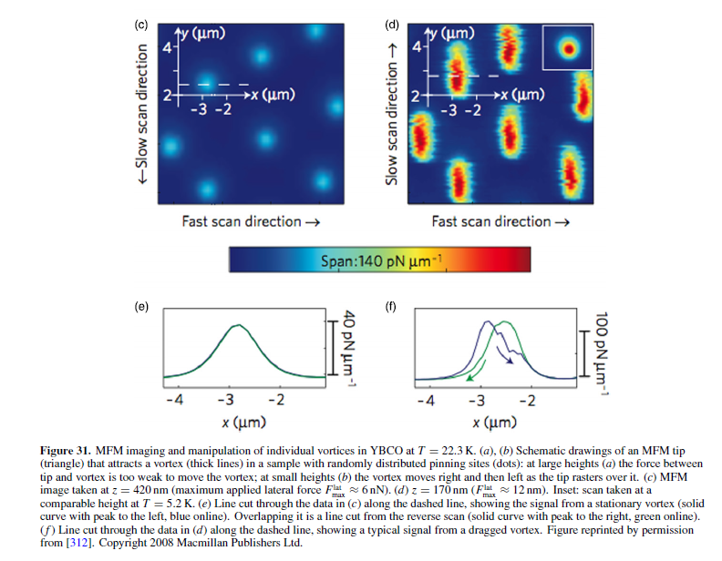

Slide 34
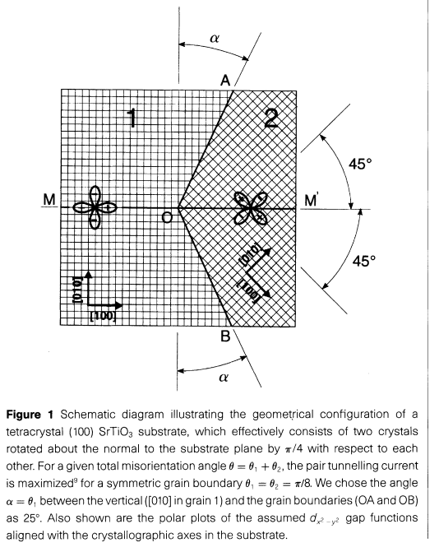
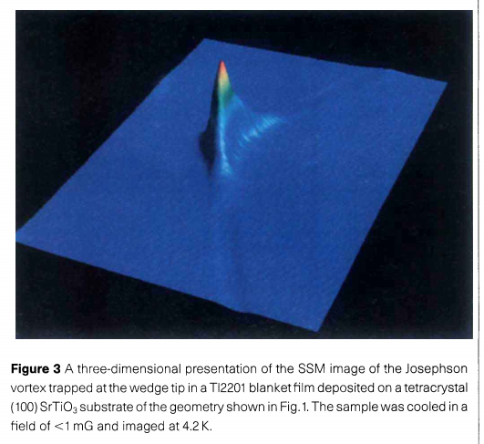
pg. 481

