Slide 1
PHY 712 Electrodynamics
9-9:50 AM MWF Olin 105
Plan for Lecture 27:
Finish Chap. 11 and begin Chap. 14
Electromagnetic field transformations & corresponding analysis using Liénard-Wiechert potentials for constant velocity sources
Radiation by moving charged particles

Slide 2
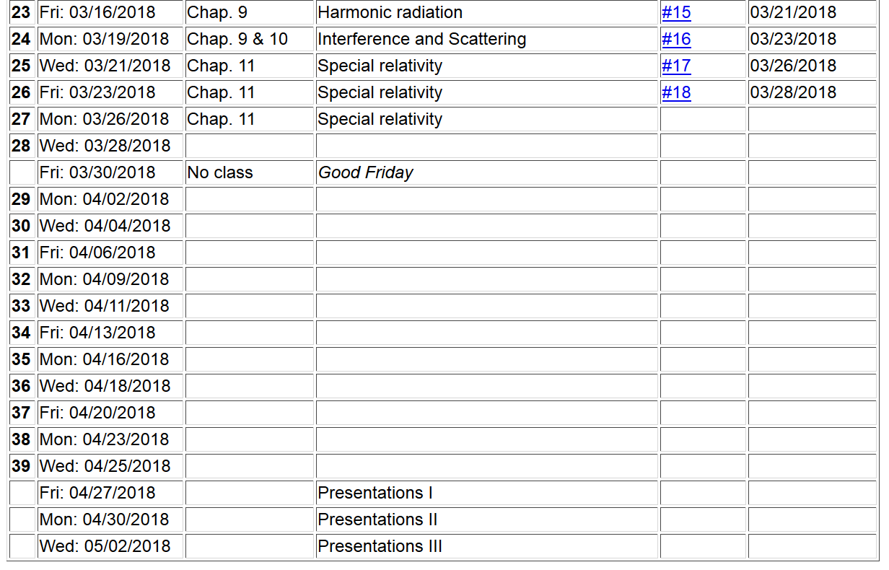

Slide 3
Inverse transformation of field strength tensor

Slide 4
Example:
y
y’
v
b
q
x
x’
z
z’

Slide 5
Example:
y
y’
v
b
q
x
x’
z
z’

Slide 6
Example:
y
y’
v
b
q
x
x’
z
z’
Expression in terms of consistent coordinates

Slide 7
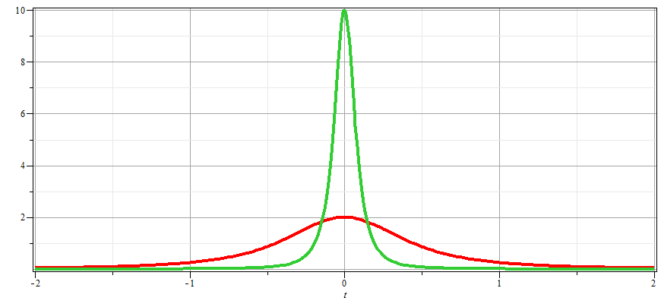
γ_{v}=10
γ_{v}=2

Slide 8
Examination of this system from the viewpoint of the
the Liènard-Wiechert potentials –(Gaussian units)

Slide 9
Examination of this system from the viewpoint of the
the Liènard-Wiechert potentials –(Gaussian units)

Slide 10
Some details

Slide 11
Some details continued:

Slide 12
Radiation from a moving charged particle
z
r-R_{q}(t)
q
r
R_{q}(t)
y
x

Slide 13
Liénard-Wiechert fields (cgs Gaussian units):

Slide 14
Electric field far from source:

Slide 15
Poynting vector:

Slide 16
Power radiated

Slide 17
Radiation from a moving charged particle
z
.
v
r-R_{q}(t_{r})=R
q
Θ
r
R_{q}(t)
y
x

Slide 18
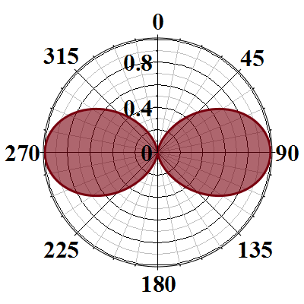
Radiation power in non-relativistic case -- continued

