Slide 1
PHY 712 Electrodynamics
9-9:50 AM MWF Olin 105
Plan for Lecture 24:
Complete reading of Chap. 9 & 10
Superposition of radiation
Scattered radiation

Slide 2
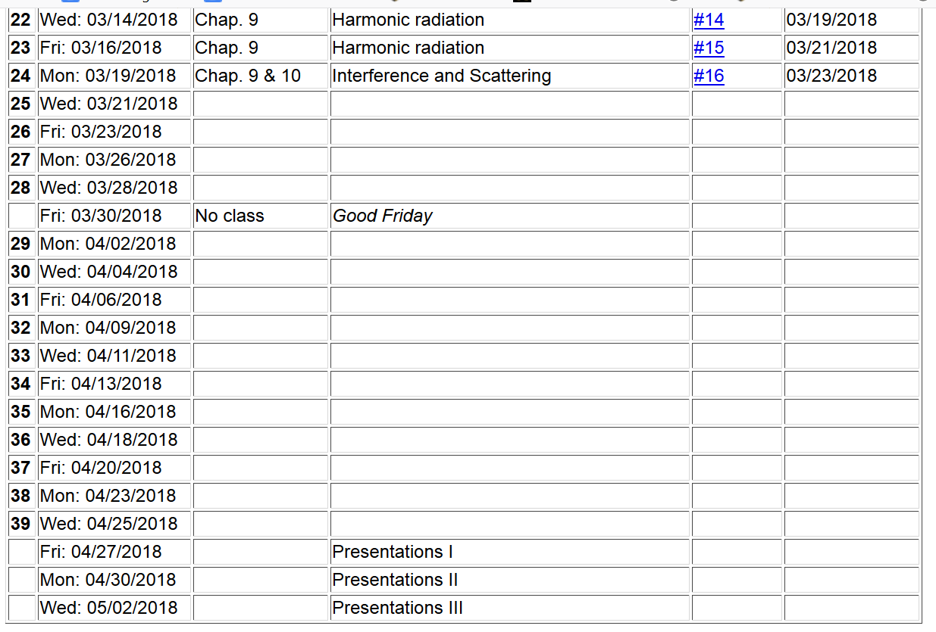

Slide 3
Electromagnetic waves from time harmonic sources – review:

Slide 4
Consider antenna source (center-fed)
Note – these notes differ from previous formulation d/2 ←→ d
r
z
d
θ
φ
y
d
x
4

Slide 5
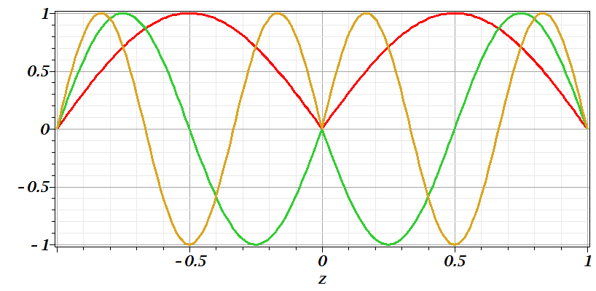
Consider antenna source -- continued
n=1
n=2
n=3

Slide 6
Consider antenna source -- continued

Slide 7
Consider antenna source -- continued

Slide 8
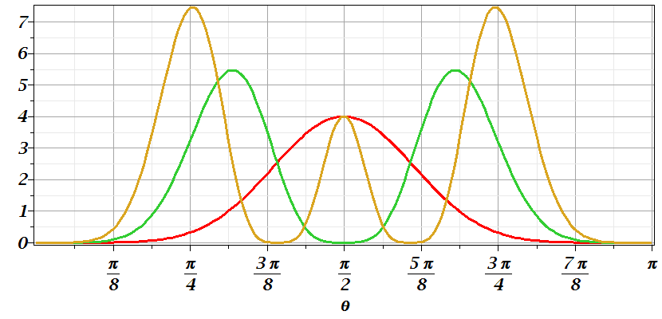
Consider antenna source -- continued
n=1
n=2
n=3

Slide 9
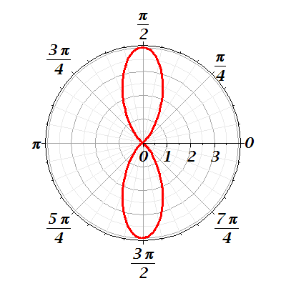
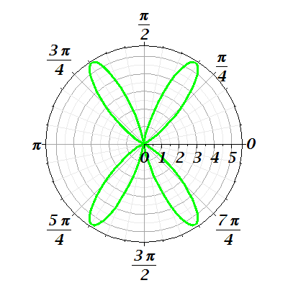
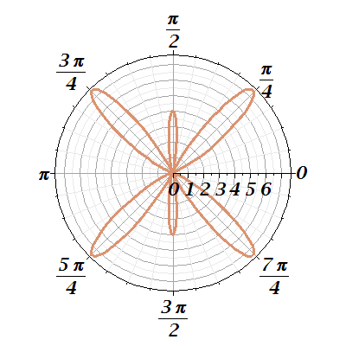
Consider antenna source -- continued
n=1
n=2
n=3

Slide 10
Radiation from antenna arrays
z
y
θ
φ
2d
x
a

Slide 11
Radiation from antenna arrays -- continued

Slide 12
Radiation from antenna arrays -- continued
N=2;a=d/2; φ=0
N=0
N=2;a=d; φ=0

Slide 13
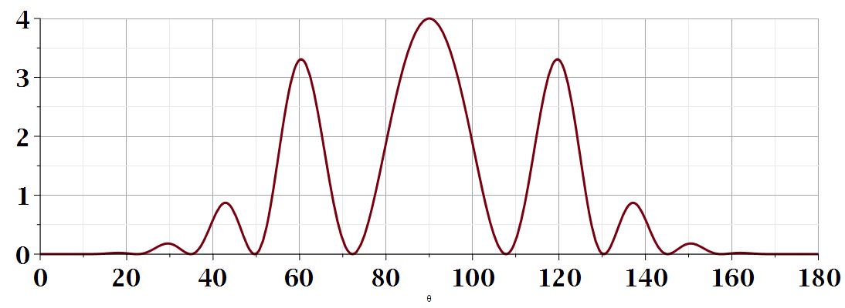
θ
Additional amplitude patterns can be obtained by controlling relative phases of antennas.

Slide 14
Brief introduction to multipole expansion of electromagnetic fields (Chap. 9.7)

Slide 15
Multipole expansion of electromagnetic fields -- continued

Slide 16
Multipole expansion of electromagnetic fields -- continued
spherical Bessel function
spherical Bessel function

Slide 17
Multipole expansion of electromagnetic fields -- continued

Slide 18
Multipole expansion of electromagnetic fields -- continued

Slide 19
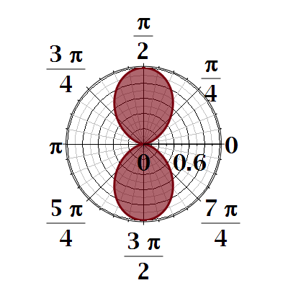
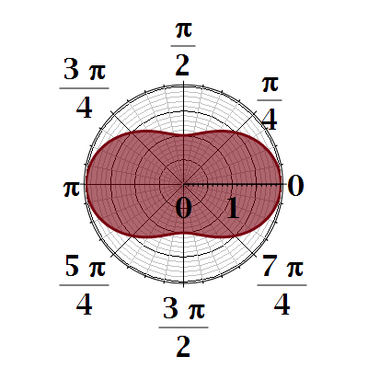

Slide 20
