Slide 1
PHY 712 Electrodynamics
9-9:50 AM MWF Olin 105
Plan for Lecture 11:
Review of Electrostatics - Chapters 1-4
Homework problems and related
Questions

Slide 2
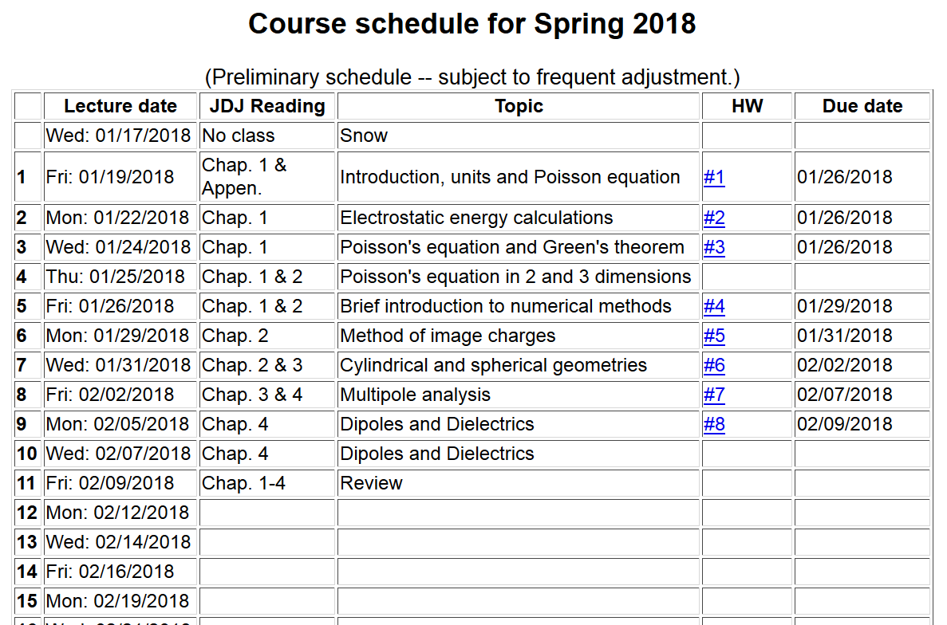

Slide 3
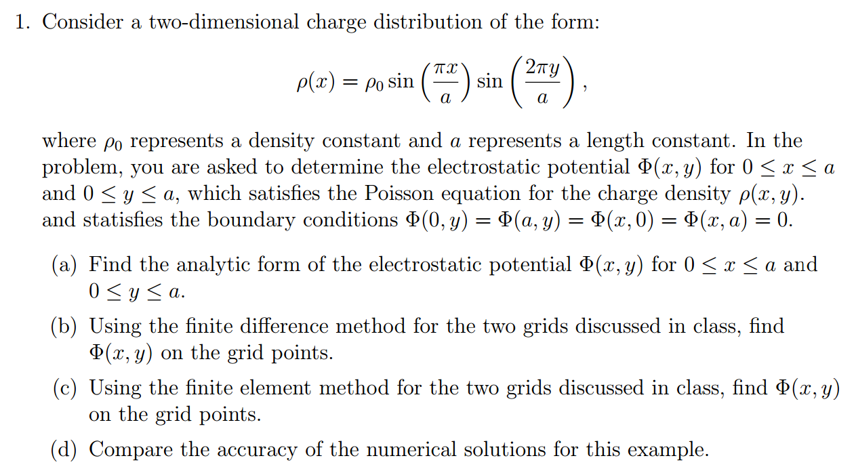
HW #4

Slide 4
Solution by finite difference method --

Slide 5
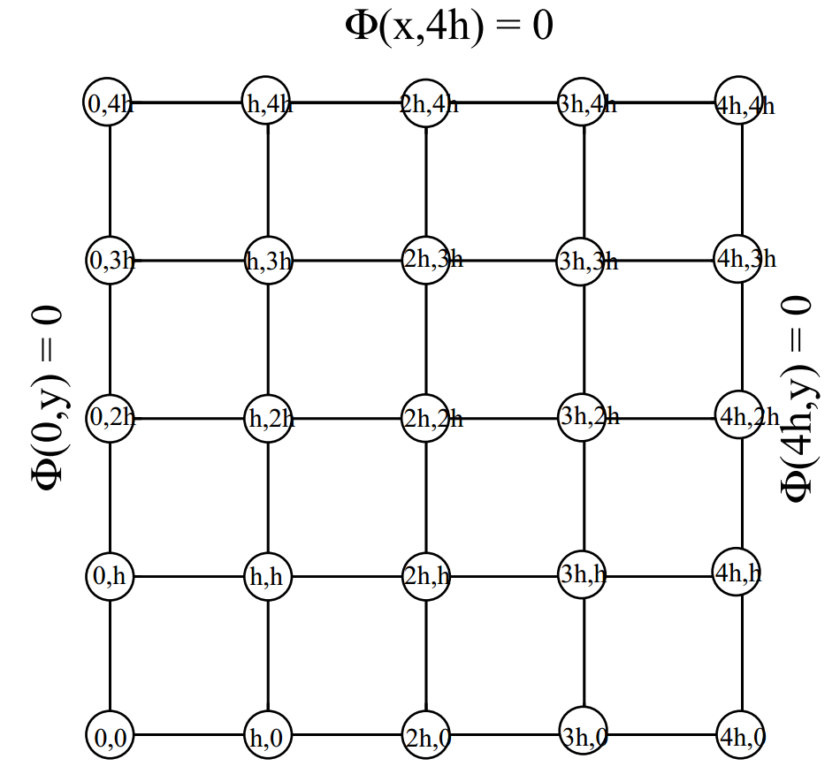
Algorithm:

Slide 6
In our case:

Slide 7
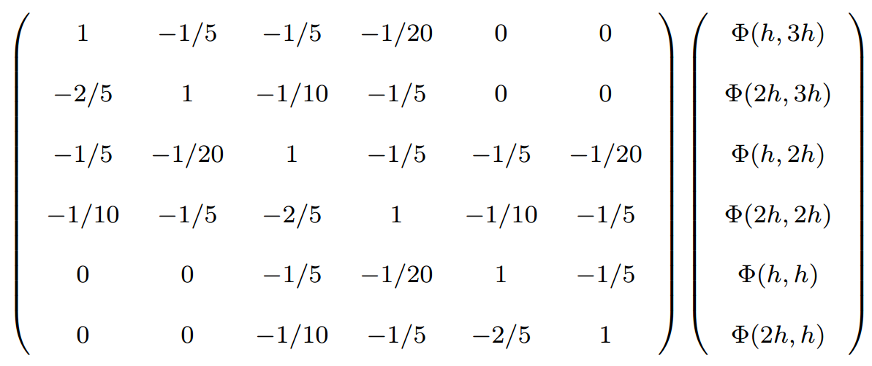
For Maple: >with(LinearAlgebra)
>evalm(MatrixInverse(LHS).RHS)

Slide 8
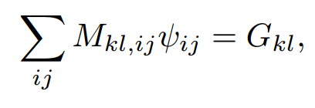
Solution by finite element method --

Slide 9
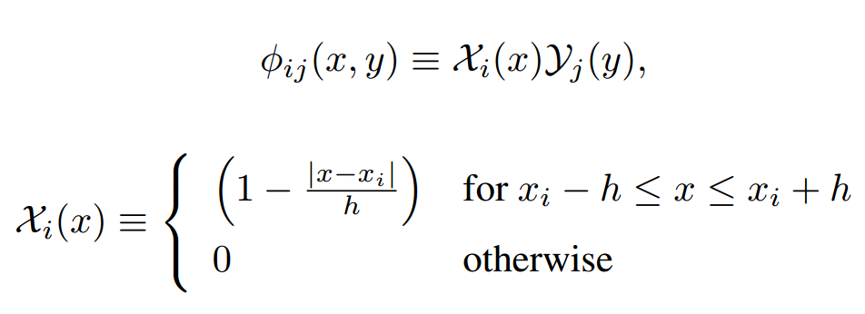

Slide 10
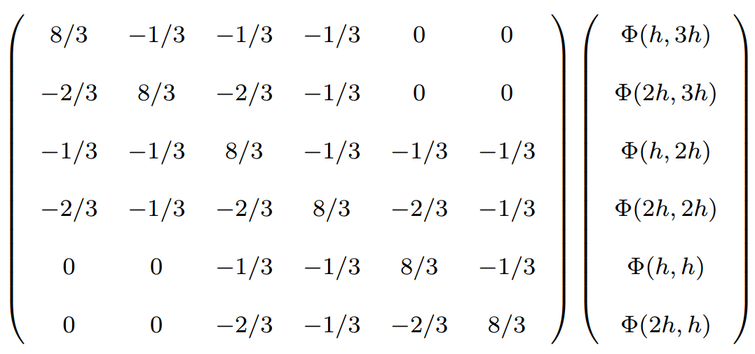

Slide 11
HW #5
Find total surface charge for d>a and for d<a
A grounded metal sphere of radius a, in the presence of a point charge q at a distance d from its center.
r
a
d
q

Slide 12
For d>a
r
a
d
q

Slide 13
For d<a
a
r
d
q

Slide 14
HW#6
top view
a
b

Slide 16
HW #7

