Slide 1
PHY 745 Group Theory
11-11:50 AM MWF Olin 102
Plan for Lecture 26:
Group theory and intrinsic spin; specifically, s=1/2
Dirac equation for hydrogen atom
Spin-orbit interaction*
Double groups*
*Chapter 14 in DDJ

Slide 2
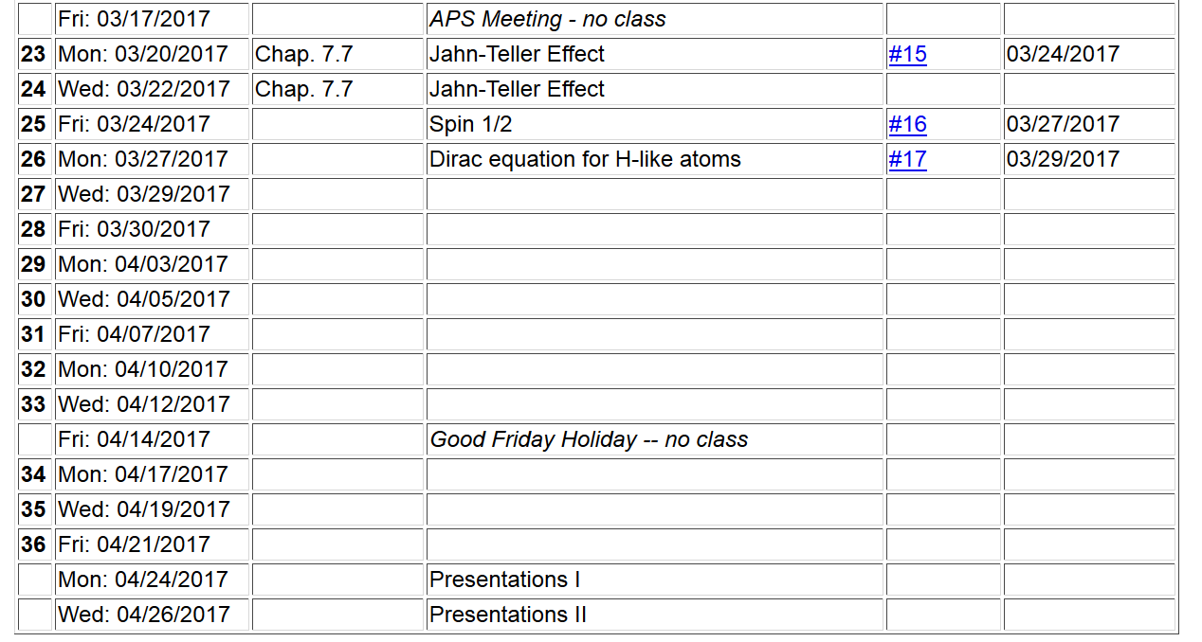

Slide 3
Dirac equation for describing the quantum mechanics of an electron
Four-component Dirac Hamiltonian for an electron in a spherically symmetric scalar potential V(r):

Slide 4
Other useful four-component matrices:
The following commutation relations can be shown:
In principle, it is possible to have eigenstates that are simultaneously diagonal in H, K, J², and J_{z}, but K and J² are closely related.

Slide 9
Eigenfunctions of Dirac Hamiltonian for spherical potential
Relationships between eigenvalues

Slide 16
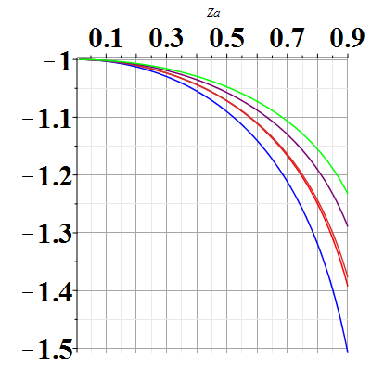
Evaluating the coefficients of the polynomial of order N
Zα
n=5
κ=1
n=1

Slide 17
Note that for a given principal quantum number n, the energies for +κ and –κ are degenerate.
For n=1, κ=-1:

Slide 18
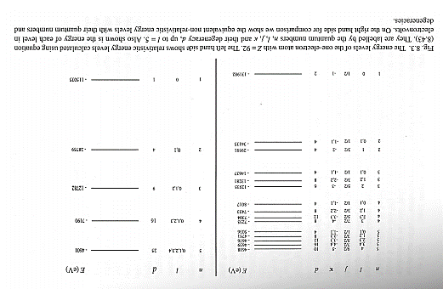
Paul Strange, “Relativistic Quantum Mechanics”, Cambridge U. Press (1998), pg. 241

Slide 19
Summary of results for solution of Dirac equation for H-like ion

