Slide 1
PHY 745 Group Theory
11-11:50 AM MWF Olin 102
Plan for Lecture 17:
Group theory for the periodic lattice
Reading: Chapter 10 in DDJ
Bloch Theorem and reciprocal space
Group theory for reciprocal space
Examples
This lecture contains some materials from an electronic version of the DDJ text.

Slide 2
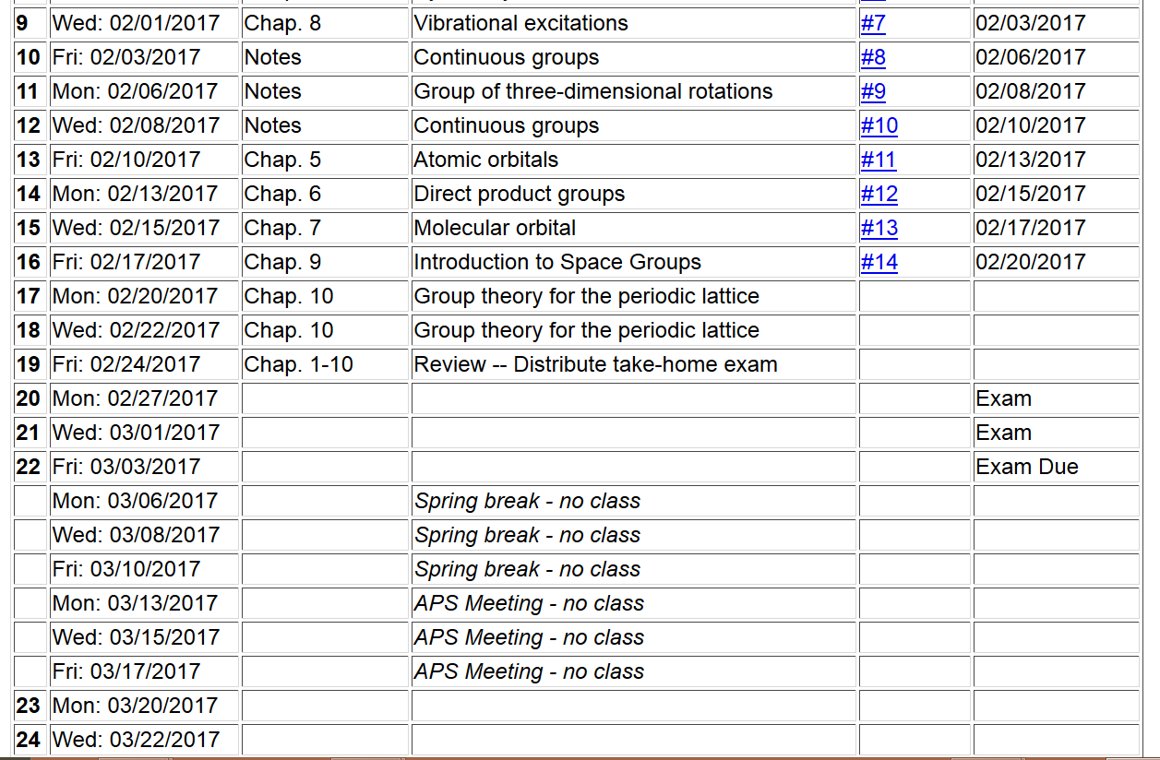

Slide 3
Space group
Non-lattice translation
Lattice translation
Point operation

Slide 4
V(x)
Periodic Hamiltonian
x

Slide 6
Example
Simple cubic lattice in real space:
a
2π/a
a
2π/a
a
2π/a

Slide 8
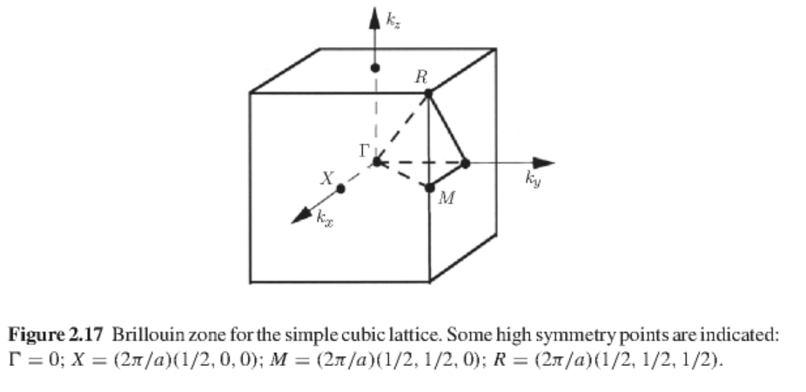
Unit cells of reciprocal space – Brillouin zones
➔simple cubic lattice

Slide 9
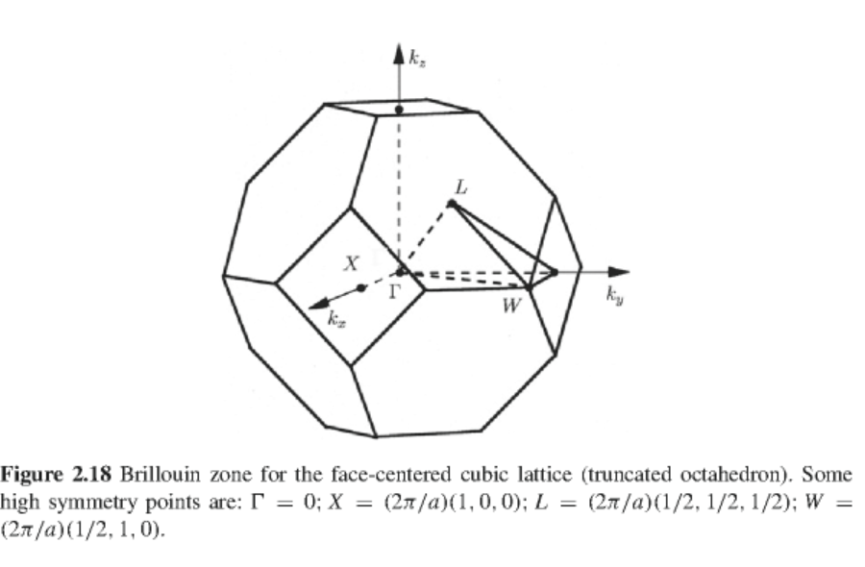
Unit cells of reciprocal space – Brillouin zones
➔face-centered cubic lattice

Slide 10
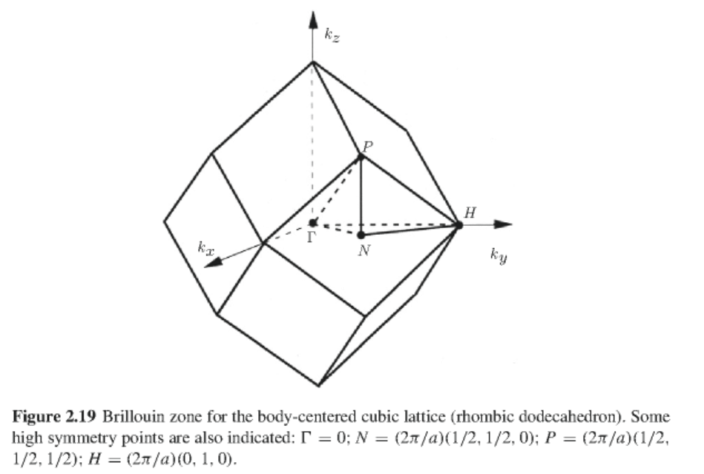
Unit cells of reciprocal space – Brillouin zones
➔body-centered cubic lattice

Slide 11
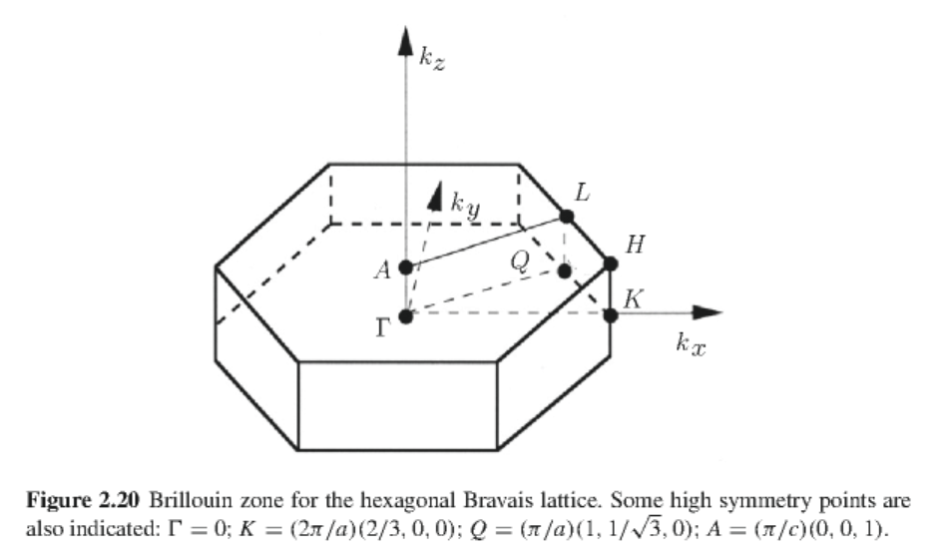
Unit cells of reciprocal space – Brillouin zones
➔hexagonal lattice

Slide 12
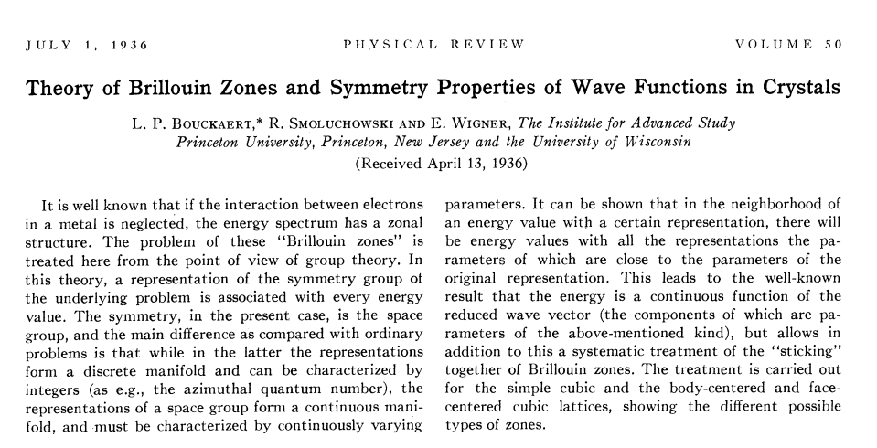

Slide 13
Effects of space group operations on Bloch functions

Slide 14
The symmetry of the wavefunction depends on k
For each k, the spatial point symmetries must be considered.

Slide 15
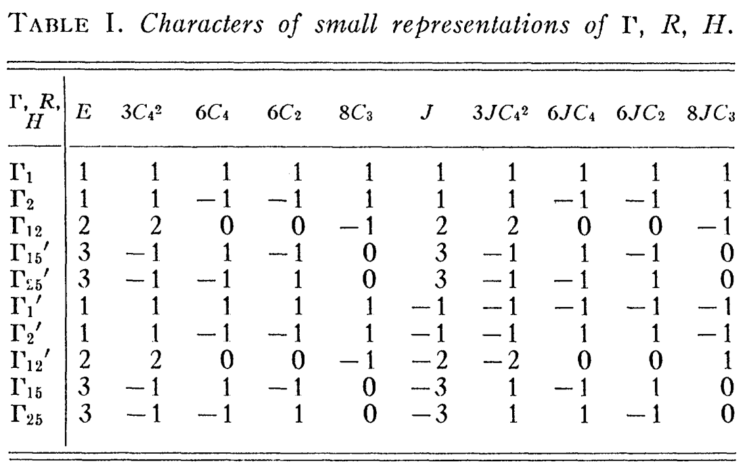
k=0 in a cubic crystal

Slide 16
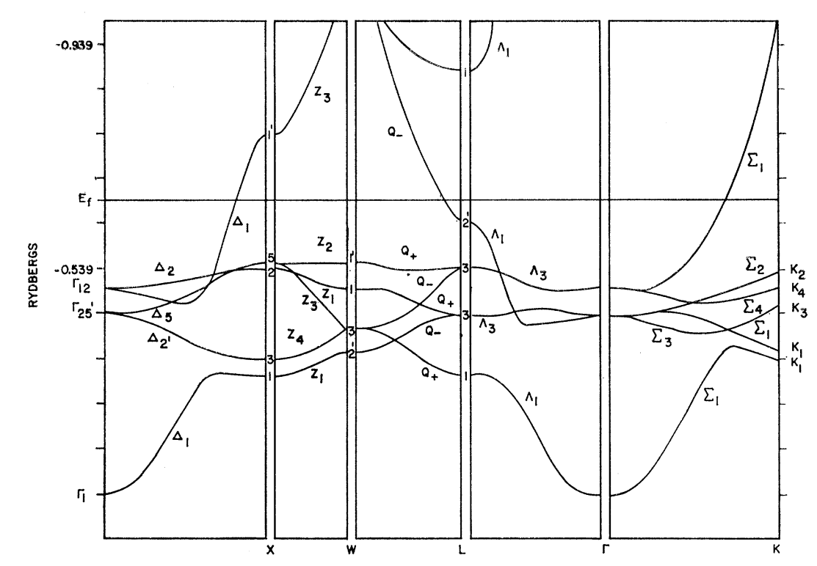
Band structure diagram for fcc Cu (Burdick, PR 129 138-159 (1963))

