Slide 1
PHY 745 Group Theory
11-11:50 AM MWF Olin 102
Plan for Lecture 11:
Introduction to groups having infinite dimension
Reading: Eric Carlson’s lecture notes
Additional reference: Symmetry Principles.. Melvin Lax, Wiley (1964)
3-dimensional rotation group
Generators of the group
Algebraic relationships

Slide 2
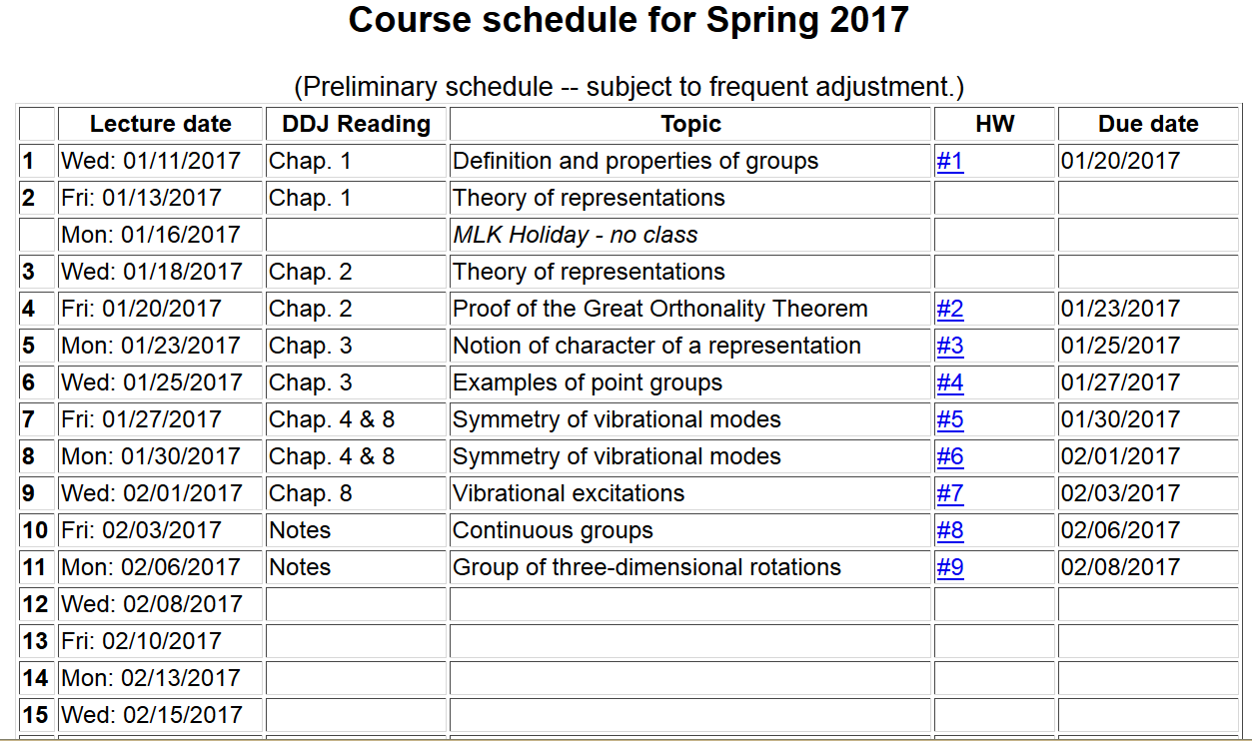

Slide 3
Notion of a generator for the three-dimensional rotation group
Consider rotation by an angle α about the z-axis
y
α
φ
x

Slide 5
Connection to angular momentum in quantum theory

Slide 6
Generator operator for rotations -- continued

Slide 7
Commuter relations for rotation generator operators

Slide 8
Irreducible representations in terms of angular momentum eigenfunctions
The group of 3-dimensional rotations about a point is called SO(3).

Slide 9
Group of all unitary matrices of dimension 2 – SU(2)

Slide 10
Group of all unitary matrices of dimension 2 – SU(2) --continued

Slide 11
Generalization of angular momentum to include ½ integers

Slide 12
Irreducible representations in terms of angular momentum-spin eigenfunctions

