Slide 1
PHY 712 Electrodynamics
9-9:50 AM Olin 103
Plan for Lecture 21:
Chap. 8 in Jackson – Wave Guides
Electromagnetic waves near an ideal conductor
Electromagnetic waves within an ideal rectangular wave guide

Slide 2
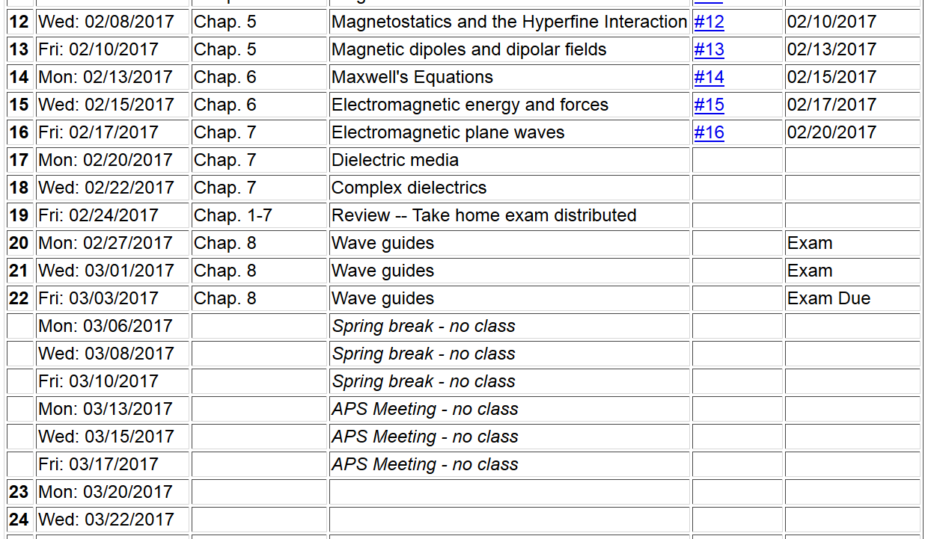

Slide 4
Fields near the surface on an ideal conductor

Slide 6
Fields near the surface on an ideal conductor -- continued

Slide 7
Some representative values of skin depth
Ref: Lorrain² and Corson
 | σ (10⁷ S/m) | μ/μ₀ | δ (0.001m) at 60 Hz | δ (0.001m) at 1 MHz
Al | 3.54 | 1 | 10.9 | 84.6
Cu | 5.80 | 1 | 8.5 | 66.1
Fe | 1.00 | 100 | 1.0 | 10.0
Mumetal | 0.16 | 2000 | 0.4 | 3.0
Zn | 1.86 | 1 | 15.1 | 117

Slide 8
Relative energies associated with field

Slide 9
Fields near the surface on an ideal conductor -- continued
r||
0
z

Slide 10
Fields near the surface on an ideal conductor -- continued
r||
0
z

Slide 11
Boundary values for ideal conductor
At the boundary of an ideal conductor, the E and H fields decay in the direction normal to the interface.
H₀

Slide 12
Waveguide terminology
TEM: transverse electric and magnetic (both E and H fields are perpendicular to wave propagation direction)
TM: transverse magnetic (H field is perpendicular to wave propagation direction)
TE: transverse electric (E field is perpendicular to wave propagation direction)

Slide 13
Analysis of rectangular waveguide
Boundary conditions at surface of waveguide:
E_{tangential}=0, B_{normal}=0
y
x
z
Cross section view
b
a

Slide 14
Analysis of rectangular waveguide
y
x
z

Slide 15
Solution of Maxwell’s equations within the pipe:

Slide 16
Maxwell’s equations within the pipe in terms of all 6 components:

Slide 17
TE modes for retangular wave guide continued:

Slide 18
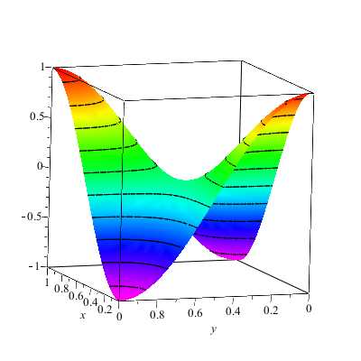
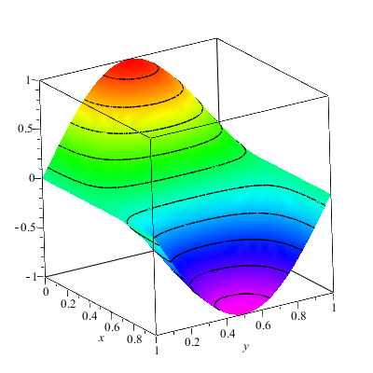
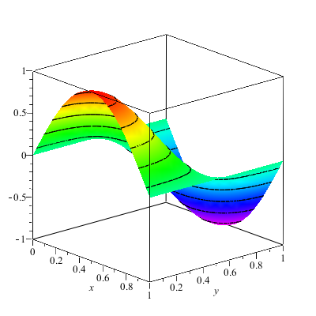
Solution for m=n=1

Slide 19
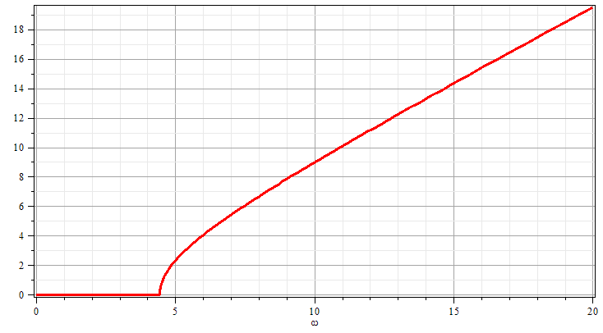
Solution for m=n=1
k
ω

Slide 20
Resonant cavity
y
x
z
20

Slide 21
Resonant cavity
y
x
z

