Slide 1
PHY 712 Electrodynamics
9-9:50 AM Olin 103
Plan for Lecture 20:
Chap. 8 in Jackson – Wave Guides
TEM, TE, and TM modes
Justification for boundary conditions; behavior of waves near conducting surfaces

Slide 2
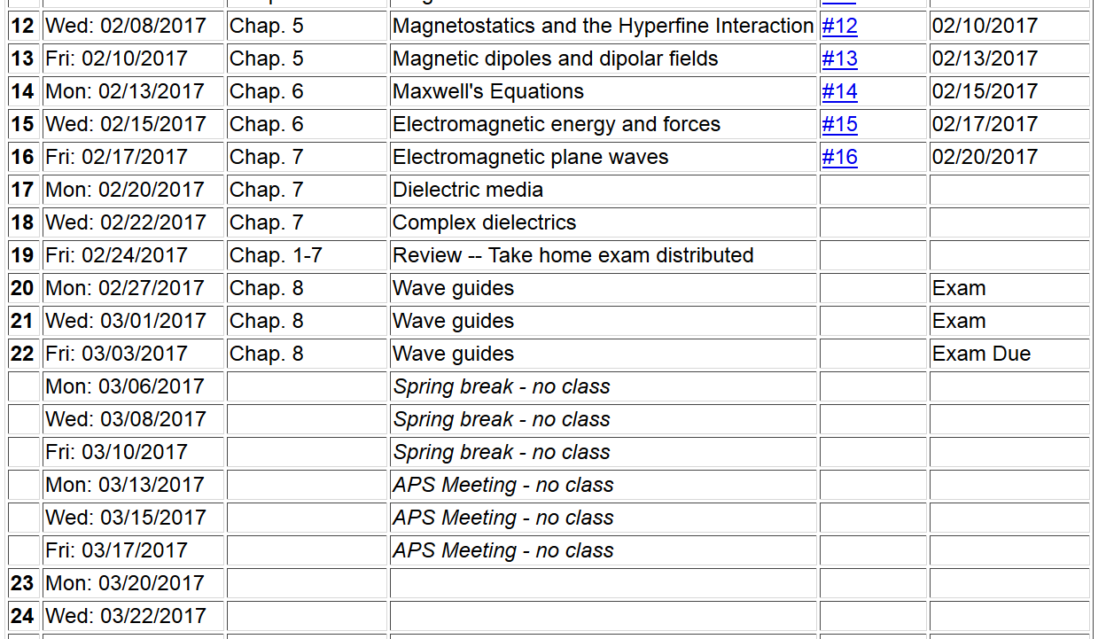

Slide 3
Maxwell’s equations

Slide 4
Analysis of Maxwell’s equations without sources -- continued:

Slide 5
Analysis of Maxwell’s equations without sources -- continued:
Both E and B fields are solutions to a wave equation:

Slide 6
Analysis of Maxwell’s equations without sources -- continued:
Note: ε, μ, n, k can all be complex; for the moment we will assume that they are all real (no dissipation).

Slide 7
Analysis of Maxwell’s equations without sources -- continued:
E₀
B₀
k

Slide 8
Transverse electric and magnetic waves (TEM)
TEM modes describe electromagnetic waves in lossless media and vacuum
E₀
B₀
k

Slide 9
In the vicinity of ideal conducting media, the electromagnetic response is affected.
H₀

Slide 10
Wave guides
Coaxial cable
TEM modes
Simple optical pipe
TE or TM modes
Waveguide terminology
TEM: transverse electric and magnetic (both E and H fields are perpendicular to wave propagation direction)
TM: transverse magnetic (H field is perpendicular to wave propagation direction)
TE: transverse electric (E field is perpendicular to wave propagation direction)

Slide 11
Wave guides
Top view:
z
μ ε
Inside medium, μ ε assumed to be real
a
b
Coaxial cable
TEM modes
(following problem 8.2 in Jackson’s text)

Slide 12
Electromagnetic waves in a coaxial cable -- continued
Top view:
μ ε
ρ
a
φ
b

Slide 13
Electromagnetic waves in a coaxial cable -- continued
Top view:
μ ε
ρ
a
φ
b

