Slide 1
PHY 712 Electrodynamics
9-9:50 AM MWF Olin 103
Plan for Lecture 11:
Start reading Chapter 5
Magnetostatics
Vector potential
Example: current loop

Slide 2
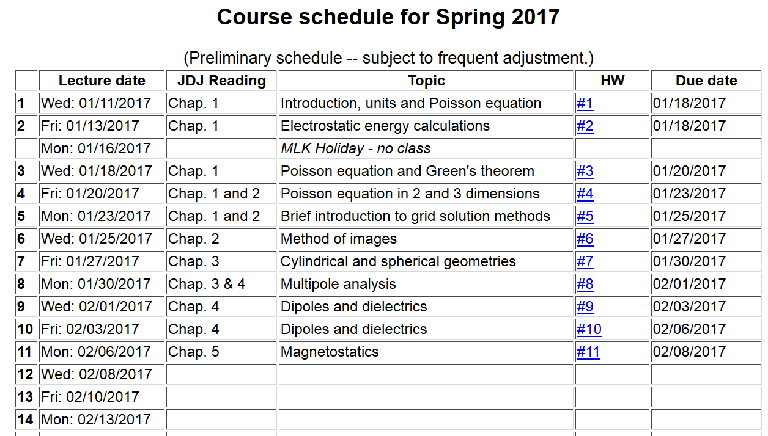

Slide 3
Magnetostatics
Magnetic flux density or magnetic induction field B
Steady state (time constant) current density J
y
q_{i}
v_{i}
r_{i}
x

Slide 4
Comparison of electrostatics and magnetostatics

Slide 5
Alternative forms magnetostatic equations

Slide 6
Alternative forms magnetostatic equations -- continued

Slide 7
Differential forms of magnetostatic equations:
Magnetostatic vector potential

Slide 8
Non uniqueness of the magnetostatic vector potential

Slide 9
Differential form of Ampere’s law in terms of vector potential:

Slide 10
Magnetostatics example: current loop
z
r
y
x

Slide 11
Magnetostatics example: current loop -- continued

Slide 12
Magnetostatics example: current loop -- continued

Slide 13
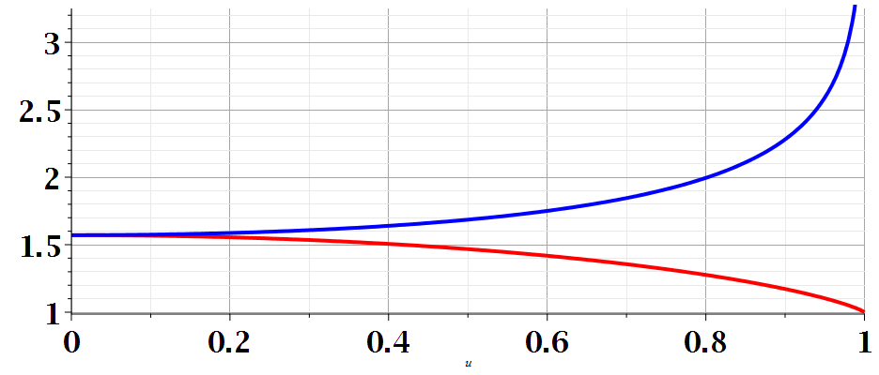
m

Slide 14
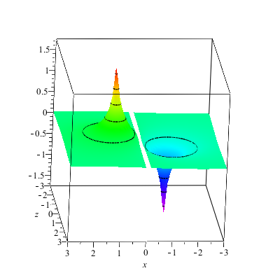
Magnetostatics example: current loop -- continued
A_{y}(x,z)

Slide 15
Magnetostatics example: current loop -- continued
Evaluation for special cases

Slide 16
Evaluation for special case k² → 0

Slide 17
Evaluation for special case k² → 0

Slide 18
Magnetostatics example: current loop -- continued

Slide 19
Other examples of current density sources:

Slide 20
Magnetic vector potential for this case:

