Slide 1
PHY 712 Electrodynamics
9-9:50 AM MWF Olin 103
Plan for Lecture 6:
Continue reading Chapter 2
Methods of images -- planes, spheres
Solution of Poisson equation in for other geometries -- cylindrical

Slide 2
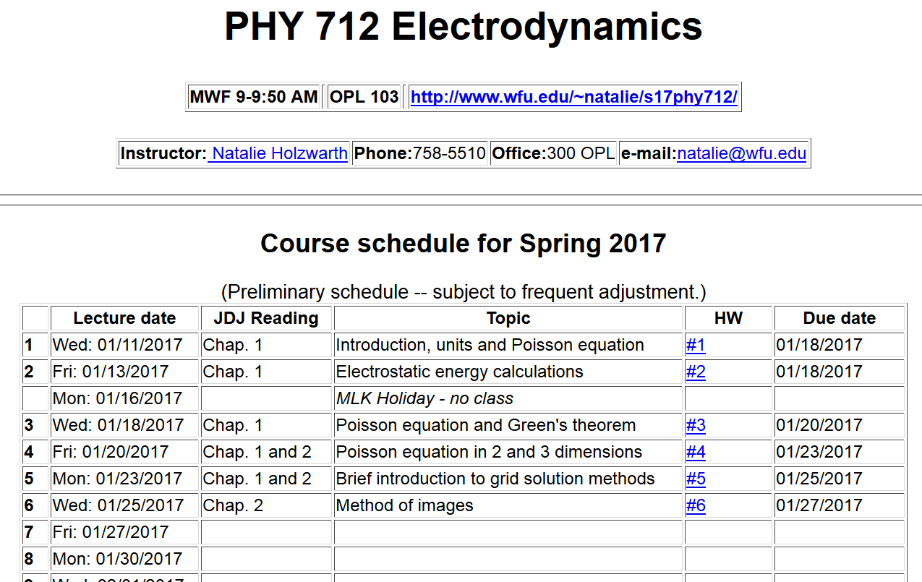

Slide 4
Survey of mathematical techniques for analyzing electrostatics – the Poisson equation
Direct integration of differential equation
Green’s function techniques
Orthogonal function expansions
Numerical methods (finite differences and finite element methods)
Method of images

Slide 5
Method of images
Clever trick for specialized geometries:
Flat plane (surface)
Sphere
Planar case:
Consider a grounded metal sheet, a distance d from a point charge q.
q
d

Slide 6
A grounded metal sheet, a distance d from a point charge q.
Mobile charges from the “ground” respond to the force from the charge q.
z
q
d
x
y

Slide 7
A grounded metal sheet, a distance d from a point charge q.

Slide 8
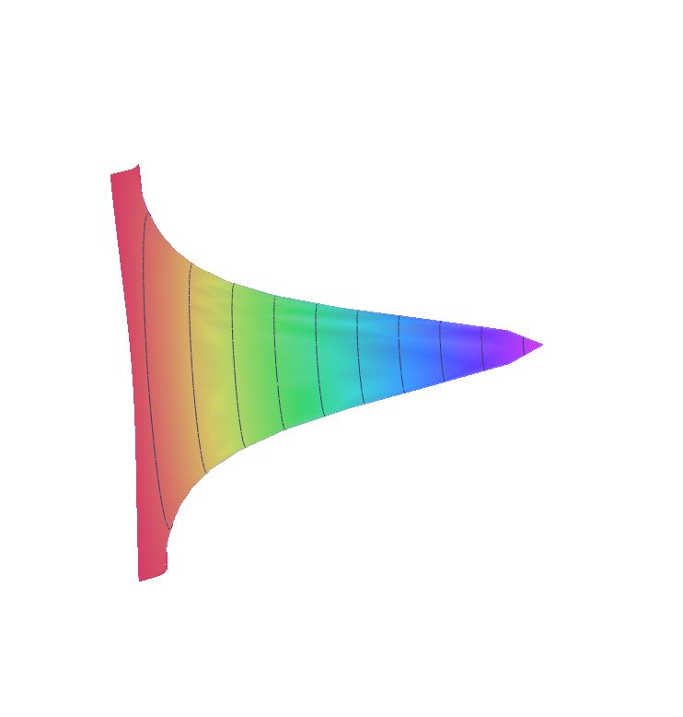
A grounded metal sheet, a distance d from a point charge q.
q
d

Slide 9
A grounded metal sheet, a distance d from a point charge q.
q
d

Slide 10
A grounded metal sphere of radius a, in the presence of a point charge q at a distance d from its center.
r
a
d
q

Slide 11
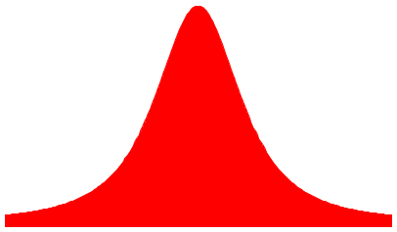
A grounded metal sphere of radius a, in the presence of a point charge q at a distance d from its center.
r
a
d
q

Slide 12
A grounded metal sphere of radius a, in the presence of a point charge q at a distance d from its center.
r
a
d
q

Slide 13
Use of image charge formalism to construct Green’s function

Slide 14
Solution of the Poisson/Laplace equation in various geometries -- cylindrical geometry with no z-dependence (infinitely long wire, for example):
φ
ρ

Slide 15
Solution of the Poisson/Laplace equation in various geometries -- cylindrical geometry with no z-dependence (infinitely long wire, for example):
φ
ρ

Slide 16
Solution of the Poisson/Laplace equation in various geometries -- cylindrical geometry with z-dependence
φ
ρ
z

Slide 17
Cylindrical geometry continued:

Slide 18
Cylindrical geometry example:

Slide 19
Cylindrical geometry example:

Slide 20
Comments on cylindrical Bessel functions
m=0
K₀
I₀/50
J₀
N₀

Slide 21
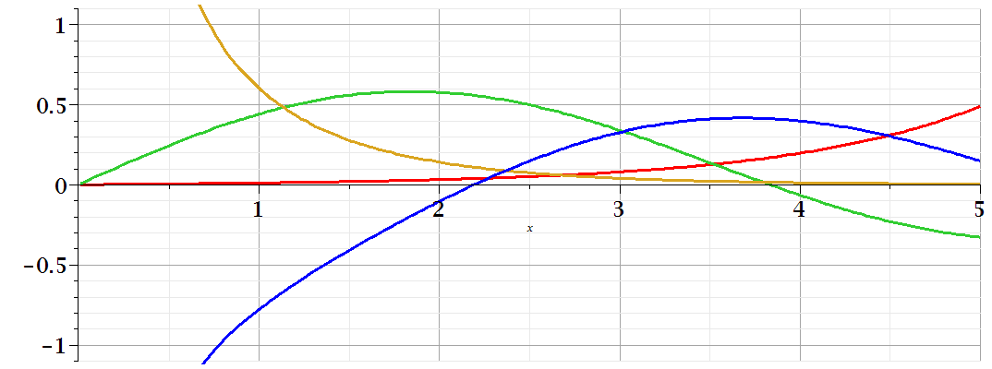
Comments on cylindrical Bessel functions
K₁
m=1
I₁/50
J₁
N₁

