Slide 1
PHY 712 Electrodynamics
9-9:50 AM MWF Olin 103
Plan for Lecture 2:
Reading: Chapter 1 (especially 1.11) in JDJ;
Ewald summation methods
Motivation
Expression to evaluate the electrostatic energy of an extended periodic system
Examples

Slide 2
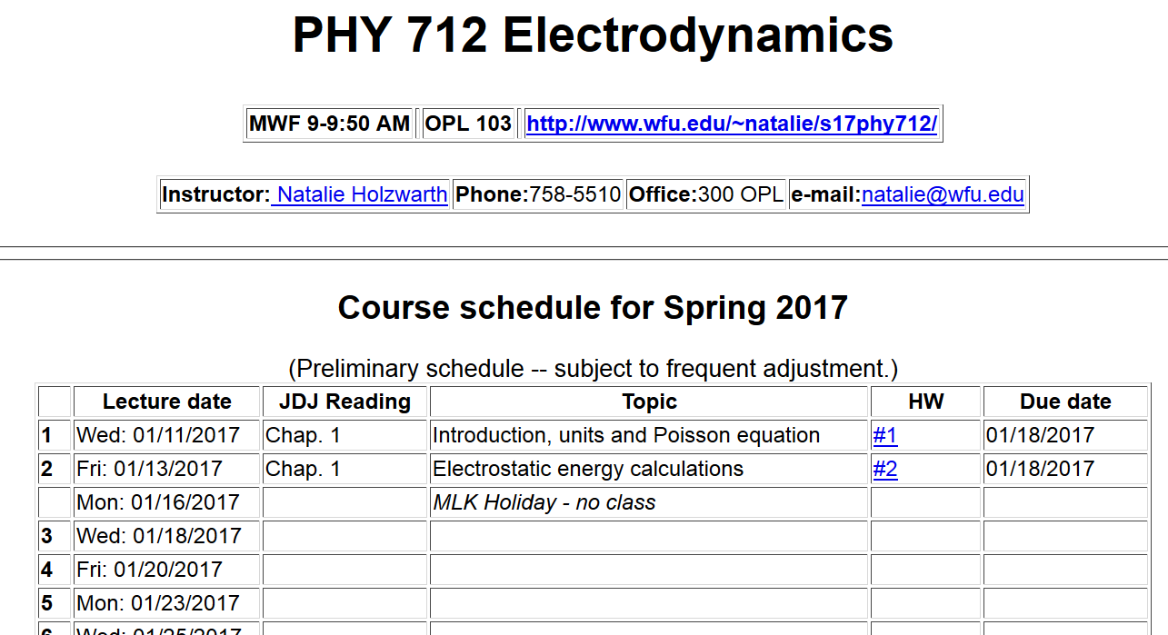

Slide 3
Ewald summation methods -- motivation

Slide 4
Ewald summation methods – slight digression
When the discrete charge distribution becomes a continuous charge density: the electrostatic energy
becomes
Notice, in this case, it is not possible to exclude the ``self-interaction''. This expression can be written in terms of the electrostatic potential

Slide 5
Evaluation of the electrostatic energy for N point charges:
Ewald summation methods – exact results for periodic systems
See lecture notes for details.

