Slide 1
PHY 712 Electrodynamics
9-9:50 AM MWF Olin 103
Plan for Lecture 1:
Reading: Appendix 1 and Chapters I&1
Course structure and expectations
Units – SI vs Gaussian
Electrostatics – Poisson equation

Slide 3
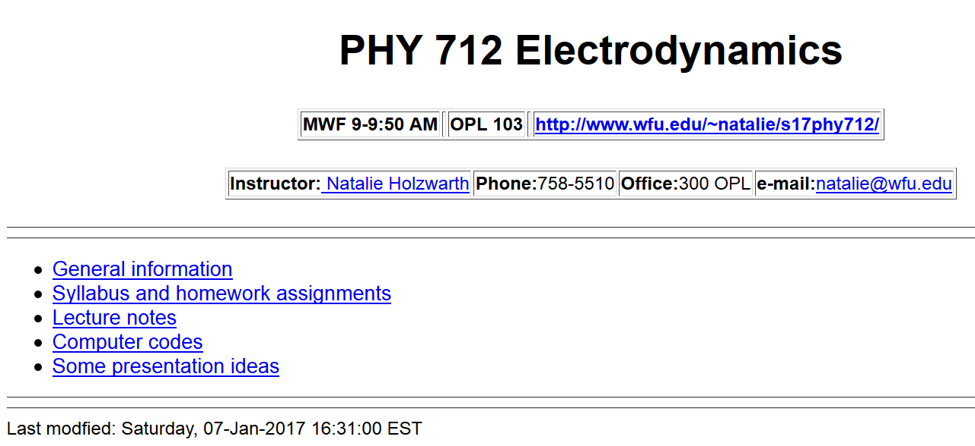
http://users.wfu.edu/natalie/s17phy712/

Slide 4
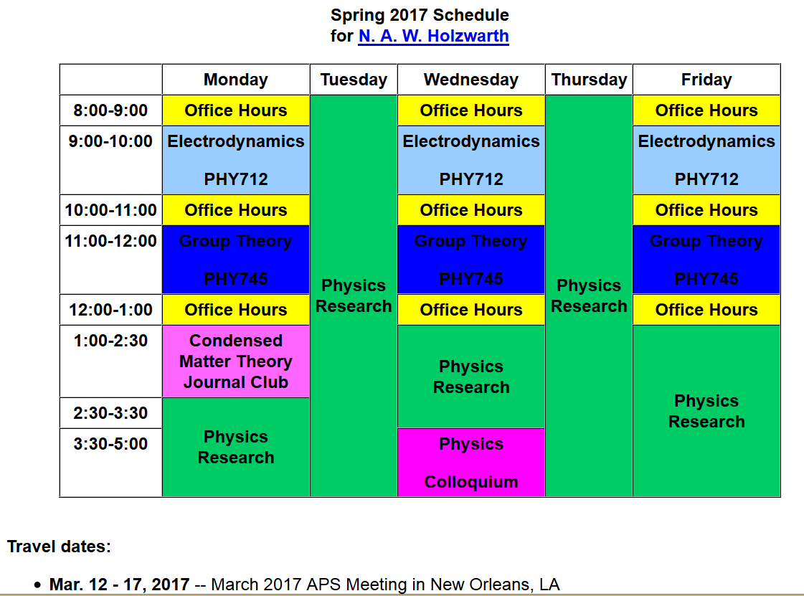

Slide 5
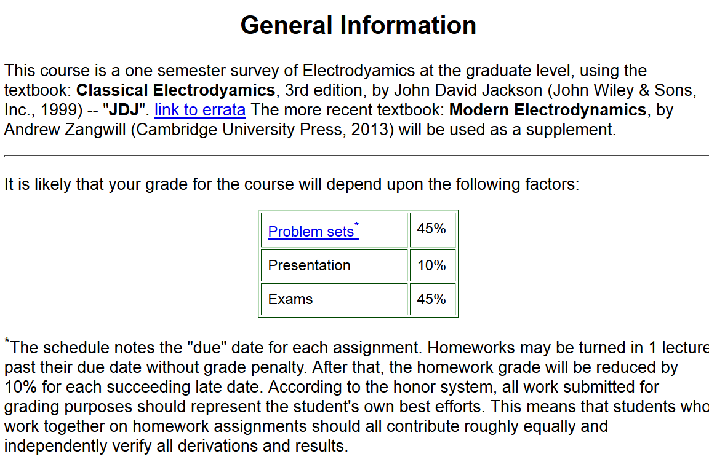

Slide 6
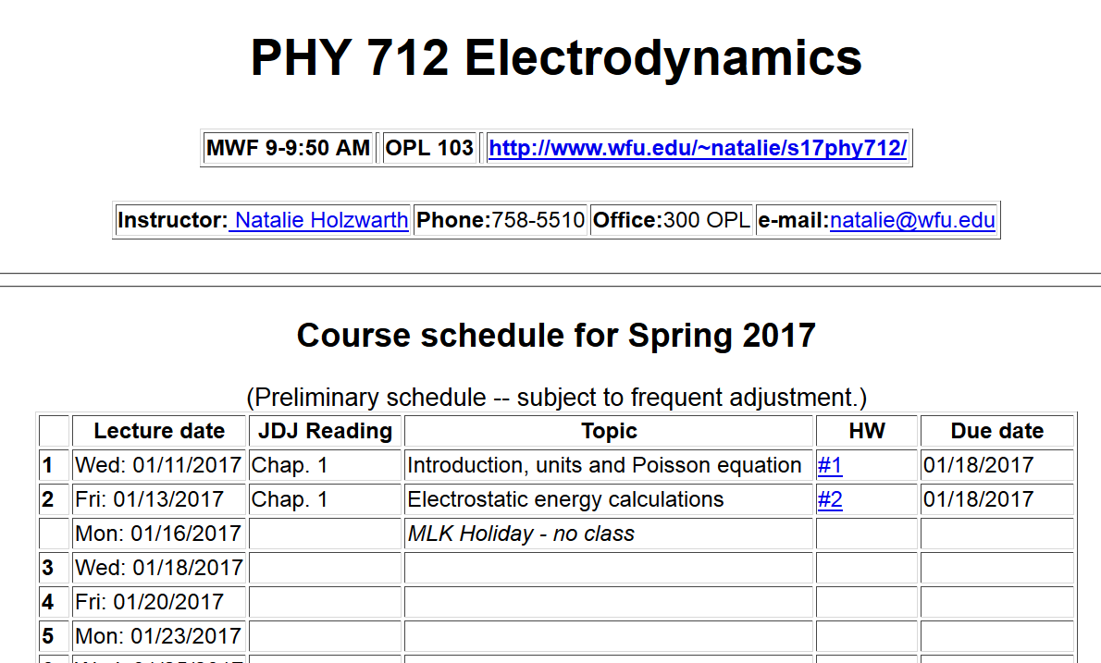

Slide 7
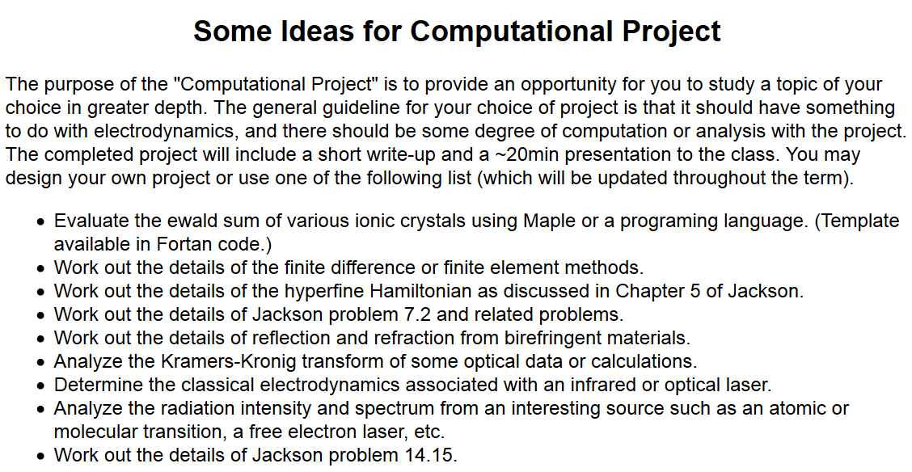

Slide 12
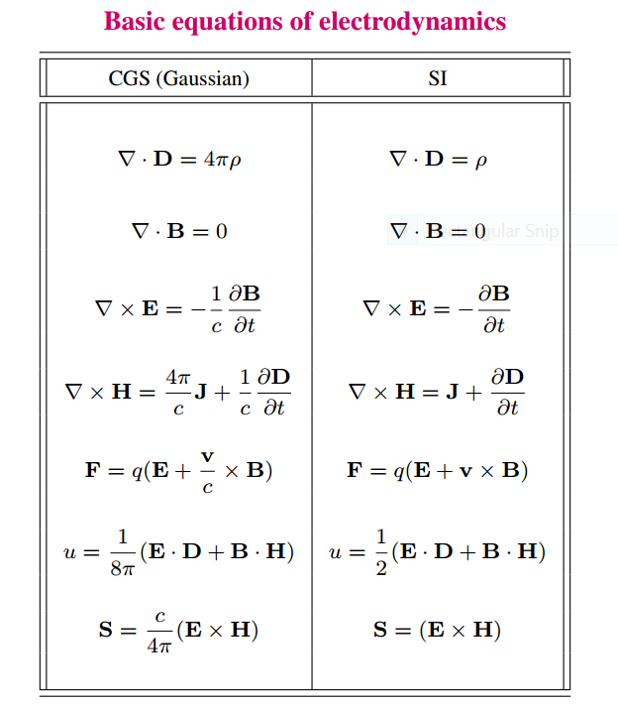

Slide 13
Units choice for this course:
SI units for Jackson in Chapters 1-10
Gaussian units for Jackson in Chapters 11-16
Electrostatics
q₂
q₁
q₃
q₄

Slide 14
Electrostatics
Discrete versus continuous charge distributions

Slide 15
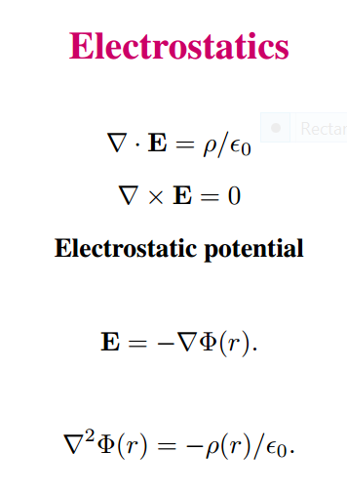
Differential equations --

Slide 16
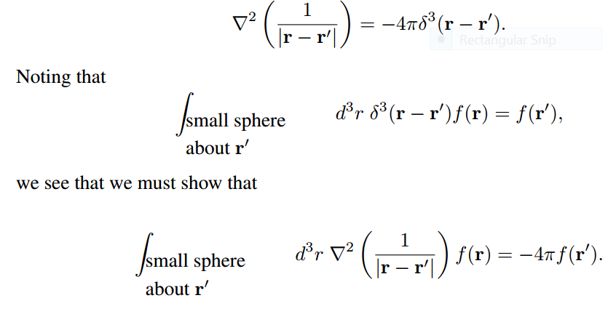
Relationship between integral and differential forms of electrostatics --
Need to show:

Slide 17
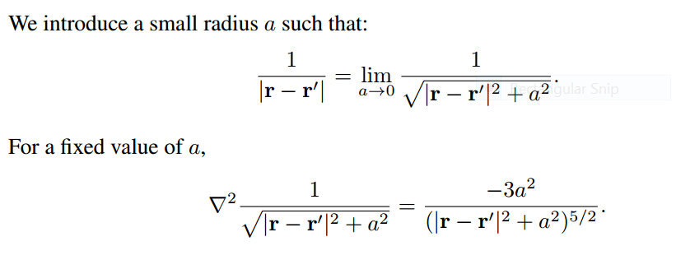

Slide 19
➔
➔

Slide 20
Example in HW1

