Slide 1
PHY 770 -- Statistical Mechanics
12:00* - 1:45 PM TR Olin 107
Instructor: Natalie Holzwarth (Olin 300)
Course Webpage: http://www.wfu.edu/~natalie/s14phy770
Lecture 20
Chap. 9 – Transport coefficients
The Boltzmann equation
Treatment of the collision term
Examples
*Partial make-up lecture -- early start time

Slide 3
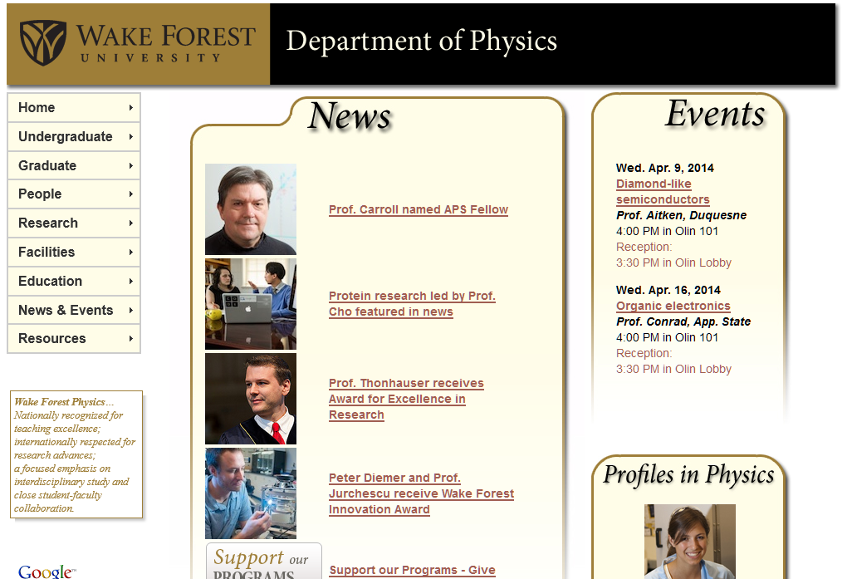

Slide 5
The Boltzmann equation

Slide 6
Analysis of collision term
Two-particle collision events
v₁’
v₂’
v₂
v₁

Slide 7
Two-particle collision events
v₁’
v₂’
v₂
v₁
Assumptions
Only two-particle collisions considered
Only elastic collisions considered
Assume that force F does not effect collisions
Assume that distribution function f(r,v,t) is slowly varying in r within collision volume
In a two-particle collision , the distribution functions for the two particles are independent (uncorrelated)

Slide 8
Analysis of collision term
Two-particle collision events
v₁’
v₂’
Denotes the number of particles per unit time and per unit flux of particles 1 incident on particles 2 with initial velocities v₁,v₂ and final velocities v₁’, v₂’
v₂
v₁
Equivalent two-particle collision events
v₁
v₂
v₁’
v₂’
v₁’
v₂’
v₂
v₂
v₁’
v₂’
v₁
v₁

Slide 9
Analysis of collision term
θ
b
As discussed in Appendix E of your textbook, the scattering cross section describes the effective area cut out of the incident beam by the scattering process.

Slide 10
Analysis of collision term
θ
b

Slide 11
Analysis of collision term

Slide 12
Summary of results:

Slide 13
Some rough estimates:

Slide 14
Properties of Bolzmann equation
Described the time evolution of the distribution of particles in six-dimensional phase space for a dilute gas. In the absence of external fields, the system should decay to equilibrium as shown by Boltzmann’s H Theorem:

Slide 15
Properties of Bolzmann’s H theorem continued (assume F=0)

Slide 16
Properties of Bolzmann’s H theorem continued (assume F=0)
Adding the two expressions together and switching variables, we find:
This implies that at equilibrium:

Slide 17
Conservation laws implied by Boltzmann equation
These results lead to identities involving the distribution function

Slide 18
Approximate solutions to Boltzmann equation

