Slide 1
PHY 770 -- Statistical Mechanics
12:00* - 1:45 PM TR Olin 107
Instructor: Natalie Holzwarth (Olin 300)
Course Webpage: http://www.wfu.edu/~natalie/s14phy770
Lecture 18
Chap. 7 – Brownian motion and other non-equilibrium phenomena
Fokker-Planck equation examples
Linear response theory
Fluctuation-Dissipation Theorem
*Partial make-up lecture -- early start time

Slide 3
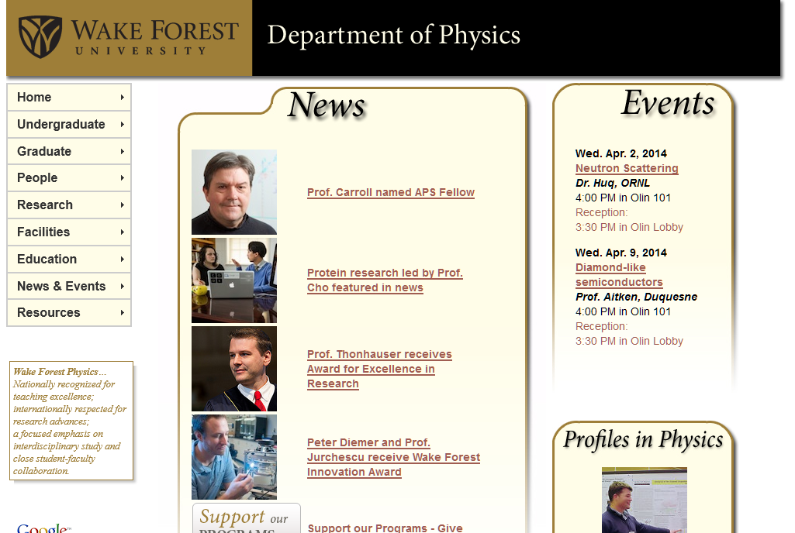

Slide 5
Probability analysis of Brownian motion -- Fokker-Planck equation
friction coefficient

Slide 7
Example solution in the limit of large friction

Slide 8
Example solution in the limit of large friction -- continued

Slide 9
Example solution for “free” particle V(x)=0

Slide 10
Example solution for “free” particle V(x)=0

Slide 11
Fluctuations about equilibrium
response function

Slide 12
Linear response function

Slide 13
Linear response function -- simple example

Slide 14
“Proof” of Kramers-Kronig relations
Im(z)
α
Re(z)

Slide 15
Kramers-Kronig transform -- continued
Im(z)
α
Re(z)
=0

Slide 16
Kramers-Kronig transform -- continued

Slide 17
Kramers-Kronig transform -- continued

Slide 18
Fluctuation-Dissipation Theorem
Relationship of the response and correlation functions of a system near equilibrium; allows a weak external field to probe equilibrium fluctuations

Slide 19
Fluctuation-Dissipation Theorem -- continued
HW #17

Slide 20
Fluctuation-Dissipation Theorem -- continued
HW #17

Slide 21
Fluctuation-Dissipation Theorem -- continued

Slide 22
Fluctuation-Dissipation Theorem -- continued

Slide 23
Fluctuation-Dissipation Theorem -- example

Slide 24
Fluctuation-Dissipation Theorem -- example

Slide 25
Microscopic linear response theory
0

Slide 26
Microscopic linear response theory -- continued

