Slide 1
PHY 770 -- Statistical Mechanics
12:00* -1:45 PM TR Olin 107
Instructor: Natalie Holzwarth (Olin 300)
Course Webpage: http://www.wfu.edu/~natalie/s14phy770
Lecture 14
Chap. 6 – Grand canonical ensemble
Fermi-Dirac distribution function
Bose-Einstein distribution
*Partial make-up lecture -- early start time

Slide 3
Reminder:
Please think about the subject of your computational project – due next week.
Suggestions available upon request.

Slide 4
Examples of grand canonical ensembles – ideal (non-interacting) quantum particles in a cube of length L with periodic boundary conditions -- Fermi-Dirac case
In the absence of a magnetic field, the particle spin does not effect the energy spectrum, and only effects the enumeration of possible states spin (g)

Slide 5
Fermi-Dirac case -- continued

Slide 6
Fermi-Dirac case -- continued

Slide 7
Fermi-Dirac case -- continued

Slide 8
Fermi-Dirac case -- continued

Slide 9
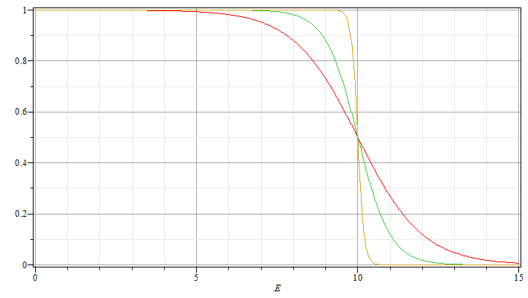
Fermi-Dirac case -- continued

Slide 10
Examples of grand canonical ensembles – ideal (non-interacting) quantum particles in a cube of length L with periodic boundary conditions -- Bose-Einstein case (assumed to have spin 0)

Slide 11
Bose-Einstein case
Fermi-Dirac case

Slide 12
Bose-Einstein case
Fermi-Dirac case

Slide 13
Case of Bose particles
Non-interacting spin 0 particles of mass m at low T moving in 3-dimensions in large box of volume V=L³: Assume that each state e_{k} is singly occupied.

Slide 14
Case of Bose particles at low T

Slide 15
Critical temperature for Bose condensation:
condensate
“normal” state

Slide 16
Case of Bose particles at low T

Slide 17
Critical temperature for Bose condensation:
condensate
“normal” state

Slide 18
Summary:

Slide 19
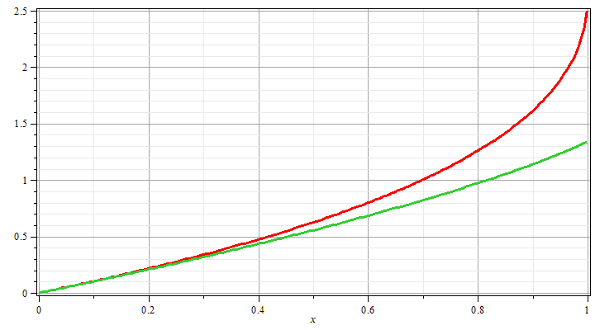
Some convenient integrals
g_{3/2}(z)
g_{5/2}(z)
z

Slide 20
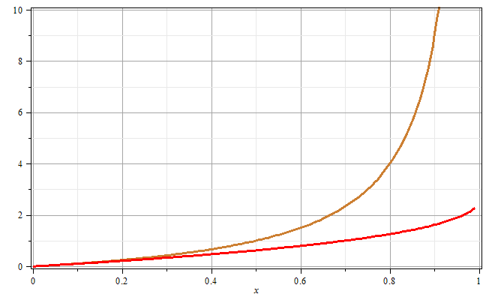
g_{3/2}(z)
z

Slide 22
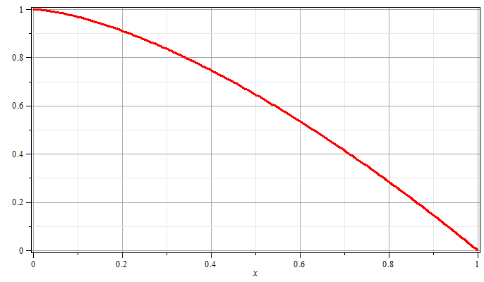
T/T_{E}

Slide 23
http://www.colorado.edu/physics/2000/bec/three_peaks.html
⁸⁷Rb atoms (~2000 atoms in condensate)

Slide 25
Other systems with Bose statistics
Thermal distribution of photons -- blackbody radiation:
In this case, the number of particles (photons) is not conserved so that μ=0.

Slide 26
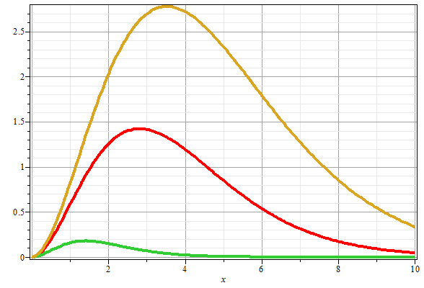
Blackbody radiation distribution:
T₃>T₂
T₂>T₁
T₁
ν

Slide 27
Other systems with Bose statistics
Thermal distribution of vibrations -- phonons:
In this case, the number of particles (phonons) is not conserved so that μ=0.

Slide 28
Other systems with Bose statistics -- continued
Thermal distribution of vibrations -- phonons:

Slide 29
Effects of interactions between particles – classical case

Slide 30
Effects of interactions between particles – classical case -- continued

Slide 31
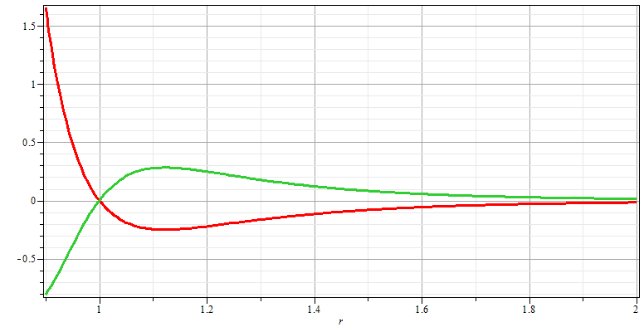
Effects of interactions between particles – classical case -- continued

Slide 32
Effects of interactions between particles – classical case -- continued

Slide 33
Effects of interactions between particles – classical case -- continued

