Slide 1
PHY 770 -- Statistical Mechanics
11 AM – 12:15 & 12:30-1:45 PM TR Olin 107
Instructor: Natalie Holzwarth (Olin 300)
Course Webpage: http://www.wfu.edu/~natalie/s14phy770
Lecture 10-11 -- Chapter 5
Equilibrium Statistical Mechanics
Canonical ensemble
Probability density matrix
Canonical ensembles; comparison with microcanonical ensembles
Ideal gas
Lattice vibrations

Slide 3
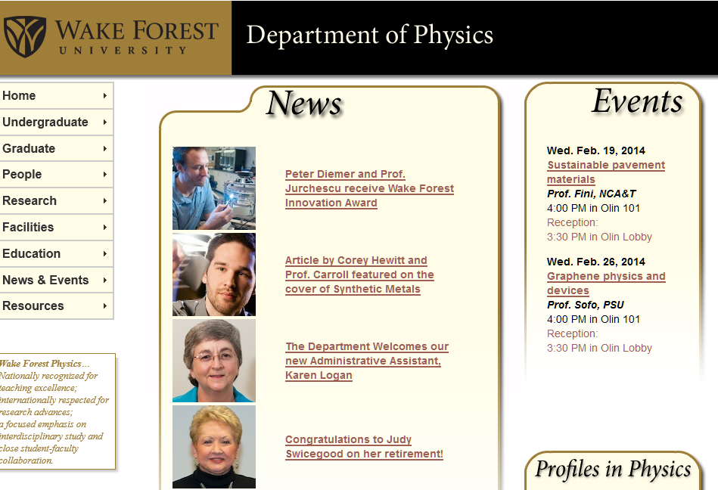

Slide 5
Microscopic definition of entropy – due to Boltzmann
Consider a system with N particles having a total energy E and a macroscopic parameter n.
denotes the multiplicity of microscopic states having the same parameters. Each of these states are assumed to equally likely to occur.
Alternative description of entropy in terms of probability density (attributed to Gibbs)

Slide 6
Probability density -- continued

Slide 7
Example of classical treatment of microstate analysis of N three dimensional particles in volume V with energy E

Slide 8
Example of classical treatment of microstate analysis of N three dimensional particles in volume V with energy E -- continued
Rough statement of equivalence of Boltzmann’s and Gibbs’ entropy analysis for this and similar cases:

Slide 9
Quantum representation of density matrix

Slide 10
Microcanonical ensemble:
Consider a closed, isolated system in equilibrium characterized by a time-independent Hamiltonian with energy eigenstates . This implies that the density matrix is constant in time and is diagonal in the energy eigenstates:

Slide 11
Microcanonical ensemble -- continued

Slide 12
Summary of results for microcanonical ensemble –
Isolated and closed system in equilibrium with fixed energy E:
Now consider a closed system which can exchange energy with surroundings – canonical ensemble
Two viewpoints
Optimization with additional constraints
Explicit treatment of effects of surroundings

Slide 13
Canonical ensemble – derivation from optimization
Find form of probability density which optimizes S with constraints

Slide 14
Canonical ensemble from optimization – continued

Slide 15
Canonical ensemble from optimization – summary of results

Slide 16
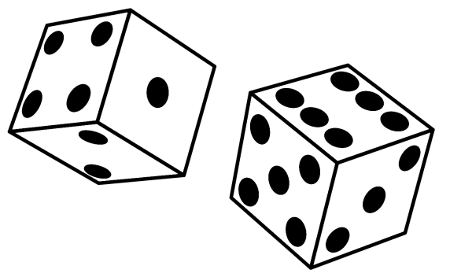
Canonical ensemble -- explicit consideration of effects of “bath” E_{b} and “system” E_{s}:
E_{b}
E_{s}
Analogy (thanks to H. Callen, Thermodyanmics and introduction to thermostatistics)
bath:
system:

Slide 17
Canonical ensemble -- explicit consideration of effects of “bath” E_{b} and “system” E_{s}; analogy with 3 dice
bath:
E_{b}
system:
E_{s}
For every toss of the 3 dice, record all outcomes with a sum of 12➔E_{tot} as a function of the red dice representing E_{s}.
E_{s} | E_{b} | P_{s}
1 | 5+6,6+5 | 2/25
2 | 4+6,6+4,5+5 | 3/25
3 | 3+6,6+3,4+5,5+4 | 4/25
4 | 2+6,6+2,3+5,5+3,4+4 | 5/25
5 | 1+6,6+1,2+5,5+2,3+4,4+3 | 6/25
6 | 1+5,5+1,2+4,4+2,3+3 | 5/25

Slide 18
Canonical ensemble -- explicit consideration of effects of “bath” E_{b} and “system” E_{s}:
E_{b}
E_{s}

Slide 19
Canonical ensemble (continued)

Slide 20
Canonical ensemble (continued)

Slide 21
Canonical ensemble (continued):

Slide 22
Canonical ensemble continued – average energy of system:
Heat capacity for canonical ensemble:

Slide 23
First Law of Thermodynamics for canonical ensemble (T fixed)
- Pressure associated with state s

Slide 24
=0

Slide 26
Canonical ensemble – summary and further results

Slide 28
Summary of relationship between canonical ensemble and its partition function and the Helmholz Free Energy:

Slide 29
Canonical ensemble in terms of probability density operator

Slide 30
Example: Canonical distribution for free particles

Slide 31
Example: Canonical distribution for free particles -- continued

Slide 32
Canonical ensemble of indistinguishable quantum particles
Indistinguishable quantum particles generally must obey specific symmetrization rules under the exchange of two particle labels (see Appendix D of your textbook)
+ ➔ Bose-Einstein particles
− ➔ Fermi-Dirac particles

Slide 33
Canonical ensemble of indistinguishable quantum particles
Example: 3-body ideal gas confined in large volume V with momenta k_{1,} k_{2,}and k_{3,}

Slide 34
Canonical ensemble of indistinguishable quantum particles
Example: 3-body ideal gas confined in large volume V with momenta k_{1,} k_{2,}and k_{3,}

Slide 35
Reduced single particle density matrix and the Maxwell-Boltzmann distribution

Slide 36
Reduced single particle density matrix and the Maxwell-Boltzmann distribution -- continued

Slide 37
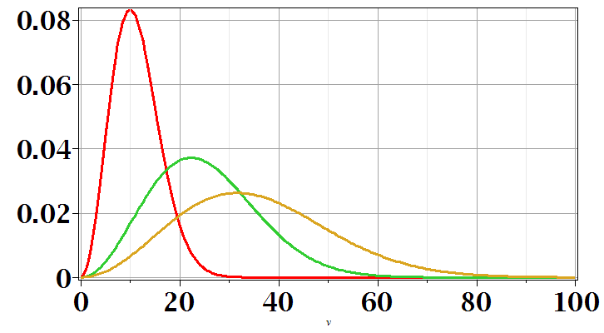
Reduced single particle density matrix and the Maxwell-Boltzmann distribution -- continued
T=100
T=500
T=1000
v

Slide 38
Canonical ensemble example: Einstein solid revisited
Consider N independent harmonic oscillators (in general
N=3 x number of lattice sites) with frequency ω
Consistent with result from microcanonial ensemble

Slide 39
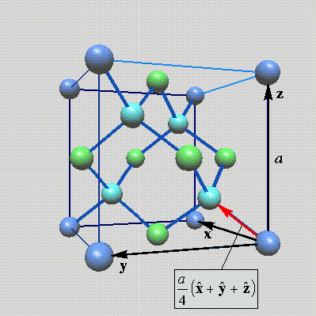
More realistic model of lattice vibrations
Lattice vibrations for 3-dimensional lattice
Example: diamond lattice
Ref: http://phycomp.technion.ac.il/~nika/diamond_structure.html

Slide 43
B. P. Pandey and
B. Dayal, J. Phys. C 6, 2943 (1973)

Slide 44
B. P. Pandey and
B. Dayal, J. Phys. C 6, 2943 (1973)

Slide 45
Lattice vibrations – continued
Classical analysis determines the normal mode frequencies and their corresponding modes
In general, for a lattice with M atoms in a unit cell, there will be 3M normal modes for each q . While the normal mode analysis for and the normal mode geometries are well approximated by the classical treatment, the quantum effects of the vibrations are important. The corresponding quantum Hamiltonian is given by:

Slide 46
Lattice vibrations continued

Slide 47
Lattice vibrations continued

Slide 48
Lattice vibrations continued
Debye model for g(ω)

