Slide 1
PHY 712 Electrodynamics
10-10:50 AM MWF Olin 107
Plan for Lecture 34:
Special Topics in Electrodynamics:
Review – Scattering and interference phenomena
Course assessment forms

Slide 6
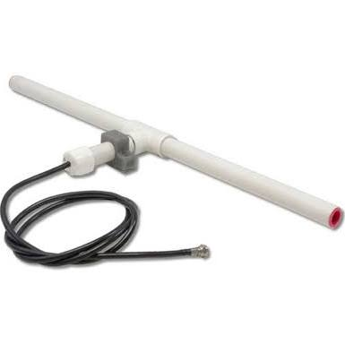
r
Review of radiation from antenna
z
Linear center-fed antenna
θ
d/2

Slide 7
Linear center-fed antenna continued

Slide 8
Linear center-fed antenna continued

Slide 9
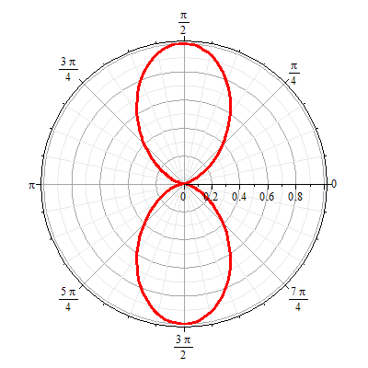
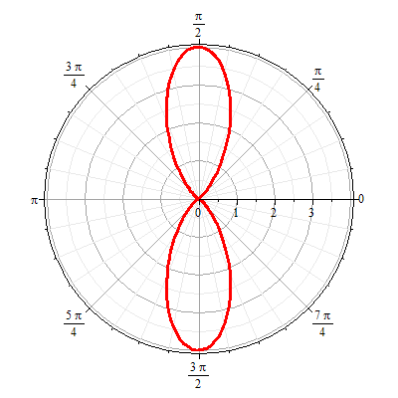
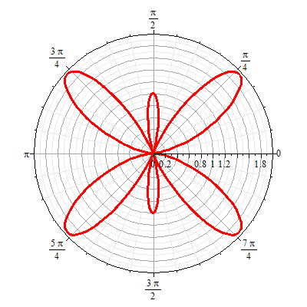
Linear center-fed antenna continued
Radiation patterns kd=mπ:
m=1 m=2 m=3

Slide 10
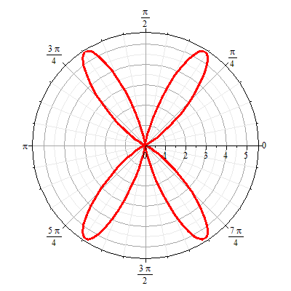
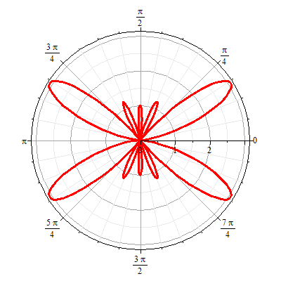
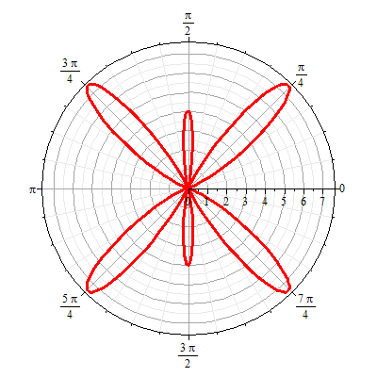
Linear center-fed antenna continued
Radiation patterns kd=mπ:
m=4 m=5 m=6

Slide 11
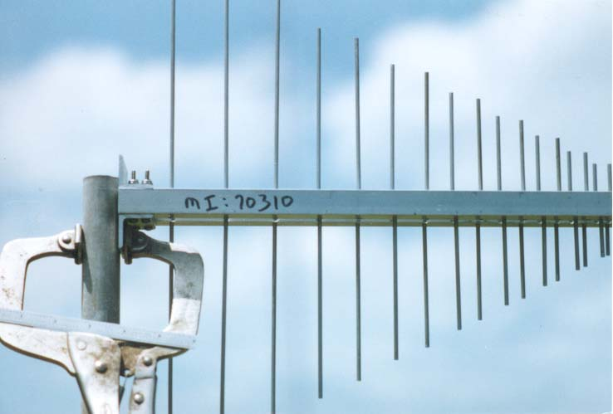
Antenna arrays
http://www.tennadyne.com/company.htm
z
a
φ
r
x

Slide 12
z
Antenna arrays
a
φ
r
z’’
x

Slide 13
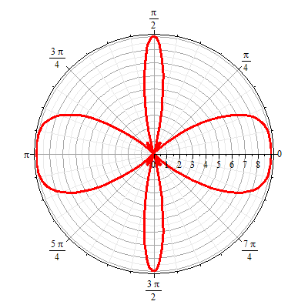
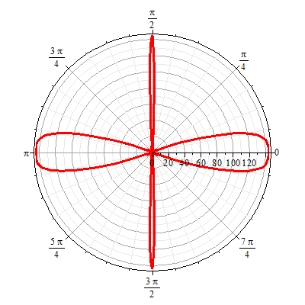
Antenna arrays
N=3
N=12
φ

