Slide 1
PHY 712 Electrodynamics
10-10:50 AM MWF Olin 107
Plan for Lecture 33:
Special Topics in Electrodynamics:
Electromagnetic aspects of superconductivity – continued
Review – reflection and refraction

Slide 3
Josephson junction -- tunneling current between two superconductors
d
x
B_{z}

Slide 4
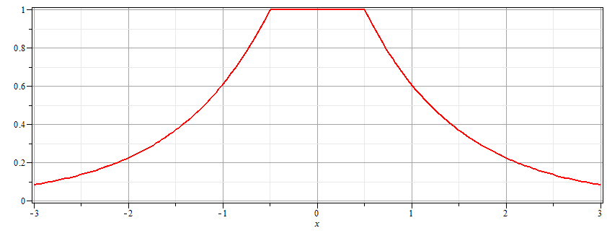
Josephson junction -- continued
Supercon left
Junction
Supercon right
B_{z}
d

Slide 5
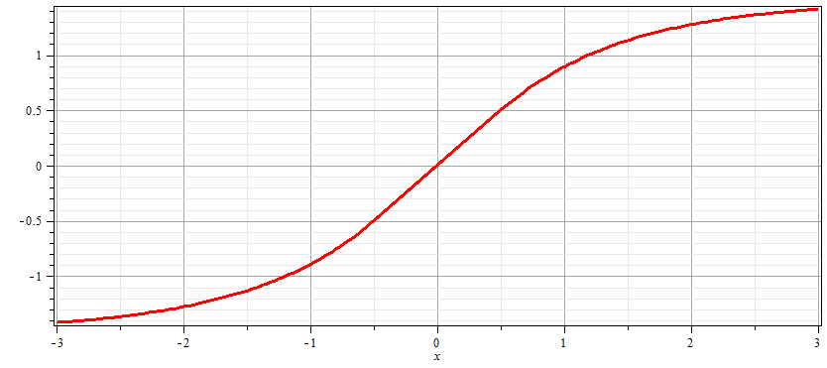
Josephson junction -- continued
Supercon left
Junction
Supercon right
A_{y}
d

Slide 6
Josephson junction -- continued
d
L
R
x

Slide 7
Josephson junction -- continued

Slide 8
Josephson junction -- continued
J_{L}
J_{R}
J_{T}
L
R
x

Slide 9
Josephson junction -- continued
J_{L}
J_{R}
J_{T}
L
R
x

Slide 10
Josephson junction -- continued
J_{L}
J_{R}
J_{T}
L
R
x

Slide 11
Josephson junction -- continued
J_{L}
J_{R}
J_{T}
L
R
x

Slide 12
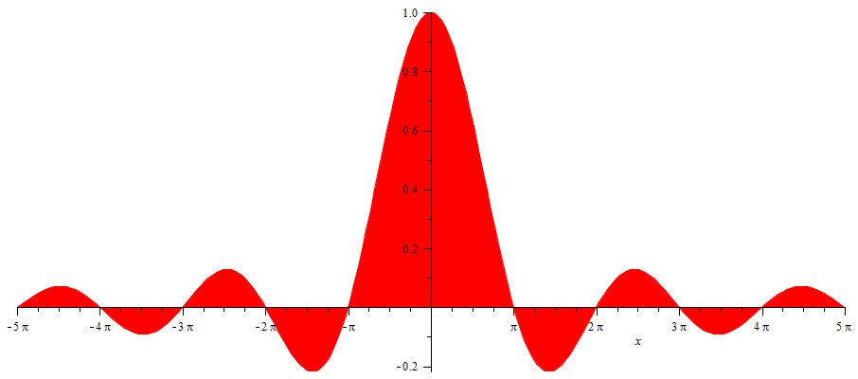
Josephson junction -- continued
SQUID =superconducting quantum interference device
I_{T}
Φ/Φ₀
Note: This very sensitive “SQUID” technology has been used in scanning probe techniques. See for example, J. R. Kirtley, Rep. Prog. Physics 73, 126501 (2010).

Slide 13
Review of reflection and refraction
Consider the normal incidence case; 3 media
n₁
n₂
n₃
E₀
E_{2T}
E_{3T}
E_{1R}
E_{2R}

Slide 14
Review of reflection and refraction -- continued
Consider the normal incidence case; 3 media
n₁
n₂
n₃
E₀
E_{2T}
E_{3T}
E_{1R}
E_{2R}
d
Note that in this steady-state formulation, we must match the tangential components of the E and H fields at each boundary

Slide 15
Review of reflection and refraction -- continued
Consider the normal incidence case; 3 media
n₁
n₂
n₃
E₀
E_{2T}
E_{3T}
E_{1R}
E_{2R}
d

Slide 16
Review of reflection and refraction -- continued
Consider the normal incidence case; 3 media
n₁
n₂
n₃
E₀
E_{2T}
E_{3T}
E_{1R}
E_{2R}
d

Slide 17
Review of reflection and refraction -- continued
n₁
n₂
n₃
E₀
E_{2T}
E_{3T}
E_{1R}
E_{2R}
d

