Slide 1
PHY 712 Electrodynamics
10-10:50 AM MWF Olin 107
Plan for Lecture 31:
Special Topics in Electrodynamics:
Electromagnetic aspects of superconductivity

Slide 4
Comment on HW

Slide 5
Comment on HW
r
v’
θ
v

Slide 6
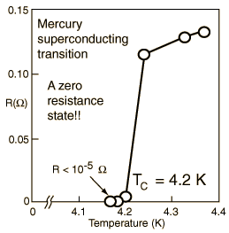
Special topic: Electromagnetic properties of superconductors
Ref:D. Teplitz, editor, Electromagnetism – paths to research,
Plenum Press (1982); Chapter 1 written by Brian Schwartz and Sonia Frota-Pessoa
History:
1908 H. Kamerlingh Onnes successfully liquified He
1911 H. Kamerlingh Onnes discovered that Hg at 4.2 K has vanishing resistance
1957 Theory of superconductivity by Bardeen, Cooper, and Schrieffer

Slide 7
Some phenomenological theories < 1957

Slide 8
Some phenomenological theories < 1957

Slide 9
London model – continued

Slide 10
London model – continued
λ_{L}
x

Slide 11
Magnetization field

Slide 12
Magnetization field
B
H
H_{C}
-4πM
H
H_{C}
G_{S}-G_{N}
H_{C}
H

