Slide 1
PHY 712 Electrodynamics
10-10:50 AM MWF Olin 107
Plan for Lecture 22:
Comments on Mid-Term Exam
Start reading Chap. 11
Equations in cgs (Gaussian) units
Special theory of relativity
Lorentz transformation relations

Slide 2
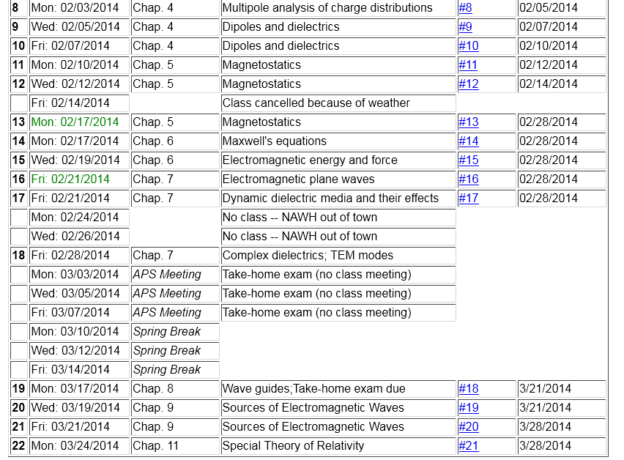

Slide 3
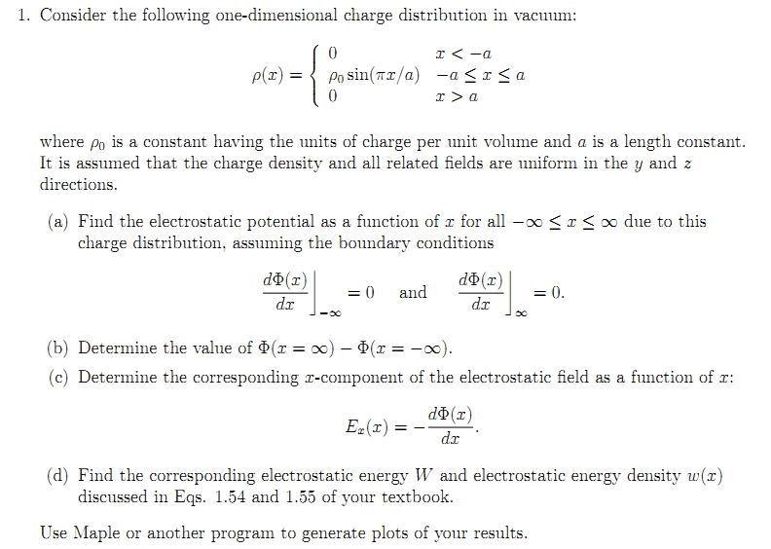
Comments on Mid-Term Exam

Slide 4
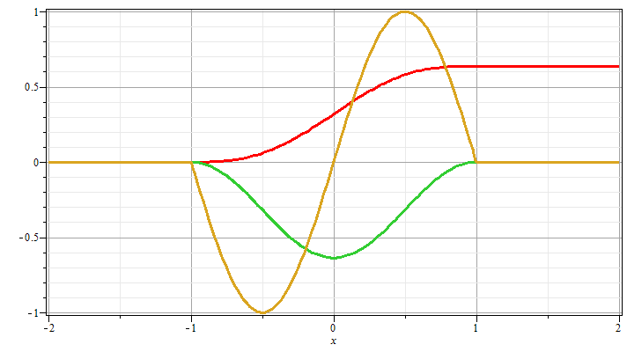
Φ
ρ
E

Slide 5
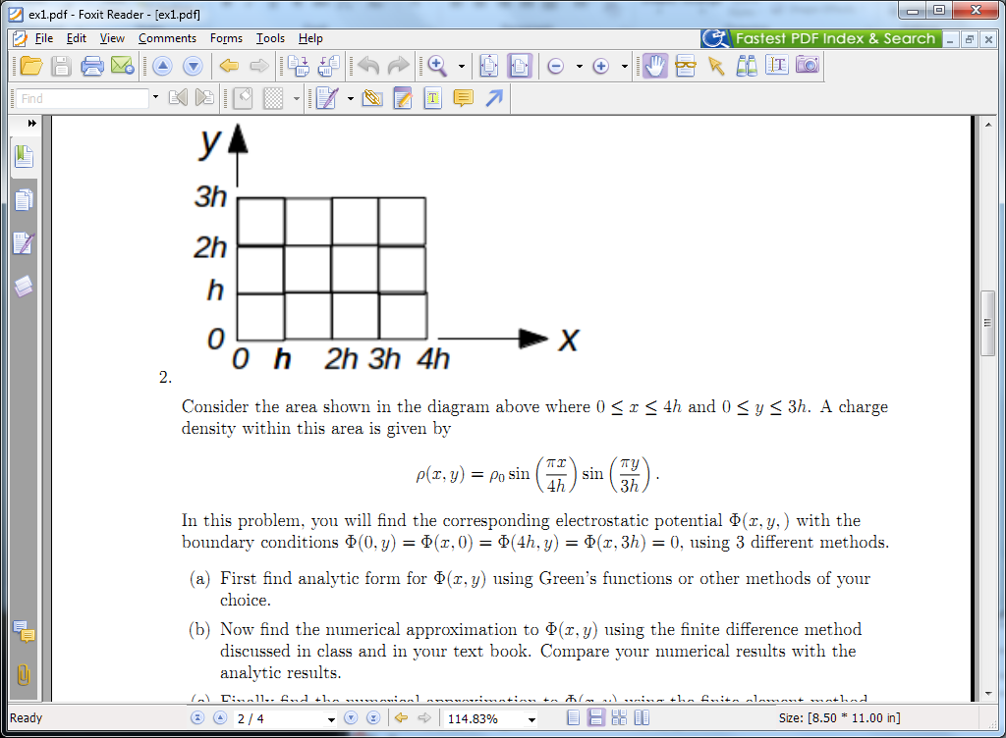

Slide 6
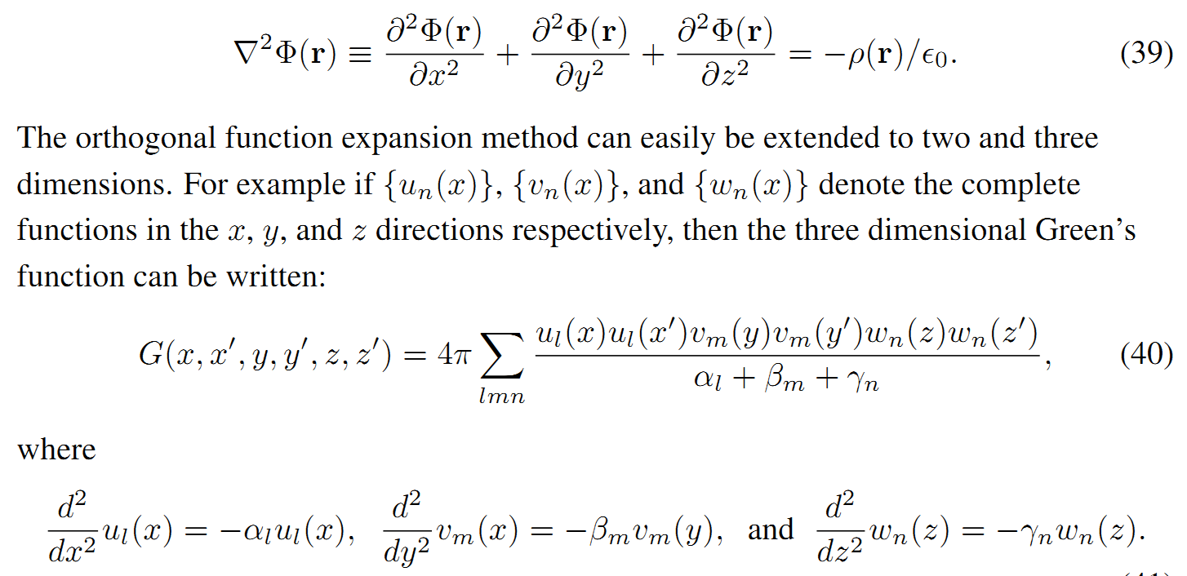
Recall from Lecture 4: Green’s function for 3-d Poisson equation in Cartesian coordinates:

Slide 8
1
2
3
4
5
6

Slide 9
1
2
3
4
5
6

Slide 10
1
2
3
4
5
6

Slide 11
1
2
3
4
5
6

Slide 12
1
2
3
4
5
6

Slide 13
1
2
3
4
5
6

Slide 19
Notions of special relativity
The basic laws of physics are the same in all frames of reference (at rest or moving at constant velocity).
The speed of light in vacuum c is the same in all frames of reference.
y
y’
v
x
x’
y’
y
x’
x

Slide 20
Lorentz transformations
y
y’
v
x
x’
y’
y
x’
x

Slide 21
Lorentz transformations -- continued

Slide 22
Examples of other 4-vectors
applicable to the Lorentz transformation:

Slide 23
The Doppler Effect

Slide 24
The Doppler Effect -- continued
y’
y
k’
v
k
x’
x

Slide 25
Electromagnetic Doppler Effect (θ=0)
Sound Doppler Effect (θ=0)

Slide 26
Lorentz transformation of the velocity
For an infinitesimal increment:

Slide 27
Lorentz transformation of the velocity -- continued

Slide 28
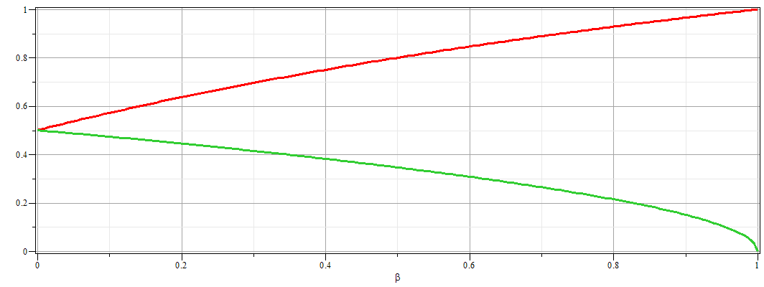
Example of velocity variation with β:
u_{x}/c
u_{y}/c

