Slide 1
PHY 712 Electrodynamics
10-10:50 AM MWF Olin 107
Plan for Lecture 20:
Start reading Chap. 9
Electromagnetic waves due to specific sources
Dipole radiation patterns

Slide 2
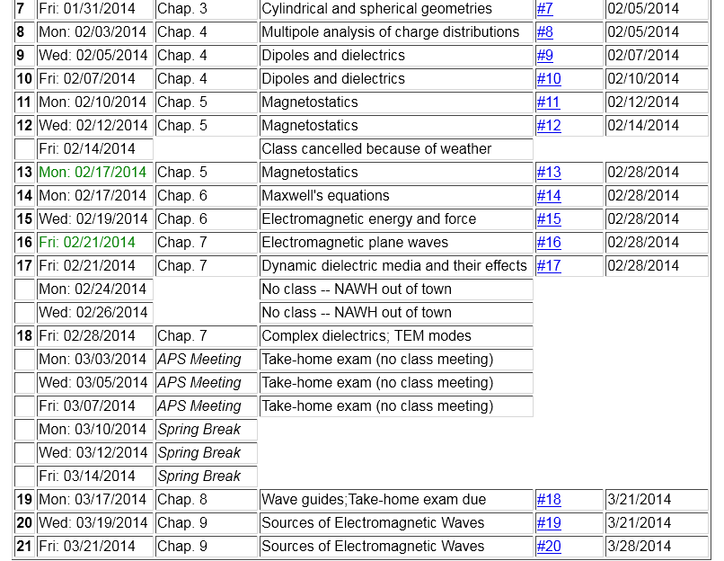

Slide 4
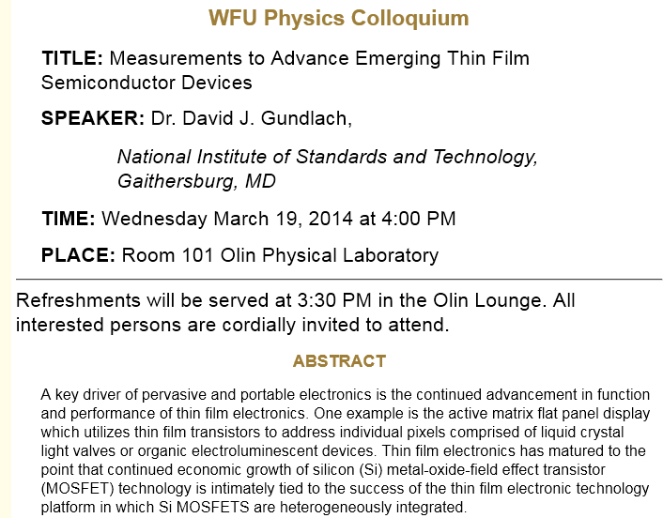

Slide 5
Maxwell’s equations

Slide 6
Formulation of Maxwell’s equations in terms of vector and scalar potentials

Slide 7
Formulation of Maxwell’s equations in terms of vector and scalar potentials -- continued

Slide 8
Solution of Maxwell’s equations in the Lorentz gauge -- continued

Slide 9
Electromagnetic waves from time harmonic sources

Slide 10
Electromagnetic waves from time harmonic sources – continued:

Slide 11
Electromagnetic waves from time harmonic sources – continued:

Slide 12
Electromagnetic waves from time harmonic sources – continued:

Slide 13
Electromagnetic waves from time harmonic sources – continued:

Slide 14
Electromagnetic waves from time harmonic sources – continued:

Slide 15
Electromagnetic waves from time harmonic sources – continued:

Slide 16
Electromagnetic waves from time harmonic sources – continued:

Slide 17
Electromagnetic waves from time harmonic sources – continued:
Note: in this case we have only assumed the throughout the extent of the source kr’<<1.

Slide 18
Electromagnetic waves from time harmonic sources – continued:

