Slide 1
PHY 712 Electrodynamics
10-10:50 AM MWF Olin 107
Plan for Lecture 12:
Continue reading Chapter 5
Examples of magnetostatic fields
Magnetic dipoles

Slide 2
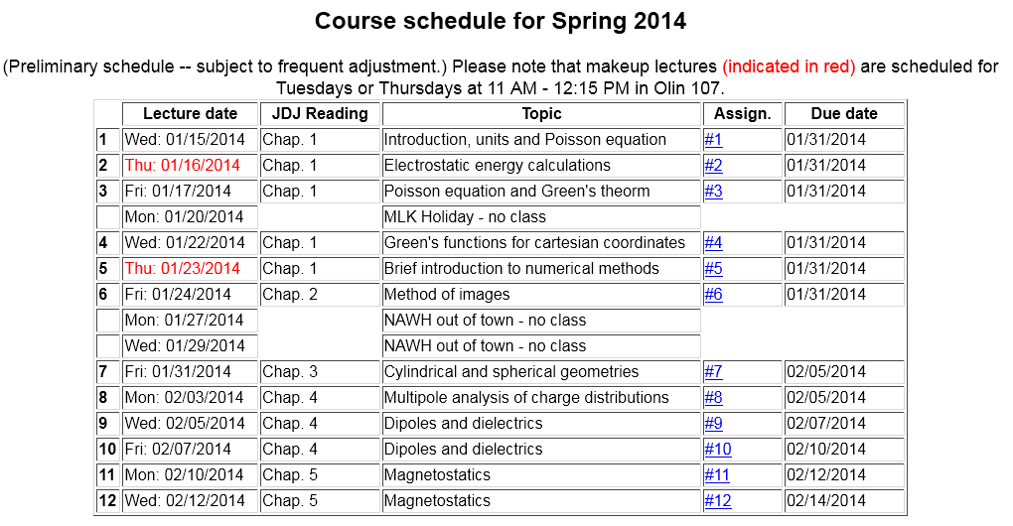

Slide 4
Various forms of Ampere’s law :

Slide 5
Other examples of current density sources:

