Slide 1
PHY 712 Electrodynamics
10-10:50 AM MWF Olin 107
Plan for Lecture 8:
Start reading Chapter 4
Multipole moment expansion of electrostatic potential –
Spherical coordinates
Cartesian coordinates

Slide 3
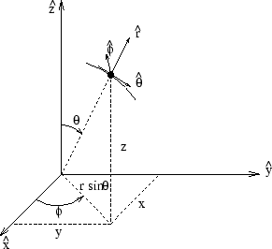
Poisson and Laplace equation in spherical polar coordinates
http://www.uic.edu/classes/eecs/eecs520/textbook/node32.html

Slide 4
Poisson and Laplace equation in spherical polar coordinates -- continued

Slide 5
Properties of spherical harmonic functions

Slide 6
Legendre and Associated Legendre functions

Slide 7
Useful identity:

Slide 8
Some spherical harmonic functions:

Slide 9
Example:

Slide 10
Example:

Slide 11
Example -- continued:

Slide 12
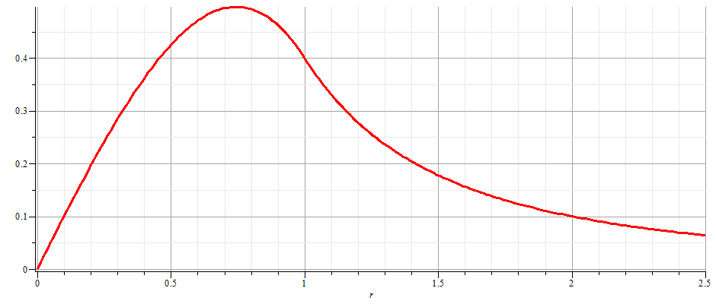
Example -- continued:

Slide 13
Notion of multipole moment:

Slide 14
Significance of multipole moments

Slide 15
Relationship between spherical harmonic and Cartesian forms of multipole moments:

Slide 16
Consider previous example:

Slide 17
General form of electrostatic potential in terms of multipole moments:

Slide 18
Example of multipole expansion in evaluating energy of a very localized charge density ρ(r) in a electrostatic field Φ(r) (such as an nucleus in the field due to the electrons in an atom).

Slide 19
Simple examples of multipole distributions
z
y
x
z
y
x

Slide 20
Another example of multipole distribution

Slide 21
Another example of multipole distribution -- continued

Slide 22
Another example of multipole distribution -- continued

Slide 23
Another example of multipole distribution -- continued

