Slide 1

Recycled &
updated
New Idea Series
Simulations of materials – focusing on
electrolytes for all solid state batteries
Contribution from: Natalie Holzwarth
Department of Physics
Acknowledgements:
Hannah Zhang and Zachary Pipkorn (former WFU undergrads)
Zachary Hood (WFU chemistry alum, Ga Tech Ph. D)
Jason Howard, Ahmad Al-Qawasmeh, Larry E. Rush, and Nicholas Lepley (current and former WFU grad students)
NSF grant DMR-1507942

Slide 2
Materials components of a Li or Na ion battery
or Na⁺

Slide 3
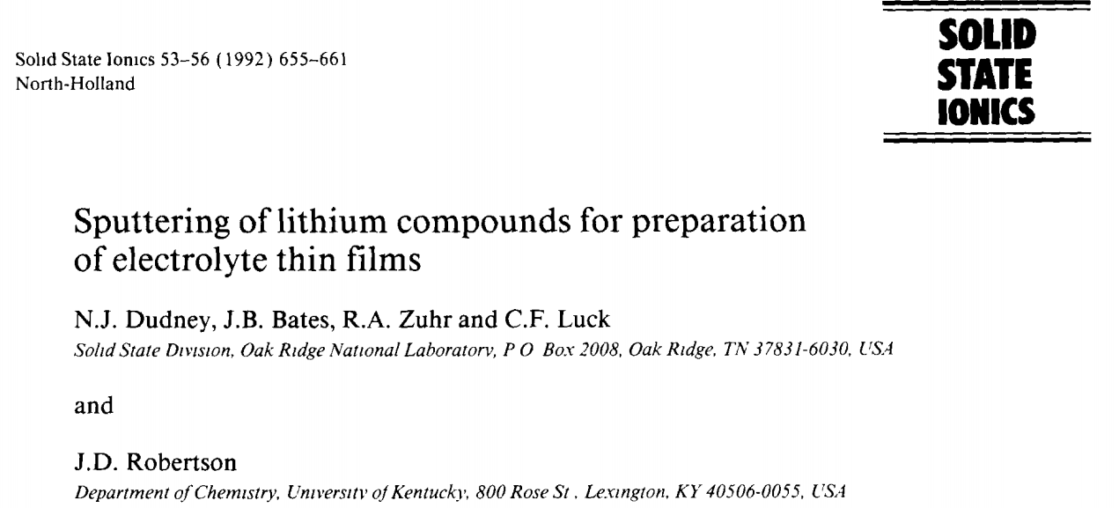
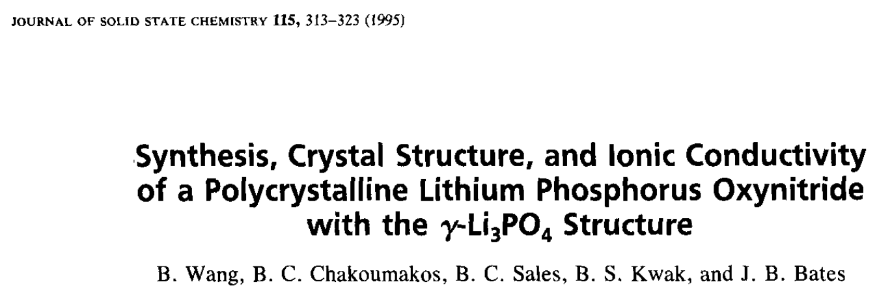
Development of LiPON electrolyte films at Oak Ridge National Laboratory

Slide 4
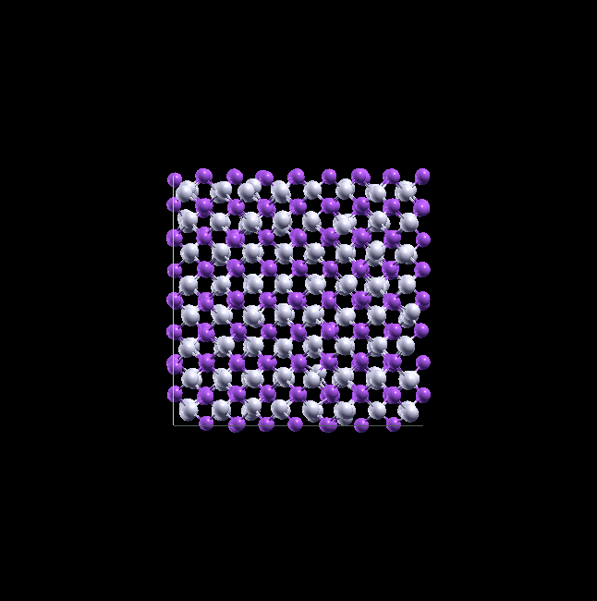
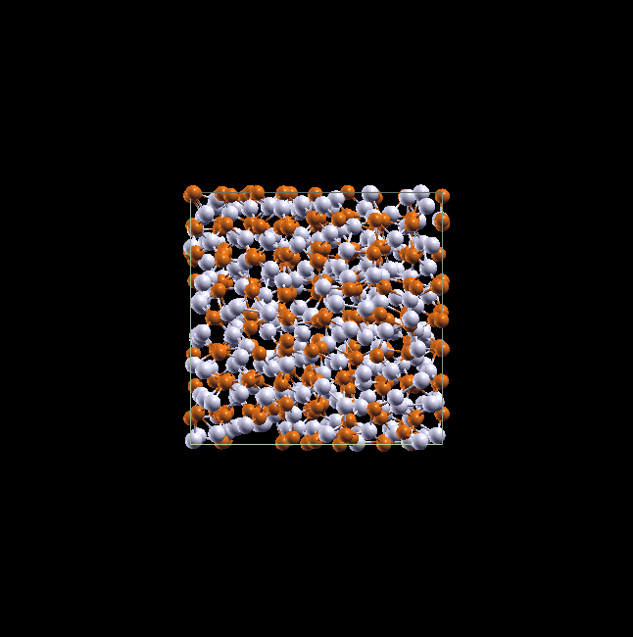
Simulations of ions in electrolyte crystals at two different temperatures.
T=427 K
T=952 K
Molecular dynamics simulations of AgI prepared by Zachary Pipkorn in 2015.

Slide 5
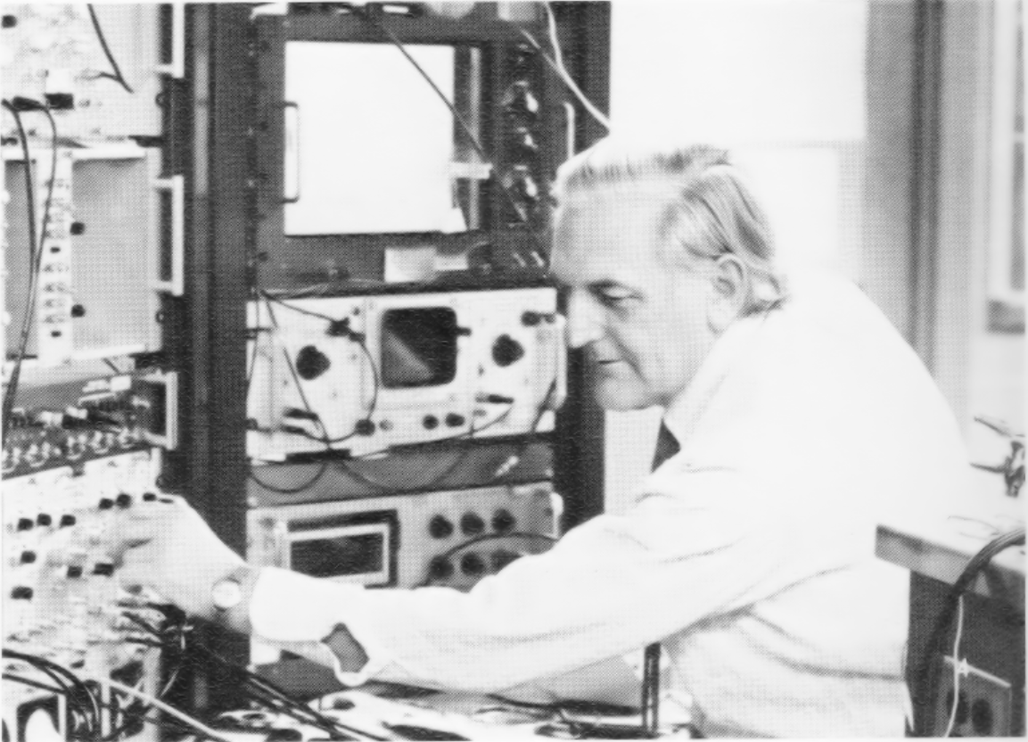
Ysbrand Haven –
WFU Physics Professor 1965-1983
1975 Howler photo of Professor Haven with his conductivity equipment.
Studied ionic conductivity in well-controlled crystalline samples as a function of temperature, to develop models of basic mechanisms and their relationship to diffusion.

Slide 6
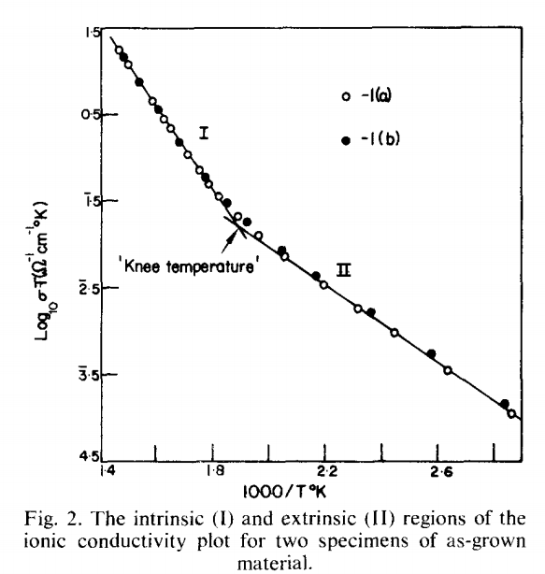
Ionic conductivity in LiI (single crystal form)
B. J. H. Jackson and D. A. Young, J. Phys. Chem. Solids 30, 1973-1976 (1969)
E_{I} and E_{II} are “activation” energies, characteristic of the hopping processes.

Slide 7
Relationship between ionic conductivity and diffusion
accessible by computation
very difficult to compute

Slide 8

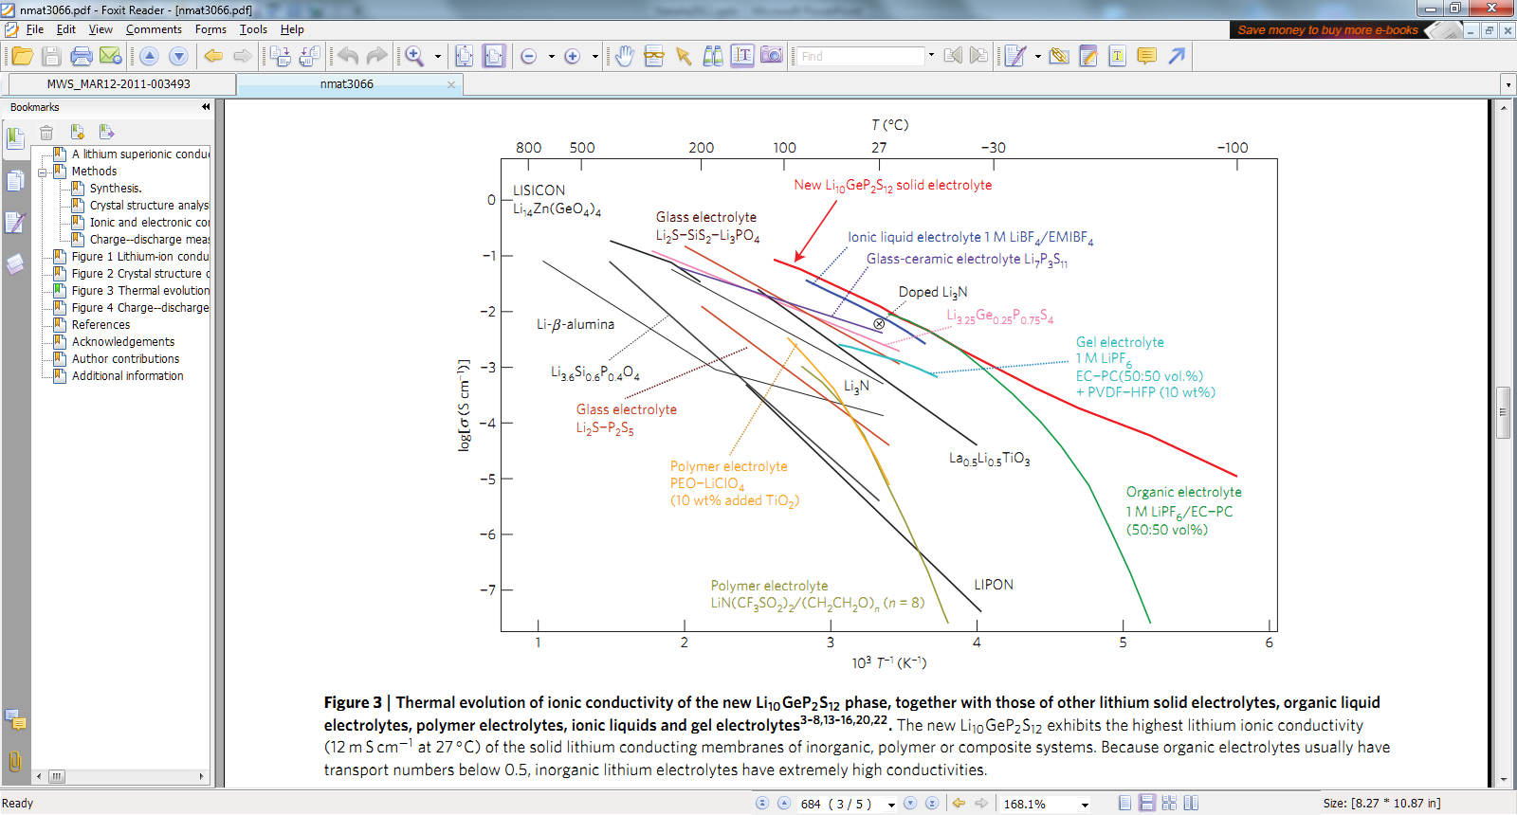
Recent ionic conductors: --
Paper by N. Kayama, et. al in Nature Materials 10, 682-686 (2011)
0
-1
-2
-3
-4
-5
-6
-7
log[σ(S/cm )]
1 2 3 4 5 6
1000/[T (K)]
Notes:
Milestone

Slide 9
Recent ionic conductors: --
Paper by N. Kayama, et. al in Nature Materials 10, 682-686 (2011)
0
-1
-2
-3
-4
-5
-6
-7
log[σ(S/cm )]
LiPON
R T
1 2 3 4 5 6
1000/[T (K)]

Slide 10
Recent ionic conductors: --
Paper by N. Kayama, et. al in Nature Materials 10, 682-686 (2011)
0
-1
-2
-3
-4
-5
-6
-7
Li₇P₃S₁₁
log[σ(S/cm )]
β-Li₃PS₄
R T
1 2 3 4 5 6
1000/[T (K)]

Slide 11
Recent ionic conductors: --
Paper by N. Kayama, et. al in Nature Materials 10, 682-686 (2011)
0
-1
-2
-3
-4
-5
-6
-7
Li₁₀GeP₂S₁₂
log[σ(S/cm )]
R T
1 2 3 4 5 6
1000/[T (K)]
Research from Toyota Motor Company

Slide 12
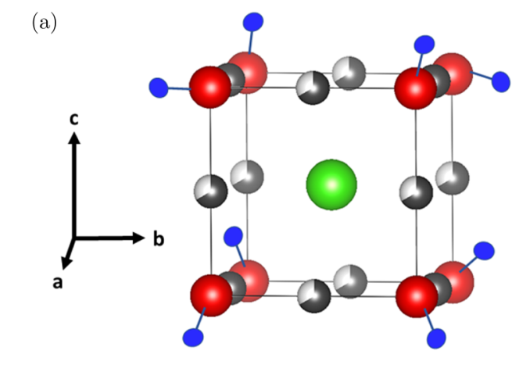
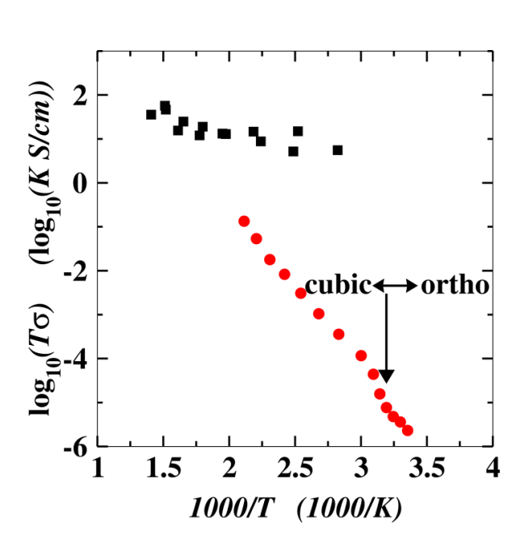
Ionic conductivity in Li₂OHCl
from Howard & co-workers,
PRM 1, 075406 (2018)
O H
Cl
Li
Tracer diffusion simulations by Jason Howard, suggesting that H_{r}>>1
Experimental measurements by Zach Hood

