Slide 1
DFT simulations of Li-ion conductor Li2(OH)Cl
Jason Howard, Natalie Holzwarth
Acknowledgements
Zach Hood
WFU Deac HPC Cluster
NSF grant DMR-1507942

Slide 2
Outline
Motivation
Background of material
Low temperature phase structure search
Molecular dynamics simulations of
high temperature phase

Slide 3
Motivation
Solid state , fast lithium ion conductor
Finding structure for low temperature phase is stepping stone for understanding the phase transition.
related materials ${Li}_{2+x}OH_{1−x}Cl , {Li}_{2}{(OH)}_{1−x}F_{x}Cl, {Li}_{2}\left(OH\right)Br$
Understanding the structure of the low temperature phase can help to understand the differences in the
phase transitions or lack there of for the related materials
Understanding the properties of diffusion on a disordered lattice is of general interest
In principle the combination of calculated tracer diffusion coefficients and experimentally measured conductivity can allow for a calculation of the Haven ratio.

Slide 4
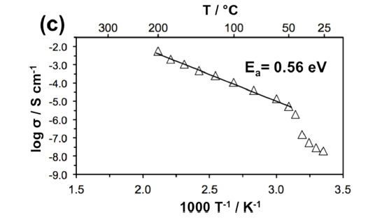
Background of Li2OHCl
Two phases orthorhombic -> cubic(disordered) at 312K
Low temperature phase poor Li-ion conductor
Disordered cubic phase is a good Li-ion conductor
Has been cycled with a lithium anode with the apparent creation of stabilizing SEI layer
Hood, Zach et al. , Li2OHCl “Crystalline Electrolyte for Stable Metallic Lithium Anodes”. J. Am. Chem. Soc. 2016, 138, 1768−1771
312K

Slide 5
Methods
Quantum Espresso QUANTUM ESPRESSO . (Giannozzi et al. JPCM 21, 394402 (2009)
PAW formalism with LDA, data sets generated with ATOMPAW
(Holzwarth et al. CPC 135, 329 (2001)) http://pwpaw.wfu.edu

Slide 6
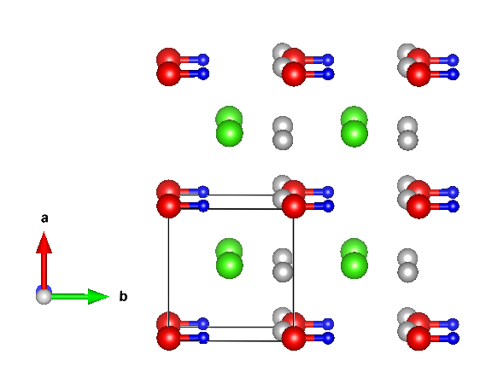
Low Temperature structure
Cubic high temp phase
Orthorhombic, diffraction peaks available but no cif file as of yet
Rapid change in conductivity orthorhombic -> cubic indicates order-> disorder transition of lithium sites
Schwering et. al. has experimentally predicted lattice parameters
Schwering, Georg CHEMPHYSCHEM 2003, 4, 343 - 348
My DFT studies predict a tetragonal ground state , a Orthorhombic structure slightly higher in energy is also predicted
Yutao Li et al
International Edition: DOI: 10.1002/anie.201604554
Li
Eo
0.02 eV + Eo
Tetragonal
Orthorhombic
O
b
Cl
Li-vacancy
c
H
a

Slide 7
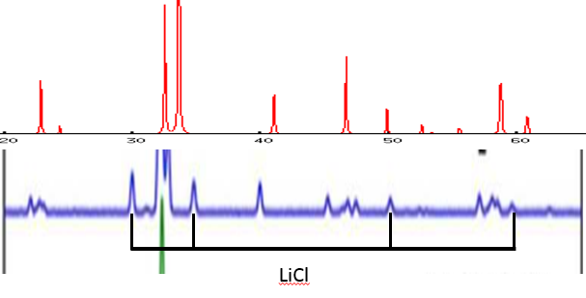
Lattice parameters and XRD
Orthorhombic phase lattice parameters reported by Schwering et al. In angstrom
a – 3.82 b – 7.998 c – 7.74, ( b/2 = 3.999, c/2 = 3.87) Schwering, Georg CHEMPHYSCHEM 2003, 4, 343 - 348
Tetragonal lattice parameters (DFT) Orthorhombic lattice parameters (DFT)
a – 3.89 b – 3.89 c – 3.66 a – 3.83 b – 7.97 c – 3.6 (if scaled by 1.08 c = 3.81)
DFT orthorhombic a, b, c scaled 1.02
DFT tetragonal a, b, c scaled by 1.02
LiCl
Hood, Zach et al. ,. J. Am. Chem. Soc. 2016, 138, 1768−1771

Slide 8
Candidate DFT orthorhombic with a-axis and b-axis scaled by 1.02 and c-axis scaled by 1.08
DFT Orthorhombic a, b scaled 1.02, c scaled 1.08
Hood, Zach et al. ,. J. Am. Chem. Soc. 2016, 138, 1768−1771
LiCl
Azuma et al report and underestimation of up to 8% in the axis along the OH bond in
$$Mg{(OH)}_{2} , Ca{(OH)}_{2}, LiOH, and NaOH$$
Azuma et al , Computational and Theoretical Chemistry 963 (2011) 215–220

Slide 9
Molecular Dynamics of disordered cubic phase
Started from randomly placing lithium on available sites
Used the micro-canonical ensemble , 1 shifted Kpoint, Ecut 45ryd, 1fm second t-step
“Scatter” plots of Lithium and hydrogen positions
a
c
b
b
Li
O
Cl
Li vacancy
H

Slide 10
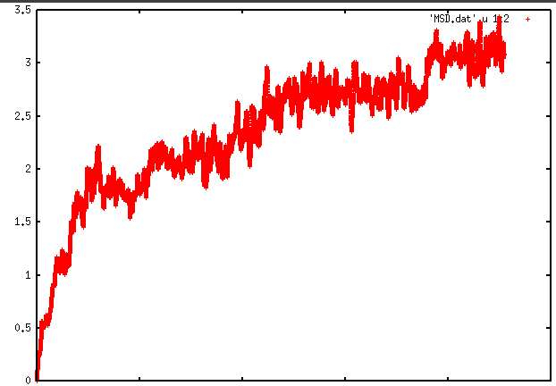
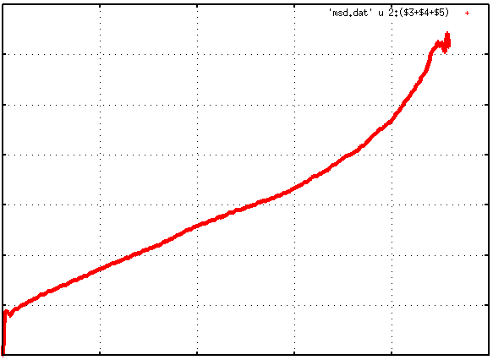
Goals of MD simulations
Calculate tracer diffusion coefficients from slopes of mean square displacement vs time plots
MSD(t) = $\frac{1}{\#Li}∗({R\left(Li\right)}_{t}−{R(Li)}_{t_{o}})^{2}$ ${\left\langle \text{MSD}\text{(}\text{t}\text{)}\right\rangle }_{t_{o}}$ vs t
Avg Temp 630K
3.25$A^{2}$
3.25$A^{2}$
MSD(t)
$${\left\langle \text{MSD}\text{(}\text{t}\text{)}\right\rangle }_{t_{o}}$$
24ps
24ps
Tracer diffusion coefficients are related to the ionic conductivity by the equation
$σ\left(T\right)= \frac{D^{∗}\left(T\right)ρe^{2}}{kTH_{r}}$ where $D^{∗}\left(T\right)$ - tracer diffusion coefficient
G.E. Murch Solid State lonics 7 (1982) 177-198
$ρ$ - density of mobile ions per unit volume , $e$ - fundamental charge, $k$ – Boltzmann constant
$T$ – temperature , $H_{r}$- the Haven ratio

Slide 11
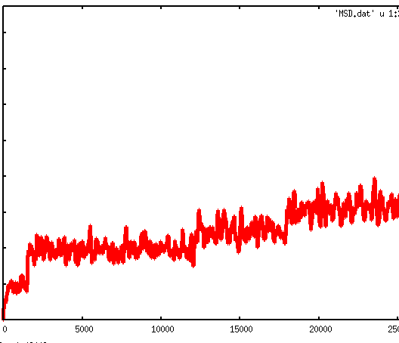
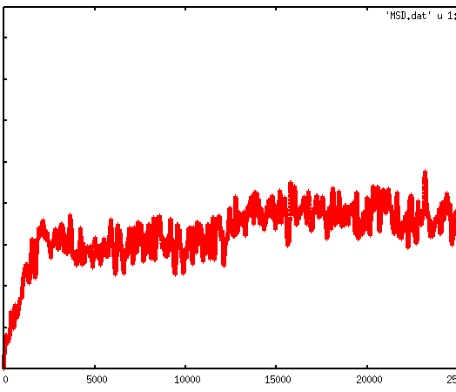
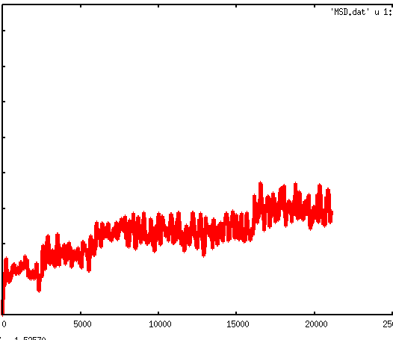
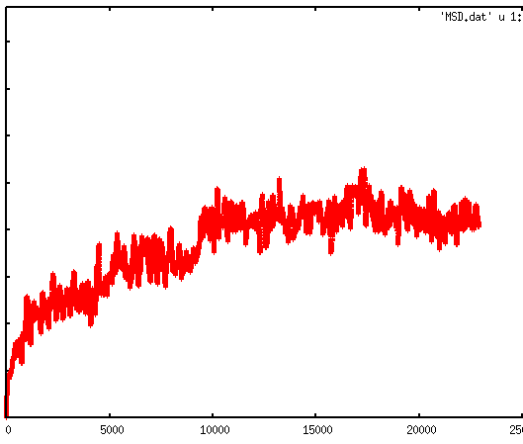
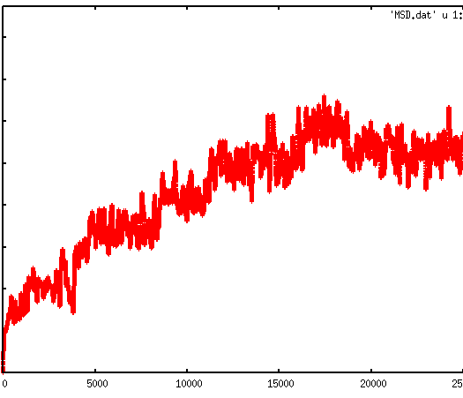
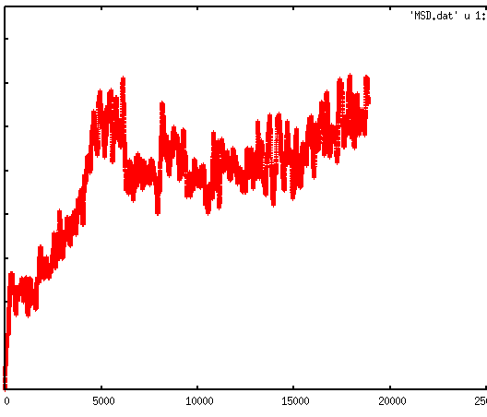
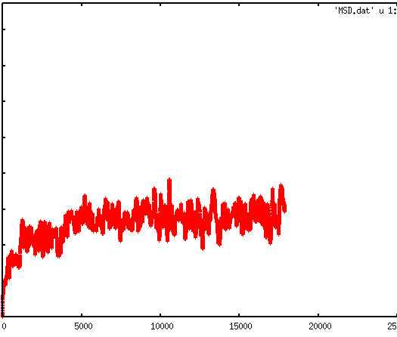
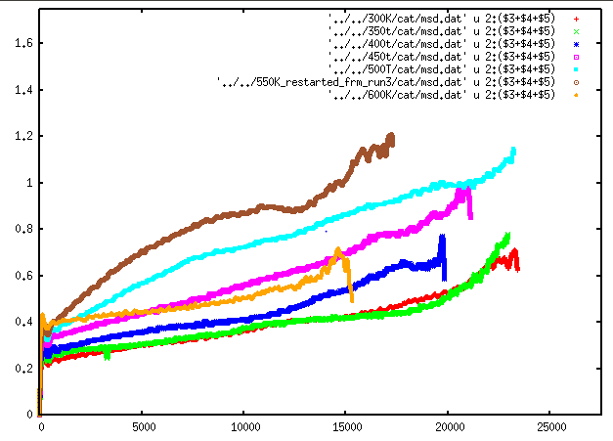
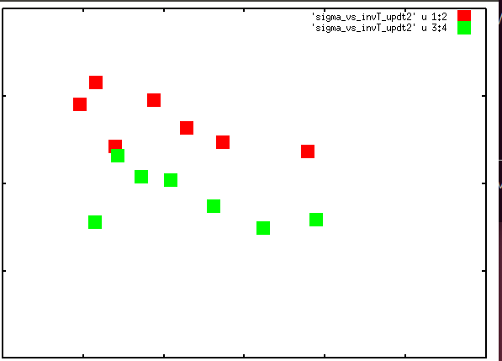
MSD continued
(Initial #1)
340K
380K
430K
490K
540K
580K
635K
1.6$A^{2}$
0
25ps
$$\frac{1}{6}{\left\langle \text{MSD}\text{(}\text{t}\text{)}\right\rangle }_{t_{o},Li}=D^{∗}(t−to)−c$$
$$σ\left(T\right)= \frac{D^{∗}\left(T\right)ρe^{2}}{kTH_{r}}$$
340K
$log⁡(σ$*T) vs $\frac{1}{T}$
1.6$A^{2}$
380K
430K
2.5 log($\frac{S}{cm}∗K)$
490K
540K
580K
Initial #2
635K
Initial #1
0.5 log($\frac{S}{cm}∗K)$
0.001 $\frac{1}{K}$
0.004 $\frac{1}{K}$
0
25ps

Slide 12
Conclusions
T = 0K ground state predicated to be tetragonal
A candidate structure is found for the low temperature Orthorhombic structure
MD simulations show Lithium hopping that corresponds to the proposed model
for lithium jumps
Hydrogen positions qualitatively correlated with Li vacancies
Measurable diffusion occurring ~350K-650K but results are not converged enough to produce accurate Arrhenius plots

Slide 13
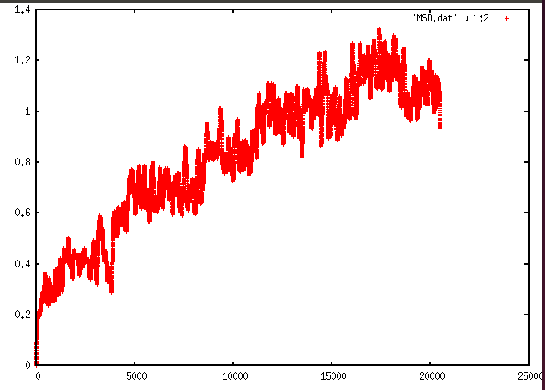
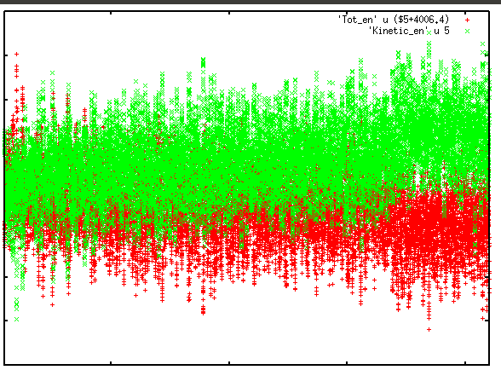
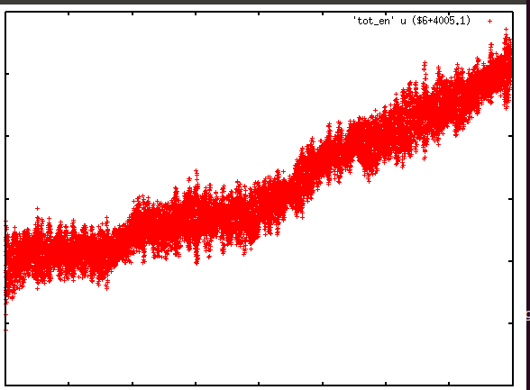
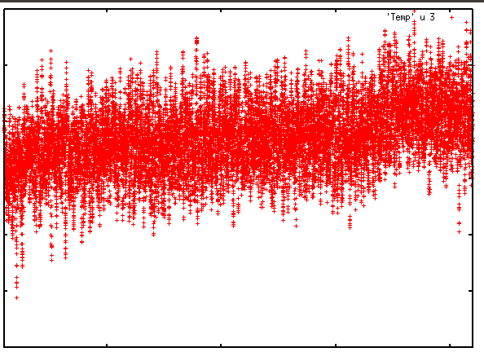
Internal energy, kinetic energy, total energy and temperature
In Micro Canonical Ensemble
MSD(t) = $\frac{1}{\#Li}∗({R\left(Li\right)}_{t}−{R(Li)}_{t_{o}})^{2}$
Kinetic ( ) and internal ( )
1.2$A^{2}$
0.75
0.65
0.55
19ps
19ps
kinetic + internal
Temperature
600K
0.015
0.01
500K
0.0
350K
19ps
19ps

Slide 14
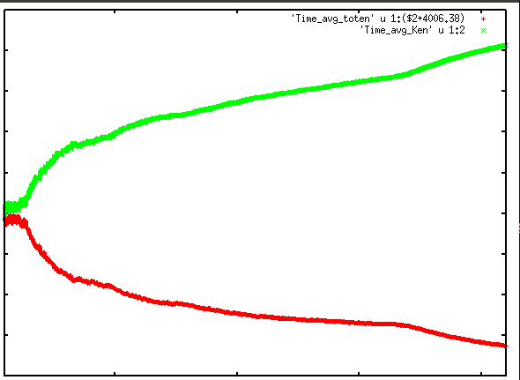
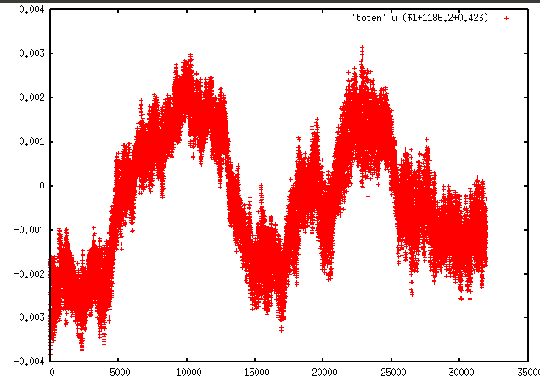
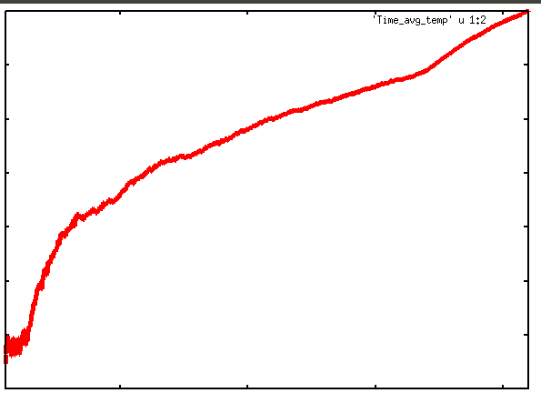
time avg kinetic and internal
time avg temperature
535K
0.68
520K
0.64
0.61
500K
19ps
19ps

Slide 15
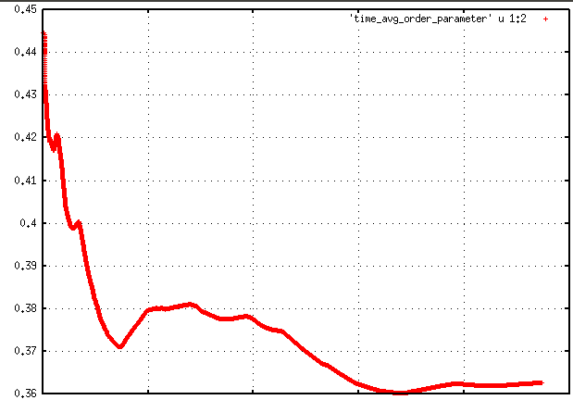
Order parameter analysis
Need a parameter that can gauge if the simulation is long enough
Define ${\left\langle SO_{i}\right\rangle }_{t}= \frac{1}{t}\int_{0}^{t}{SO_{i}\left(t\right)dt}$ where $SO_{i}\left(t\right)=1$ if a lithium is occupying the site $i$ at time $t$
$SO_{i}\left(t\right)=$ 0 if a lithium is not occupying the site $i$ at time $t$
Because each site should be equally occupied and there are 3 sites for every 2 lithium's
${\left\langle SO_{i}\right\rangle }_{t}→ \frac{2}{3}$ at long $t$
For a supercell this leads to ${\left\langle \left|\frac{2}{3}−{\left\langle SO_{i}\right\rangle }_{t}\right|\right\rangle }_{i}→ 0$ for long $t$. The index $i$ is for the possible Li sites in simulation cell
$${\left\langle \left|\frac{2}{3}−{\left\langle SO_{i}\right\rangle }_{t}\right|\right\rangle }_{i}(t)$$
MSD(t) = $\frac{1}{\#Li}∗({R\left(Li\right)}_{t}−{R(Li)}_{t_{o}})^{2}$
Avg Temp 630K
0.44
3.25$A^{2}$
24ps
0.36
24ps

Slide 16
Effective temperature in the Micro canonical ensemble
Tempurature flucates in MD simulation in small(not in Thermodynamic limit) supercell
Calculated diffusion constants are an average over a range of temperatures
${\left\langle D(T)\right\rangle }_{T}= \int_{T_{min}}^{T_{max}}{ρ\left(T\right)D_{o}e^{−\frac{Ea}{kT}}dT = D_{o}e^{−\frac{Ea}{kT_{eff}}}= D(T_{eff})}$
Where $ρ\left(T\right)$ probability of the Temperature T during the run.
$T_{eff}$ is an effective temperature for the run

