Slide 1
Computational Investigation of Li Boracite Li₄B₇O₁₂Cl and Related Materials as Solid Electrolytes
Yan Li, Cory Lynch, Natalie A. W. Holzwarth
Department of Physics, Wake Forest University, Winston-Salem, NC 27109, USA
WFU DEAC cluster
DMR-1940324
240th ECS Meeting 2021
Session A03 - Solid State Batteries 1

Slide 2
Li Boracites
Mineral boracites M₃B₇O₁₃X, where M = Mg, Cr, Mn, Fe, Co, Ni, Zn or Cd, and X = Cl, Br or I
Li-containing boracites Li_{4+x}B₇O_{12+x/2}X, where 0 $≤x$ $≤$ 1, and X = Cl, Br or I
BO₃ & BO₄
In Li ion conducting compounds, the Li ions are arranged in diffusional channels formed by the B₇O₁₂ framework.
This talk: Structural and electrolyte properties of Li₄B₇O₁₂Cl & analogs obtained by ionic substitution

Slide 3
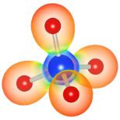
Summary of computation methods
Density Functional Theory (DFT) and Density Functional Perturbation Theory (DFPT) with the modified Perdew-Burke-Ernzerhof generalized gradient approximation (PBEsol GGA)
The projector augmented wave (PAW) formalism with atomic datasets generated by ATOMPAW code available at http://pwpaw.wfu.edu
Perdew et al., PRL 100, 136406 (2008)
First principles electronic-structure calculations and materials modeling
https://www.quantum-espresso.org/
https://www.abinit.org/
Structural visualization, symmetry identification, X-ray patterns
https://jp-minerals.org/vesta/
http://www.xcrysden.org/
https://stokes.byu.edu/iso/findsym.php
https://www.ccdc.cam.ac.uk/solutions/csd-core/components/mercury/

Slide 4
Reported structures of Li₄B₇O₁₂Cl from 1977*
Three disordered phases
*Jeitschko et al., Acta Cryst. B33, 2767-2775 (1977)
Above 348 K
γ phase (F$\overline{4}$3c, No. 219)
Li(24c): 93.7% occupied
Li(32e): 31.6% occupied
310 – 348 K
β phase (P$\overline{4}$3c, No. 218)
Li(24c): 96.7% occupied
Li(32e): 27.8% occupied
Ideal F$\overline{4}$3c model
Room T
α phase (Exp. R3, No. 146)
Li(24c): 100% occupied
Li(32e): 25% occupied
Ideal F$\overline{4}$3c model
Ideal cubic model
8 formula units/cell
* The real space groups of the α and β phases are subgroups of F$\overline{4}$3c.
** The atomic positions for both α and β phases are not known in experiment

Slide 5
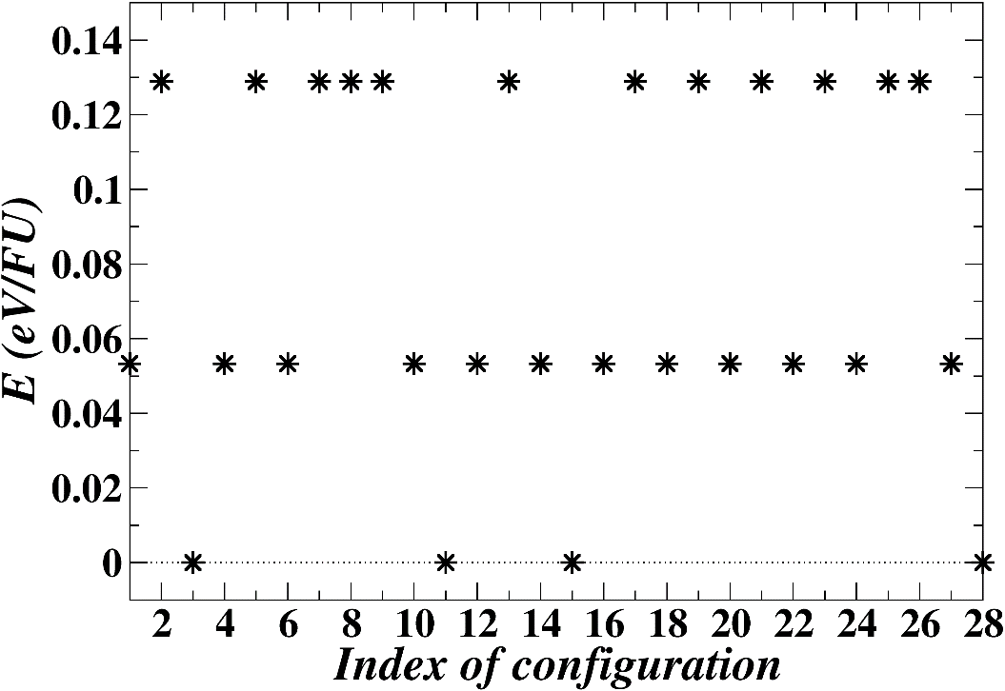
Find the ground state structure for α-Li₄B₇O₁₂Cl
Li(24c)
Li(32e)
B
O
Cl
Perform geometry optimizations for 28 unique configurations in the primitive cell setting
Cubic F$\overline{4}$3c model of the α phase
Li(24c): 100% occupied
Li(32e): 25% occupied
The calculation finds four identical lowest-energy configurations with the rhombohedral R3c (No. 161) symmetry

Slide 6
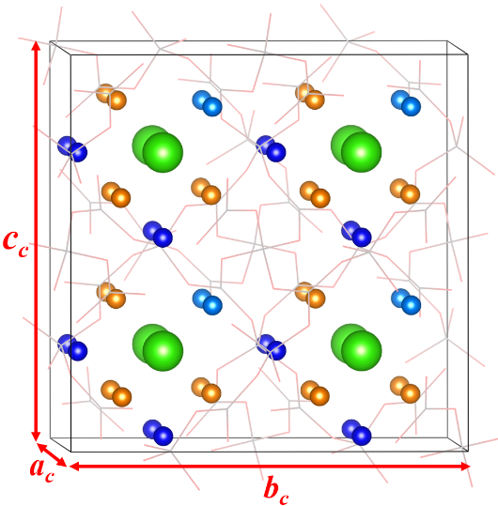
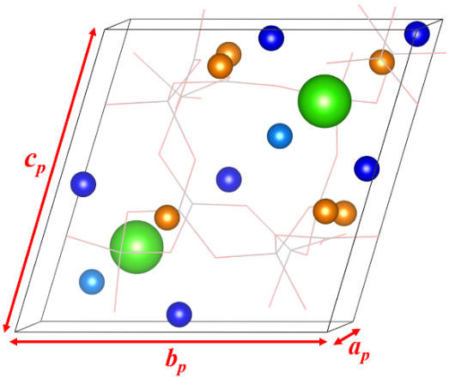
α-Li₄B₇O₁₂Cl in rhombohedral R3c structure
Host Li sites
Conventional cell
8 formula units
Face-centered primitive cell
2 formula units
B-O Wireframe
Native Li vacancies
Cl
a_{c} = b_{c}= c_{c} and α = β = γ = θ_{c} ≈ 90°
a_{p} = b_{p}= c_{p} and α = β = γ = θ_{p} ≈ 60°

Slide 7
α-Li₄B₇O₁₂Cl in rhombohedral R3c structure
Lattice parameters and Li ion fractional coordinates for the R3c structure of α-Li₄B₇O₁₂Cl, comparing calculated results with the experimental measurements.
Li₄B₇O₁₂Cl | a = b = c (Å) | α= β = γ (deg)
Cal. R3c | 12.137 | 90.108
Exp.* R3 | 12.141 | 90.084
Exp.* F$\overline{4}$3c model | 12.141 | 90.000
Primitive cell model
Cal. R3c |  |  |  | Exp. F$\overline{4}$3c model
Atom | Wyck | f(x, y, z) (conv.) | Occ. | Atom | Wyck | f(x, y, z) | Occ.
Li(1) | 4x6 b | (0.030, 0.245, 0.245) | 1.00 | Li(1) | 24 c | (0.000, 0.250, 0.250) | 1.00
Li(2) | 4x2 a | (0.865, 0.865, 0.865) | 1.00 | Li(2) | 32 e | (0.871, 0.871, 0.871) | 0.25
Vac. Li | 4x6 b | (0.633, 0.635, 0.873) | 0.00
Host Li sites
Native Li vacancies
B-O Wireframe
Cl
Conventional cell model
*Experimental data taken from Jeitschko et al., Acta Cryst. B. 33, 2767-2775 (1977)

Slide 8
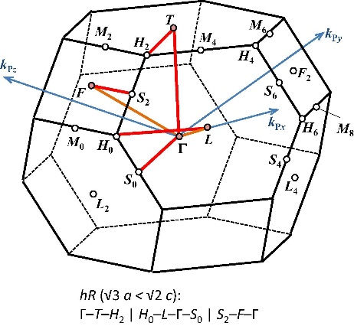
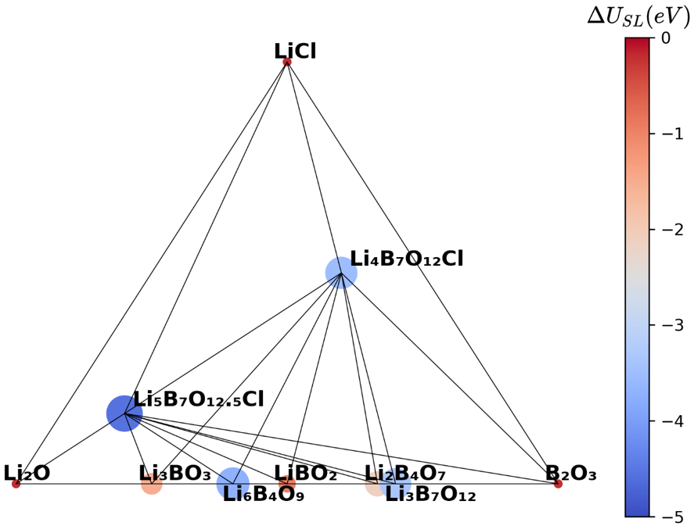
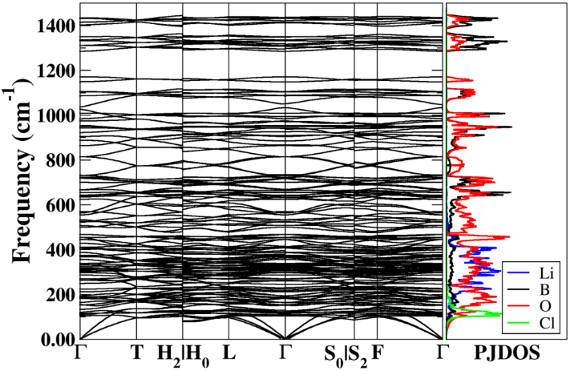
Phase stability of α-Li₄B₇O₁₂Cl
Li₂O-B₂O₃-LiCl phase diagram at 0 K and 0 atm
Reaction energy:
Where $U_{SL}$ is the total static energy per formula unit of a specific compound. $x_{i}$ with $i$ = Li₂O, B₂O₃, and LiCl represents the compositional ratio of each reference phase for which the total static energy per formula unit is denoted by $U_{SL}^{i}$.
Phonon dispersion curves and projected density states of Li₄B₇O₁₂Cl with frequencies ranging from 0 ~ 1440 cm⁻¹.
Brillouin zone diagram: Hinuma et al., Comp. Mat. Sci. 128, 140-184 (2017). Note that the rhombohedral lattice is described by an equivalent hexagonal system.

Slide 9
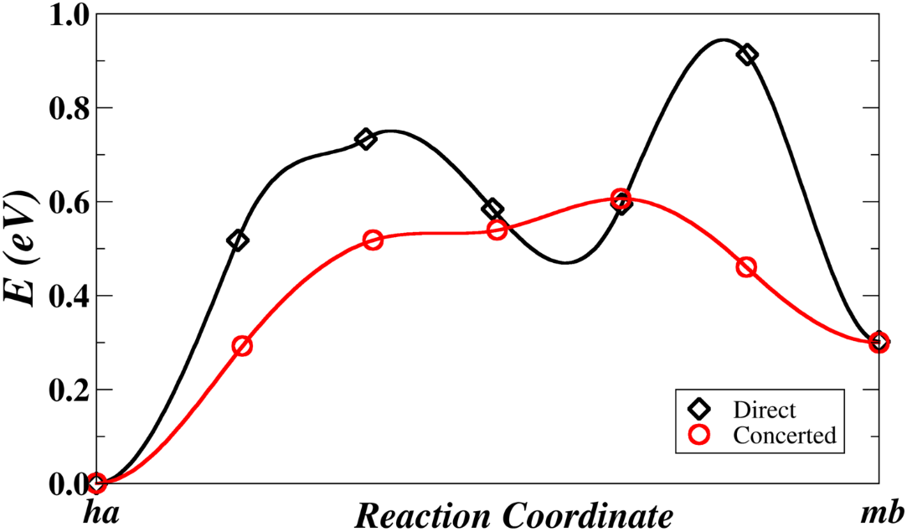
Nudged Elastic Band (NEB) analysis for α-Li₄B₇O₁₂Cl
E_{hb} < E_{ha} < E_{mb}
0.33 eV
Direct: ha → mb
Concerted: ha→ hb & hb→ mb
hb: host b-type site; ha: host a-type site
mb: metastable b-type site (native vacancy)
→ The concerted migration mechanism reduces the energy barrier for Li ion conduction in α-Li₄B₇O₁₂Cl.
NEB: ¹Jónsson et al., in Classical and Quantum Dynamics in Condensed Phase Simulations, World Scientific, Singapore (1998)
²Henkelman et al., J. Chem. Phys. 113, 9901-9904 (2000)

Slide 10
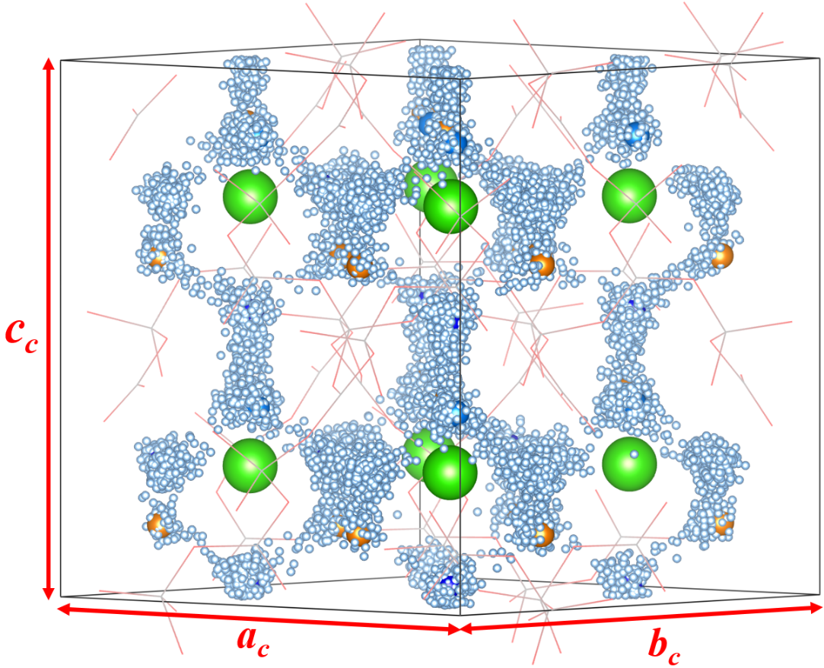
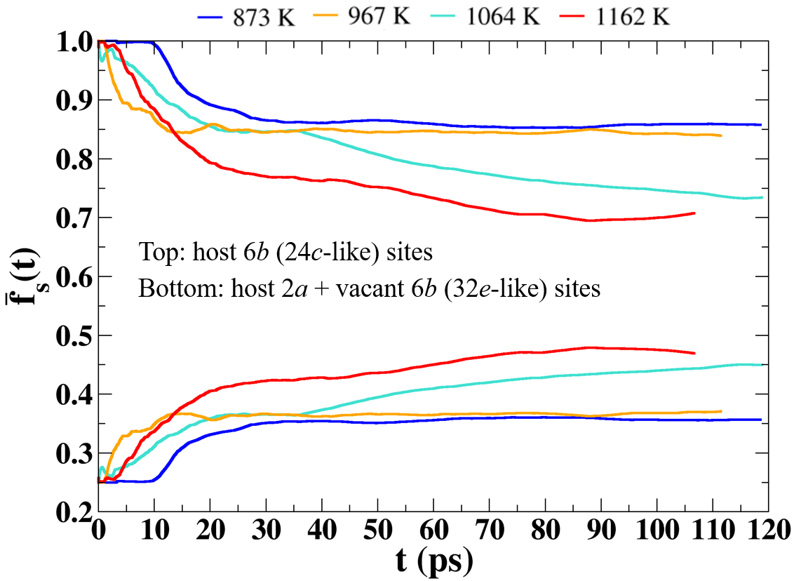
Results of molecular dynamic simulations
Site occupancy factor:
Li(6b)
Li(2a)
Vacant Li(6b)
Time-dependent positions of Li ions
Time-averaged:
mb
T+
hb
ha
T+
Model of Li₄B₇O₁₂Cl crystal cell with superposed Li positions of molecular dynamics simulation at <T> = 1162 K.
*Recall: the three reported forms α (T< 310 K), β (310 K <T < 348 K), γ (T > 348 K) mainly differ in lattice site occupancy.

Slide 11
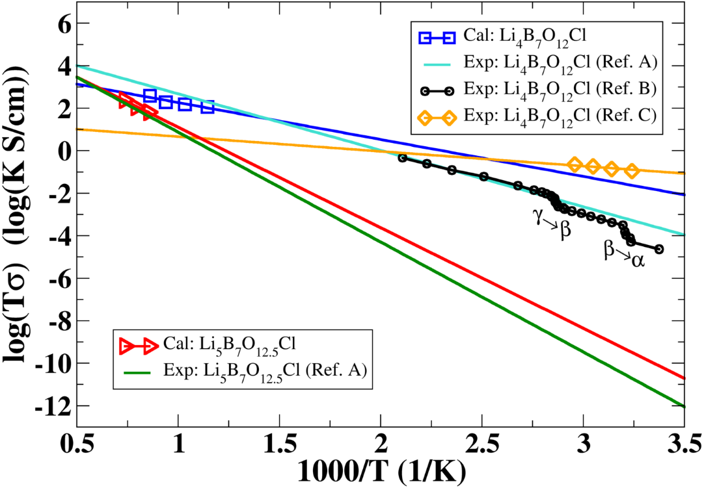
Results of molecular dynamic simulations
Materials | Analysis | Samples | E_{a} (eV) | σ (T = 300 K, S/cm)
Li₄B₇O₁₂Cl | Cal. | Ideal | 0.34 | 3.83 x 10⁻⁴
 | Exp: Ref (A) | Polycrystalline | 0.53 | 1.00 x 10⁻⁷
 | Exp: Ref (B) | Single crystal | 0.49 | 0.98 x 10⁻⁷
 | Exp: Ref (C) | Polycrystalline | 0.14 | 3.68 x 10⁻⁴
 | Cal. | Ideal | 0.84 | 6.58 x 10⁻¹²
 | Exp: Ref (A) | Polycrystalline | 1.03 | 2.14 x 10⁻¹⁴
Li₅B₇O_{12.5}Cl*
with
,
*Li₅B₇O_{12.5}Cl has a similar B-O framework with Li₄B₇O₁₂Cl but a different ordering of Li ions.
Ref. A: Cales et al., Solid State Commun. 24, 323 (1977)
Ref. B: Jeitschko et al., Acta Cryst. B. 33, 2767-2775 (1977)
Ref. C: Tan et al., ACS Appl. Energy Mater. 2, 5140 (2019).

Slide 12
Ionic substitutions in α-Li₄B₇O₁₂Cl
B(1) → Al
O → S
B(1) → Al & O → S
Li₄B₇O₁₂Cl
Li₄Al₃B₄O₁₂Cl
Li₄B₇S₁₂Cl
Li₄Al₃B₄S₁₂Cl
Original material
Realized in experiment*
Predicted in this work
Predicted in this work
Rhombohedral R3c
a_{p} = b_{p} = c_{p} = 8.574 Å
α_{p} = β_{p} = γ_{p} = 60.124°
a_{c} = b_{c} = c_{c} = 12.137 Å
α_{c} = β_{c} = γ_{c} = 90.108°
Rhombohedral R3c
a_{p} = b_{p} = c_{p} = 9.133 Å
α_{p} = β_{p} = γ_{p} = 61.194°
a_{c} = b_{c} = c_{c} = 13.033 Å
α_{c} = β_{c} = γ_{c} = 91.022°
Rhombohedral R3c
a_{p} = b_{p} = c_{p} = 10.584 Å
α_{p} = β_{p} = γ_{p} = 59.704°
a_{c} = b_{c} = c_{c} = 14.934 Å
α_{c} = β_{c} = γ_{c} = 89.743°
Rhombohedral R3c
a_{p} = b_{p} = c_{p} = 11.386 Å
α_{p} = β_{p} = γ_{p} = 68.601°
a_{c} = b_{c} = c_{c} = 15.933 Å
α_{c} = β_{c} = γ_{c} = 88.771°
*Kajihara et al., Bull. Chem. Soc. Jpn. 90, 1279–1286 (2017)

Slide 13
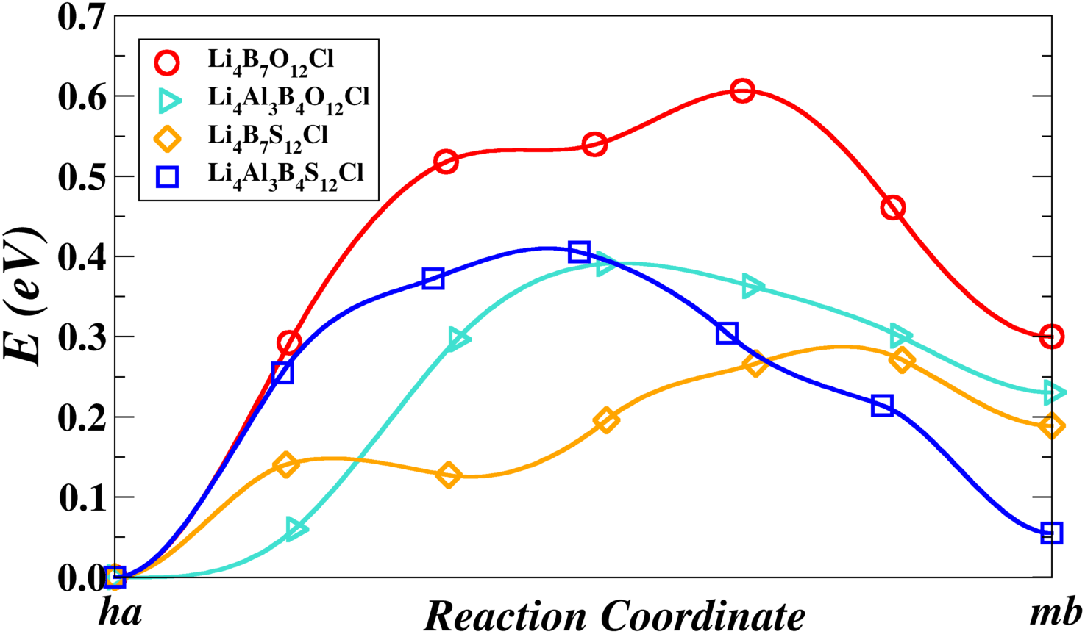
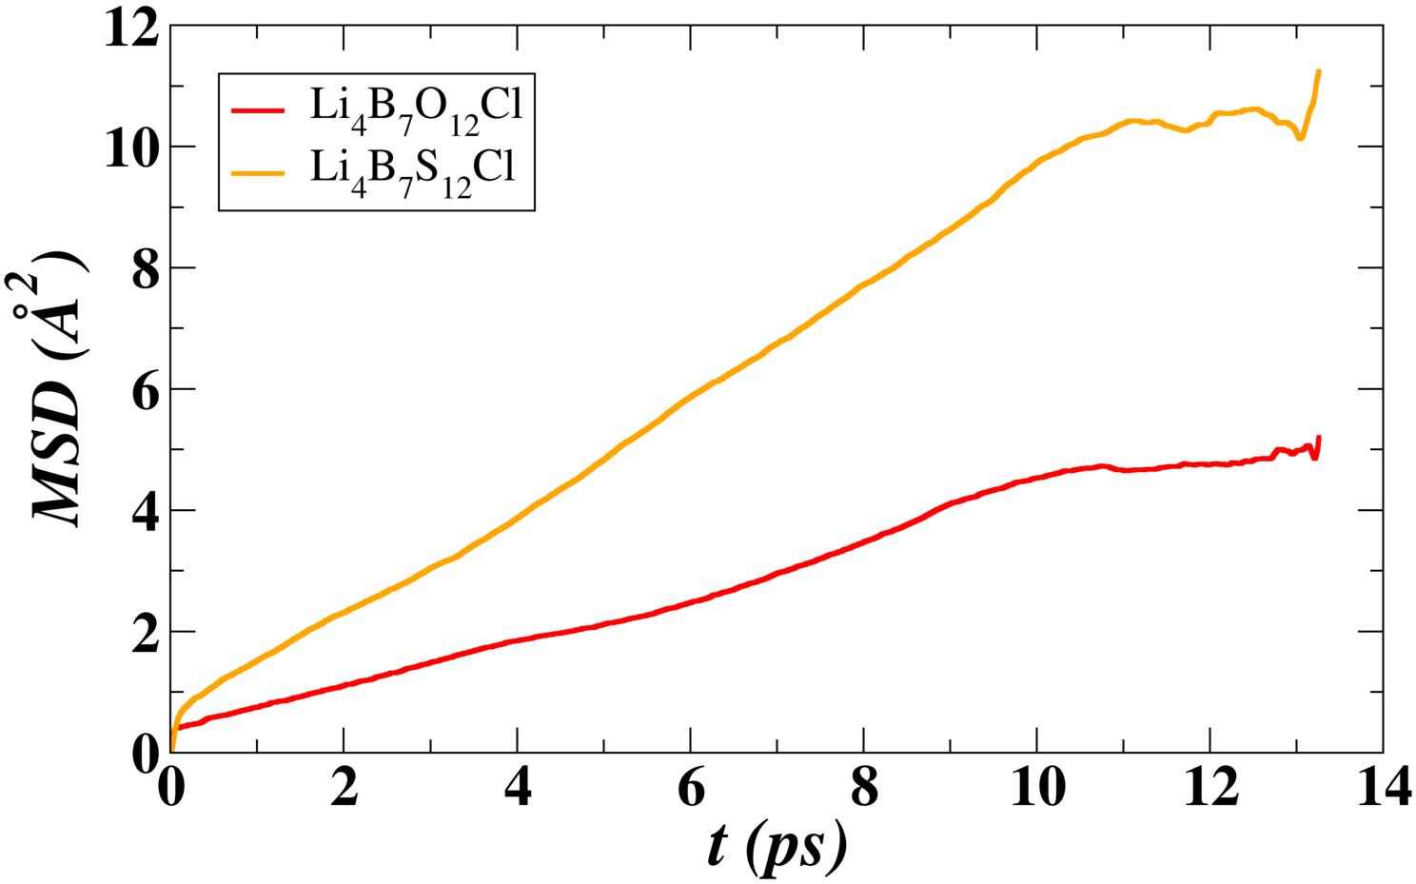
Comparison of diffusional properties
0.60 eV
583 K
0.41 eV
0.39 eV
0.30 eV
948 K
NEB energy diagram of concerted migrations
Mean squared displacement (MSD) vs. time interval

Slide 14
Are the analog compounds stable?
Li₄Al₃B₄O₁₂Cl
Kajihara et al., Bull. Chem. Soc. Jpn. 90, 1279–1286 (2017)
Li₄B₇S₁₂Cl (proposed)
Li₄Al₃B₄S₁₂Cl (proposed)

Slide 15
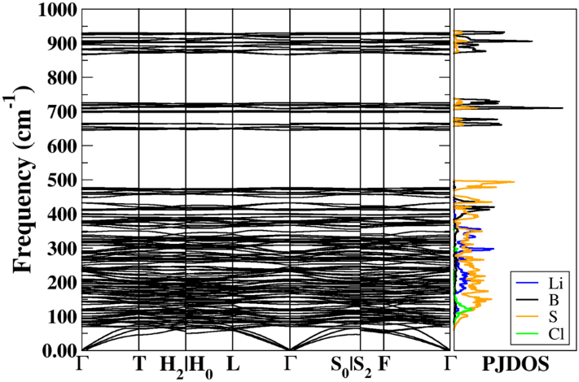
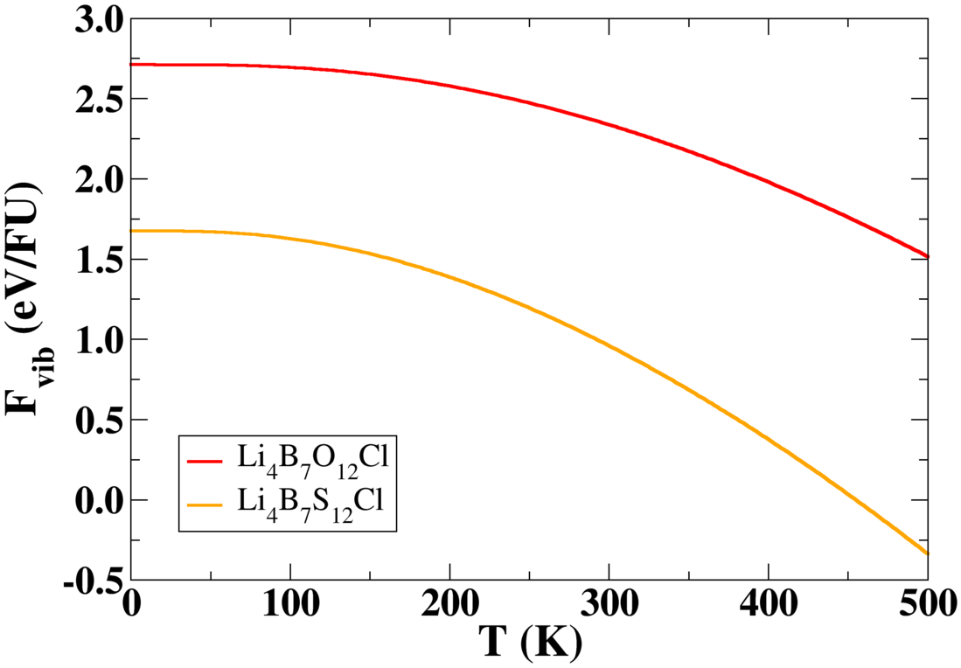
Phonon calculations
Predicated
Li₄B₇S₁₂Cl
0 cm⁻¹$≤$ ω(q) $≤$ 931 cm⁻¹
Known
Li₄B₇O₁₂Cl
∆F_{vib} (T = 300 K) = 1.38 eV/FU
0 cm⁻¹$≤$ ω(q) $≤$ 1440 cm⁻¹

Slide 16
Summary
The ground state structure of the room-temperature form of Li₄B₇O₁₂Cl is identified to have rhombohedral R3c symmetry. The phase is estimated to be stable from the analysis of the convex hull approach and of the phonon spectrum.
The NEB calculations indicate that Li ion migration in Li₄B₇O₁₂Cl most likely proceeds via concerted migration mechanisms involving two host sites and one natural vacancy.
The room-temperature ionic conductivity of Li₄B₇O₁₂Cl, calculated from the MD simulation results, is on the order of 10⁻⁴ S/cm, which is in good agreement with the recent experiment measurement for pure polycrystalline samples.
Consistent with the recent experimental results, our preliminary calculations also find reduced Li ion migration barriers in the partially B-replaced compound Li₄Al₃B₄O₁₂Cl. The studies on predicted compounds Li₄B₇S₁₂Cl and Li₄Al₃B₄S₁₂Cl also suggest improved Li ion conducting performance compared with Li₄B₇O₁₂Cl.
The chemical stabilities of the Li₄B₇S₁₂Cl and Li₄Al₃B₄S₁₂Cl need further investigation.

