Slide 1
PHY 711 Classical Mechanics and Mathematical Methods
10-10:50 AM MWF Olin 103
Plan for Lecture 9:
Continue reading Chapter 3
Hamilton’s principle
Lagrange’s equations in presence of magnetic fields

Slide 3
Hamilton’s principle:

Slide 4
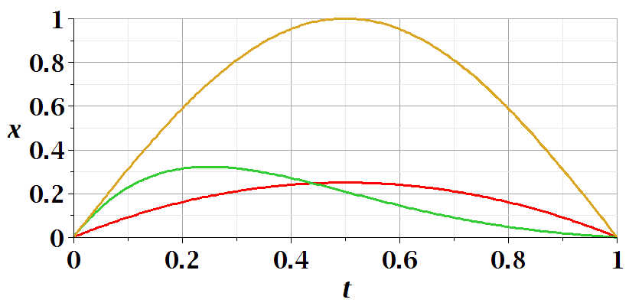
Example – simple harmonic oscillator
x₁
x₃
x₂

Slide 5
Note: in “proof” of Hamilton’s principle:

Slide 6
Lorentz forces:

Slide 7
Lorentz forces, continued:

Slide 8
Lorentz forces, continued:

Slide 9
Lorentz forces, continued:

Slide 10
Example Lorentz force

Slide 11
Example Lorentz force -- continued

