Slide 1
PHY 711 Classical Mechanics and Mathematical Methods
10-10:50 AM MWF Olin 103
Plan for Lecture 8:
Continue reading Chapter 3
Lagrange’s equations
D’Alembert’s principle

Slide 2
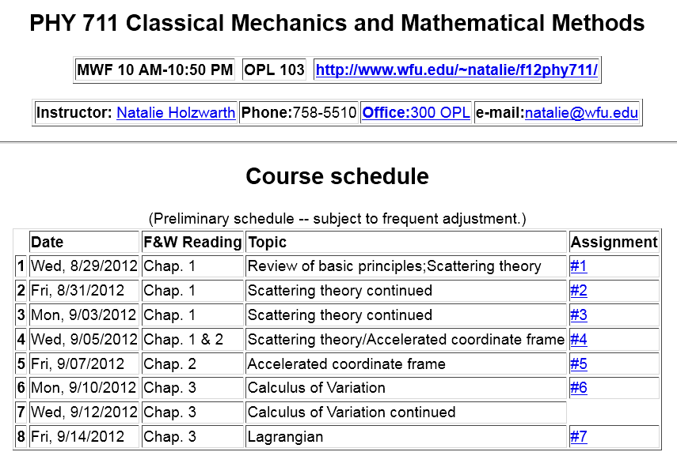

Slide 3
Summary of results from the calculus of variation

Slide 4
Application to particle dynamics
Simple example: vertical trajectory of particle of mass m subject to constant downward acceleration a=-g.

Slide 5
Potential energy
Kinetic energy

Slide 13
Example:
d
θ

