Slide 1
PHY 711 Classical Mechanics and Mathematical Methods
10-10:50 AM MWF Olin 103
Plan for Lecture 7:
Continue reading Chapter 3
Further development of the “calculus of variation”

Slide 5
Brachistochrone problem: (solved by Newton in 1696)
http://mathworld.wolfram.com/BrachistochroneProblem.html
A particle of weight mg travels frictionlessly down a path of shape y(x). What is the shape of the path y(x) that minimizes the travel time from
y(0)=0 to y(π)=-2 ?

Slide 8
Parametric equations for Brachistochrone:

Slide 9
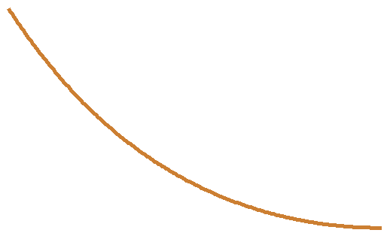
Shape of a rope of length L and mass density ρ hanging between two points
x₁ y₁
x₂ y₂

Slide 10
Lagrange multiplier

Slide 14
Summary of results

Slide 15
Application to particle dynamics

