Slide 1
PHY 711 Classical Mechanics and Mathematical Methods
10-10:50 AM MWF Olin 103
Plan for Lecture 4:
Chapter 1 – scattering theory summary
Chapter 2 – Physics described in an accelerated coordinate frame

Slide 3
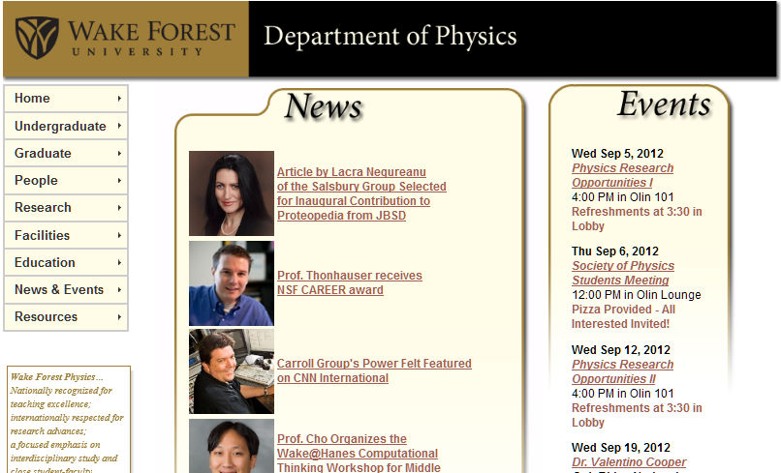

Slide 5
Some more details on the laboratory and center of mass reference frames
Laboratory reference frame:
Before After
m₁
m₂
u₁
v₁
ψ
u₂=0
ζ
v₂
Center of mass reference frame:
Before After
m₁
m₂
V₁
U₁
U₂=0
θ
θ
V₂

Slide 6
Laboratory reference frame:

Slide 7
Analysis before and after collision in CM frame:

Slide 8
Physical laws as described in non-inertial coordinate systems

Slide 9
Comparison of analysis in “inertial frame” versus “non-inertial frame”

Slide 10
Properties of the frame motion (rotation):
dΩ
dΩ

Slide 11
Effects on acceleration:

Slide 12
Extension to rotation and translation of coordinate system
Newton’s laws; Let V = r, the position of particle of mass m:
Coriolis
force
Centrifugal
force

Slide 13
Motion on the surface of the Earth:

Slide 14
Non-inertial effects on effective gravitational “constant”
0.03 m/s²
9.80 m/s²

