Slide 1
PHY 711 Classical Mechanics and Mathematical Methods
10-10:50 AM MWF Olin 103
Plan for Lecture 38:
Comment on Exam questions
Remaining concepts in classical mechanics
Stokes equation
Class evaluation

Slide 3
Schedule for PHY 711 presentations Monday, Dec. 3, 2012 10:00 Pete Diemer -- examples of hydrodynamic phenomena 10:15 Katelyn Goetz - Physics and Golf 10:30 10:45 11:00 Xiaohua Liu--- Wednesday, Dec. 5, 2012 10:00 Zach Lamport -- The Physics of Hockey 10:15 Jiajie Xiao -- Physics of Chinese Flute 10:30 David Montgomery-- 10:45 Chaochao Dun-Membranes 11:00

Slide 4
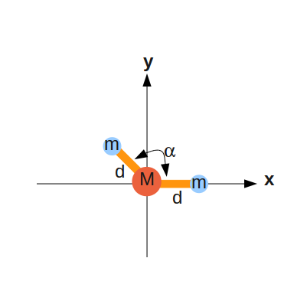
Comment on exam problem 2

Slide 5
Principal moments of inertia
x

Slide 6
Comment on exam problem 4
2a
a

Slide 7
2a
a

Slide 8
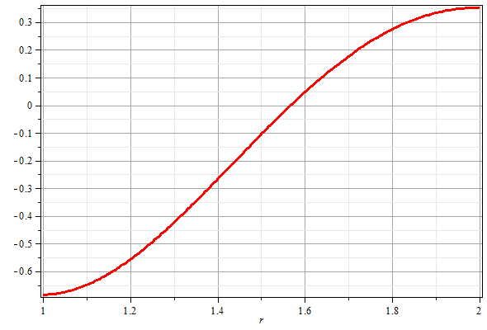
For l=0: k=3.286/a x=-2.125

Slide 9
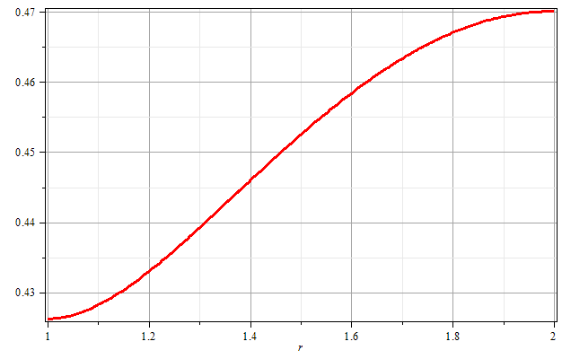
For l=1: k=0.920/a x=-0.092/a

Slide 10
Brief introduction to viscous effects in incompressible fluids
u
F_{D}
Plan:
Consider the general effects of viscosity on fluid equations
Consider the solution to the linearized equations for the case of steady-state flow of a sphere of radius R
Infer the drag force needed to maintain the steady-state flow

