Slide 1
PHY 711 Classical Mechanics and Mathematical Methods
10-10:50 AM MWF Olin 103
Plan for Lecture 37:
Chapter 10 in F & W:
Soliton surface waves
Nonlinear water surface waves – soliton solutions

Slide 3
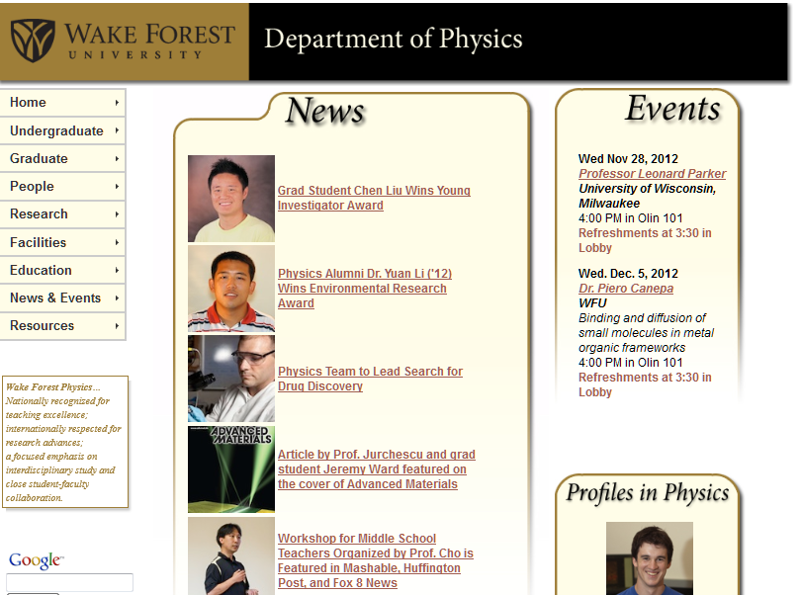

Slide 4
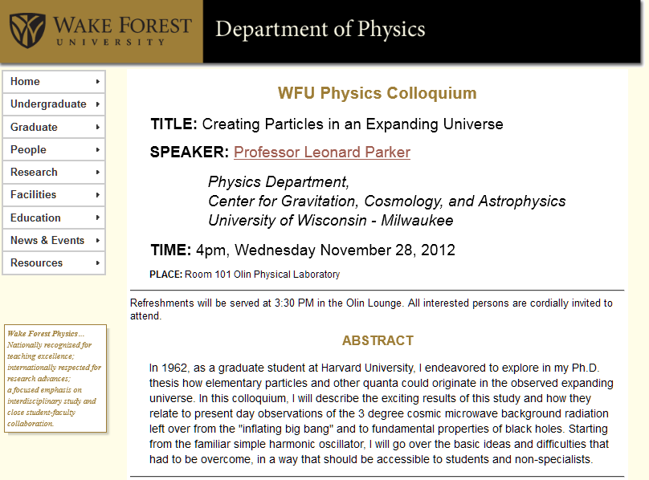

Slide 5
Consider a container of water with average height h and surface h+ζ(x,y,t) (slightly different notation than last time):
p₀
ζ
z
h
y
x

Slide 6
p₀
ζ
z
h
y
x

Slide 7
Bernoulli’s equation at water surface

Slide 8
Boundary condition at z=0

Slide 9
Bernoulli’s equation at water surface

