Slide 1
PHY 711 Classical Mechanics and Mathematical Methods
10-10:50 AM MWF Olin 103
Plan for Lecture 36:
Chapter 10 in F & W: Surface waves
Water waves in a shallow or deep channel – linear equations
Nonlinear effects – soliton solutions

Slide 3
Consider a container of water with average height h and surface h+ζ(x,y,t) (slightly different notation than last time):
p₀
ζ
z
h
y
x

Slide 5
p₀
ζ
z
h
y
x

Slide 6
Full equations:
Linearized equations:

Slide 7
For simplicity, keep only linear terms and assume that horizontal variation is only along x:

Slide 8
For simplicity, keep only linear terms and assume that horizontal variation is only along x – continued:

Slide 9
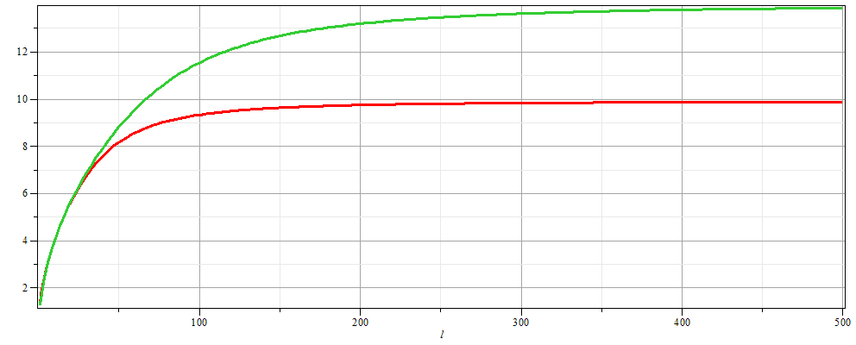
For simplicity, keep only linear terms and assume that horizontal variation is only along x – continued:
h=20 m
c
h=10 m
λ

Slide 10
For simplicity, keep only linear terms and assume that horizontal variation is only along x – continued:

Slide 11
General
problem:
p₀
ζ
z
h
y
x

Slide 12
Some links:
Details of soliton equations
Maple animation
Website – http://www.ma.hw.ac.uk/solitons/

