Slide 1
PHY 711 Classical Mechanics and Mathematical Methods
10-10:50 AM MWF Olin 103
Plan for Lecture 25:
Rigid body rotational motion (Chap. 5)
Motion of a symmetric top

Slide 3
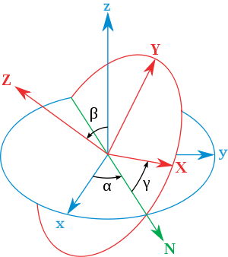
x
y
y
x

Slide 4
Rotational kinetic energy

Slide 5
Motion of a symmetric top under the influence of the torque of gravity:
γ
β
mg
α

Slide 7
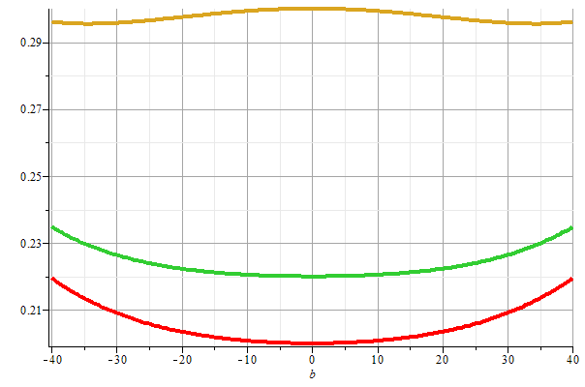
Stable/unstable solutions near
β=0

Slide 9
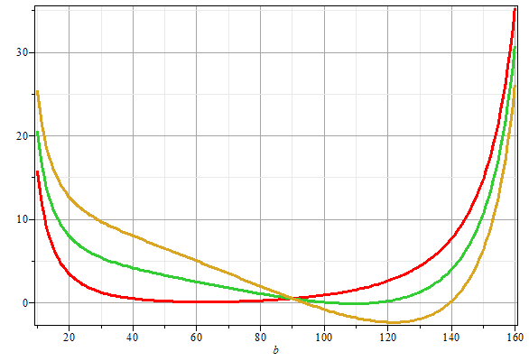
More general case:

